Slide 1

Parent Assisted Immersive Reading
( P.A.I.R. )
Immersive Reading
to deeply engage the child in the reading experience
through rich conversation, using multiple techniques.

Slide 2
Inspired by Finland
Finland’s children have regularly outperformed the world in Reading tests …
1st in 2000 1st in 2003 2nd in 2006
Yet children in Finland don’t start school until they turn 6 or or even 7 !!!
Why ?

Slide 3
Parent, Child and School Partnership
Finnish educators conclude that it’s social and educational equality, along with cooperation and collaboration (between and within schools & community). They believe this is the ‘key’.
The research suggests that if parents are engaged in education then the children will engage also. In Finland, the parents believe that education is extremely important
– as a result, so do their children.

Slide 4
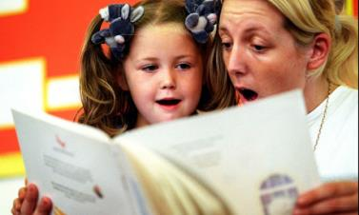
And …
Finnish parents …
read and read and read to their children

Slide 5

Timing - so important
What is the child’s brain doing?

Slide 6

A Child’s Early Years
It is clear that the early years, from conception to age six, have the most important influence of any time in the life cycle on brain development & subsequent learning, behaviour & health.
There are critical periods when a young child requires appropriate
stimulation for the brain to establish the neural pathways in the
brain for optimum development. Many of these critical periods
are over or waning by the time a child is six years old.
These early critical periods include: … language and literacy.
McCain M. & Mustard J., Ontario - Canada, 1999

Slide 7
Parents – the ‘Key’
Early reading experiences with their parents prepare children for the benefits of formal literacy instruction. Indeed, parental involvement in their child’s reading has been found to be the most important determinant of language and emergent literacy
Bus, van Ijzendoorn & Pellegrini, 1995

Slide 8

Screen vs Read Aloud
Reading aloud in the early years exposes children to story and print knowledge as well as rare words and ideas not often found in day-to-day conversations or screen time.
Reach Out and Read, 2012
          VS
big nice vs gigantic delightful

Slide 9
International and
Local
Research the proof …

Slide 10
First year at school
The Programme for International Student Assessment (PISA) 2009 …
“Fifteen-year-old students whose parents often read books with them during their first year of primary school show markedly higher scores in PISA 2009 than students whose parents read with them infrequently or not at all”
Also … “the performance advantage among students whose parents read to them in their early school years is evident regardless of the family’s socio-economic background.”

Slide 11
NAPLAN results go up
A recent Australian study concluded that …
Children read to more frequently at age 4-5 achieved higher scores on the National Assessment Program – Literacy and Numeracy (NAPLAN tests) for both Reading and Numeracy in Year 3 (age 8 to 9)

Slide 12

How do parents read aloud to their children ?

Slide 13
The researchers say …
that parents read aloud in different ways …
- the ‘Describer’ reader
- the ‘Comprehender’ reader
- the ‘Performance Orientated’ reader

Slide 14
How parents can help
Parent Assisted Immersive Reading (P.A.I.R.) is built on a wealth of international research. Its purpose and structure is underpinned by the work of some of the world’s leading educators.
P.A.I.R. is designed to help parents create an environment where their child can become ‘reading ready’. It does this by providing simple, time effective techniques for parents.
Our Mission
To engage children in quality, read-aloud conversations that enrich their literacy experience and enable their future learning.

Slide 15
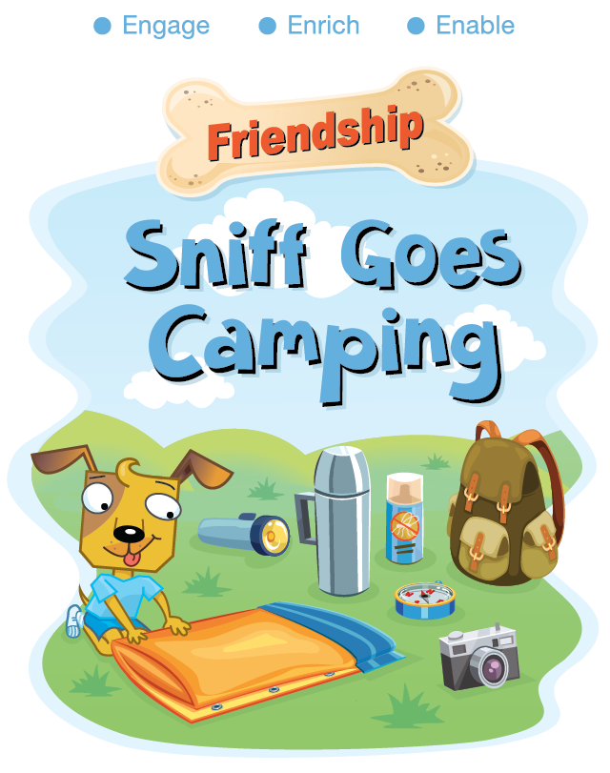
What is P.A.I.R. ?
P.A.I.R. is a series of books with prompts on the corners designed to support parents when reading with their children.
The book’s text (story) is designed to be read aloud by the parent.

Slide 16
How P.A.I.R. works
P.A.I.R. provides parents with the vital prompts and questions that will help the child engage in valuable conversation around the book.
-
- the ‘Describer’ reader
- the ‘Comprehender’ reader
- the ‘Performance Orientated’ reader

Slide 17
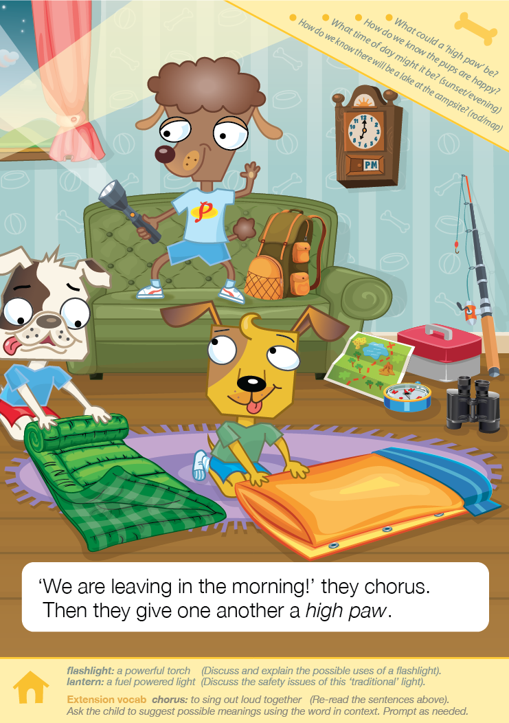
Simple but powerful …
Inferential
Vocabulary

Slide 18
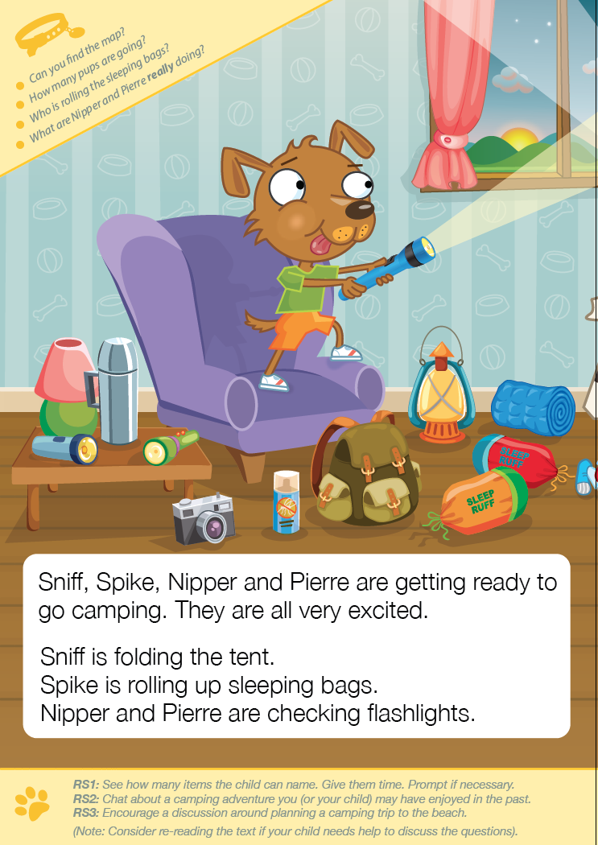
The parent is guided …
Literal
Decontextualised

Slide 19
The Read-Aloud session
Firstly, read the whole book through to your child.
The second time read one question from each of the yellow boxes.
Discuss one word from the vocabulary builder.
Repeat this process ideally everyday.
Video - Website - http://pisceanpublishing.com/

Slide 20
Key notes for parents
ENCOURAGEMENT
The parent must give their child time and lots of encouragement, when responding to the questions and prompts.

Slide 21
Key notes for parents
MODIFY or MAKE UP QUESTIONS
If you find that the child struggles with any question or suggested activity, you should feel free to modify or even make up a question that is more suitable to your child’s needs and understandings. You know your child best.

Slide 22
Key notes for parents
ITS ABOUT THE CONVERSATION
Always remember – there are no wrong answers, just answers that might need more support or prompting. The conversation is the critical thing. When discussing the story with the child you should always value their input.

Slide 23
P.A.I.R Vision at Perryfields Infants
Half term - Parents to fill out pre – project questionnaire.
Autumn 2 – All children take home a blue bag with a parent guide and first book – ‘Sniff Goes Camping’.
Read book everyday with your child using question prompts.
All books to be returned by Monday of following week in named blue bag.

Slide 24
P.A.I.R Vision at Perryfields Infants
Week 2 – Children to take home a normal school reading book using some of the new P.A.I.R techniques.
Week 3 – Children take home next P.A.I.R reading book and repeat questioning process.
This process to continue until the February half term – 5 titles/10 weeks.
Parents to fill out post project questionnaire.
Please note that one of the books is a wordless book but there is guidance to show how to get the best from this book in the parent guidance,

Slide 25
Key findings…
a positive change in the way reading is done at home – after one week !!!
children were more ‘switched on’ to reading
Improved school-parent and parent-school relationships
100% of parents in the trials stated “I would recommend PAIR books to other parents”

Slide 26
One parent’s comments
It was a fun easy read.
The large book means the text and images are easily identifiable.
(My son) was engaged in the story from the start.
(The corner questions) were great which usually led to further discussions.
(The paw section) made the conversation about the book smooth and coherent.
(The vocabulary section) was fantastic. It made my job as a parent a lot easier.
I would most definitely (recommend P.A.I.R.) to other parents. It makes reading fun and engaging.
When can we get another book?
Website - http://pisceanpublishing.com/

Slide 27
P.A.I.R will …
Engage children
Enrich literacy
Enable learning
Questions ?

