Slide 1
https://www.youtube.com/watch?v=D6raJluIg40&list=RDD6raJluIg40&start_radio=1&t=0 Welcome Everyone Happy Monday
Be safe, be kind, listen and think a lot, be your best.

Slide 2
Stars of the Week!
Ruby Class – Bella
Topaz Class – Emily
Emerald Class – Maelyn
Sapphire Class – Kai
Diamond Class – Tara
Pearl Class - Dexter

Slide 4
What Is Perseverance?
Perseverance is when someone keeps trying, no matter how hard something is.
It can help someone achieve their goals.

Slide 5
How Can We Show Perseverance at school but also whilst working and learning from home?
We can show perseverance at home by:
not giving up;
following school rules at home;
trying your best;
setting some goals for yourself;
asking for help if you need it.

Slide 6
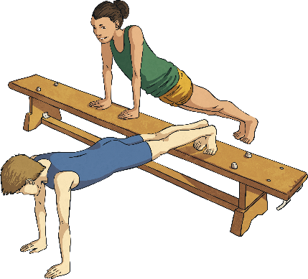
Examples of Perseverance
Never giving up on your dreams!
Training for the team you would like to join, no matter how tiring it is.
Finding new ways of learning something that you need to know to make sure you achieve your goal!

Slide 7
Perseverance
Perseverance is not giving up – you should try, try and try again. It is having a go and keeping a positive attitude.
https://vimeo.com/32352442
Skateboarding Legend Danny Way in the 2008 X-Games on the Megaramp. He kept falling off…….. But he always got back up. This is PERSEVERANCE.

Slide 8
When will you need to show perseverance this year?

Slide 9
What can you do to help yourself when things get tough?

Slide 10
Perseverance
I think Bruno Mars has a great view on Perseverance…..
Listen to the lyrics.

