Slide 1
Happy New Year!
It seems a long time since we were at school together.
I wonder what you have done during the holidays…

Slide 2
Did you help with some Christmas cooking?

Slide 3
Did you get some good presents for Christmas?

Slide 4
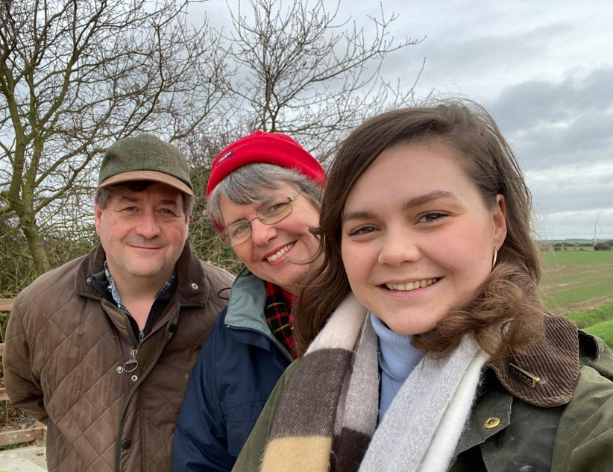
Did you spend some time with your family?

Slide 5
Did you go for any walks?

Slide 6
Did you…
Eat some delicious meals?
Play some games?
Watch some interesting programmes on the television?
Play lots of computer games?
If you didn’t do anything at all, what do you wish you could have done?

Slide 7
Have you made any New Year’s Resolutions?
That is when you decide to try really hard to do something or get better at something.

Slide 8
Today, we’d like you to write about
Some of the things you did during the Christmas holidays, or
What you would like to have done if you didn’t do much, and
Any New Year’s resolutions you have made.
Use the questions in this PowerPoint to help you decide – see if you can write a sentence for each one.
(You can type this if you want to.)

Slide 9
Here is a word bank to help you:
Christmas holidays
helped watched walked opened
cooked played
presents food ate games
favourite resolution
Remember to say each sentence before writing and to read it back afterwards to check it makes sense.

