Slide 2
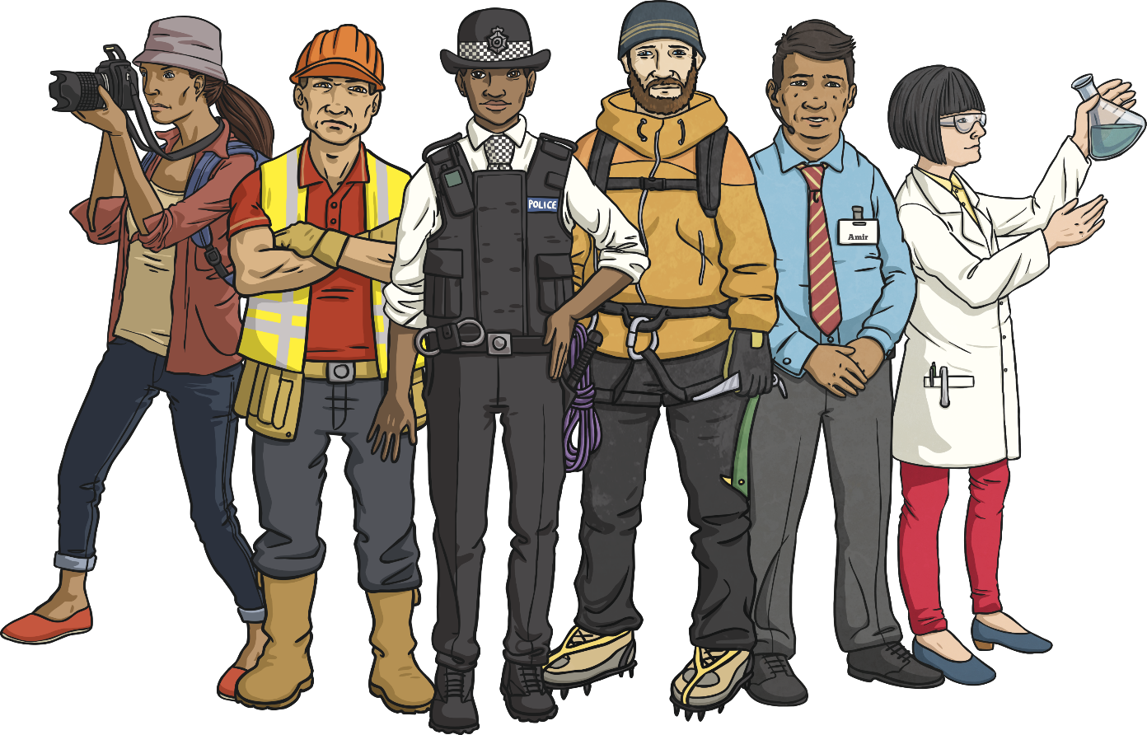
What jobs are in your community?
What other jobs can you think of?

Slide 3
How can you sort these jobs?
Shop jobs
Inside jobs and outside jobs
Night time jobs and day time jobs
Jobs that care for people

Slide 4
How can you help your community?
Litter picking
Recycling
Help elderly people with their
shopping
Volunteer

Slide 5
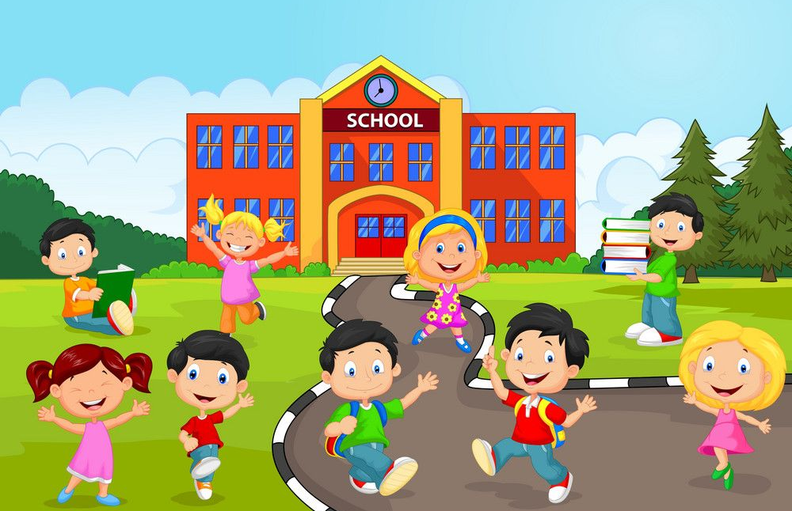
What rights and responsibilities do you have in the school community?

