Slide 1
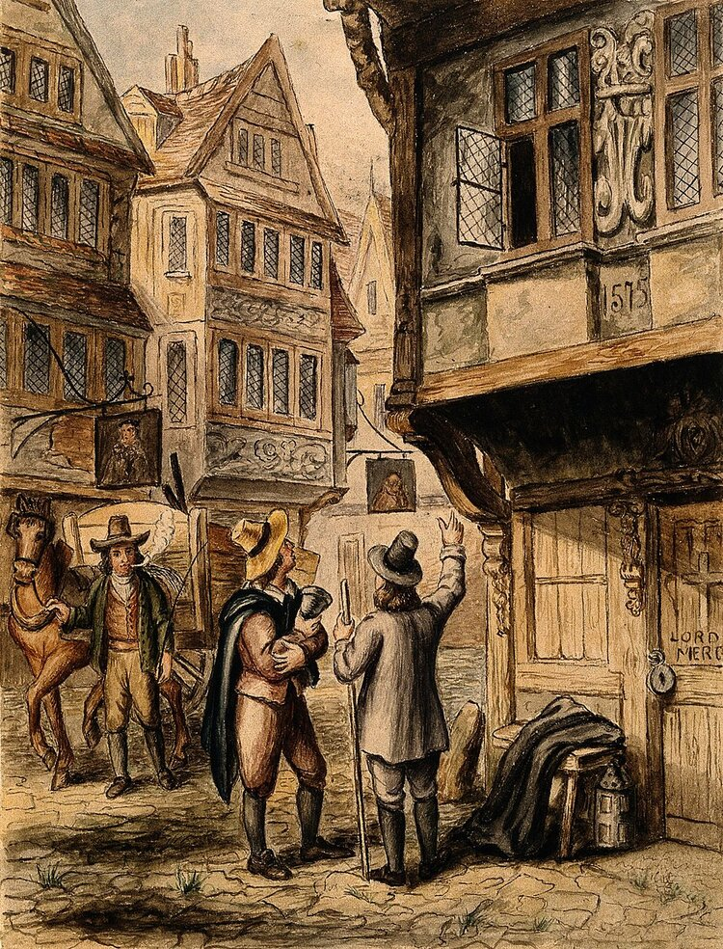
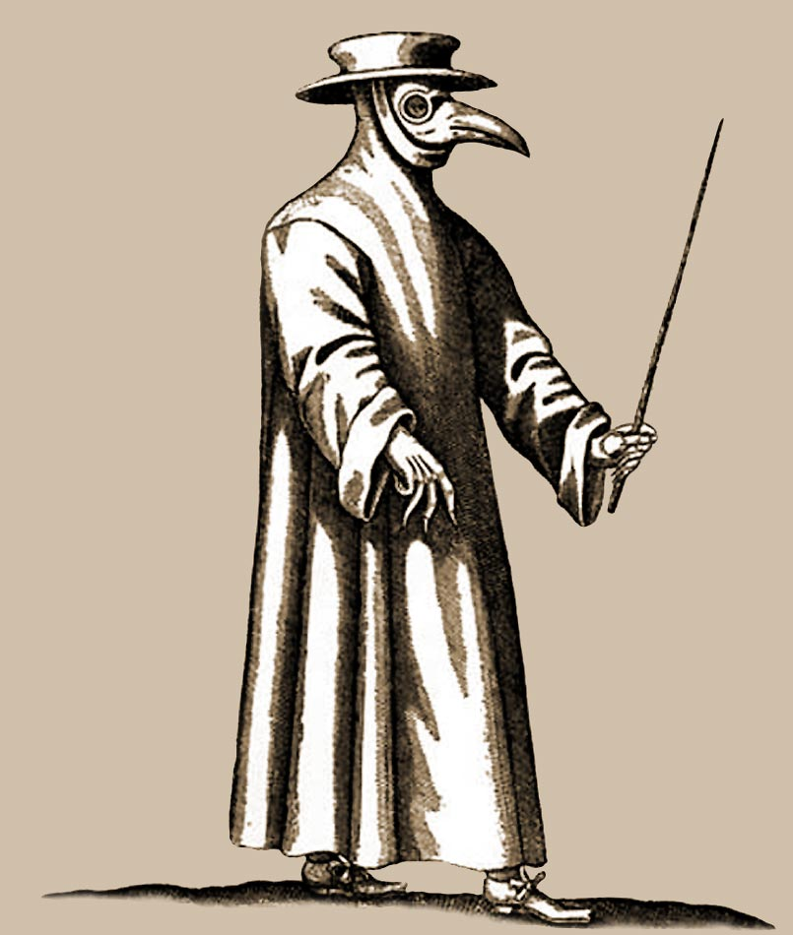
Last week we learned a little bit about the Great Plague.
Tell me about it!
When did it happen?
Where was very badly affected?
What happened?
How did it spread?
Who wore costumes with beaks?
Why did they lock people in their houses?

Slide 2
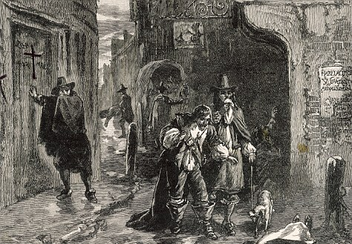
Here’s a recap
It happened in 1665.
London was very badly affected.
Lots of people died.
It was spread by the fleas on rats.
Doctors wore costumes with beaks. They were filled with herbs to purify the air.
They locked some people in their houses to stop them spreading the disease.

Slide 3
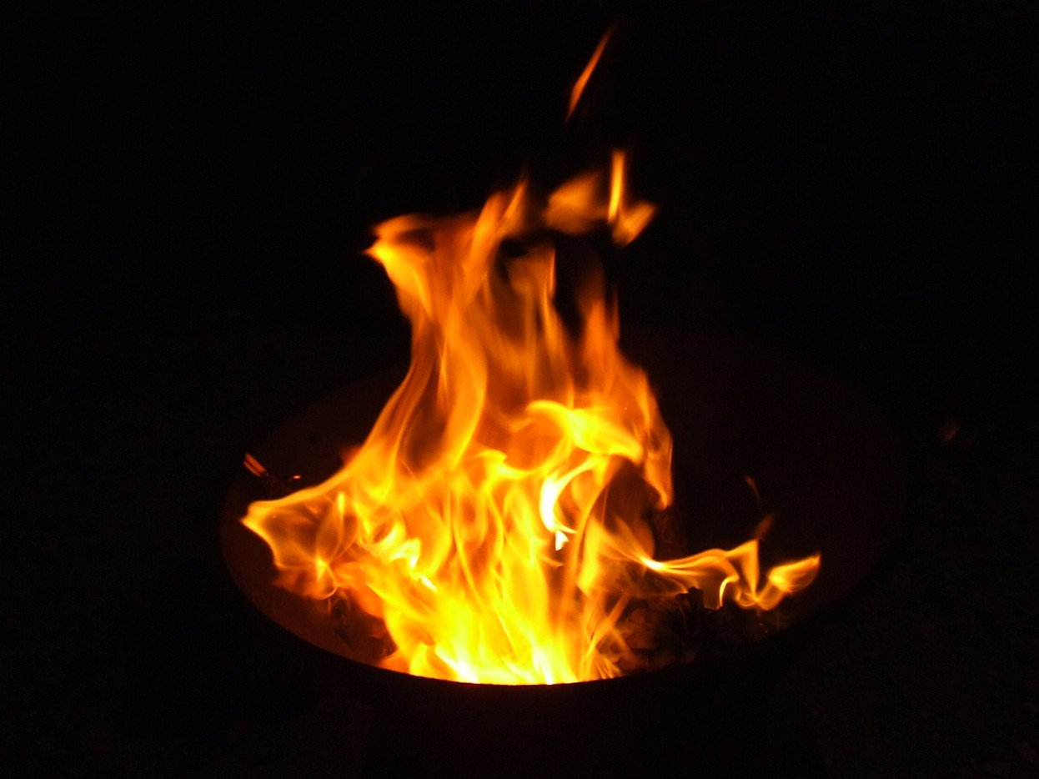
Today we are going to start learning about the Great Fire of London.
Do you know anything about it already?

Slide 4
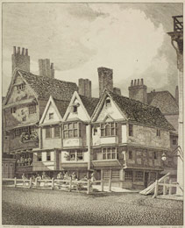
This is what London looked like before the fire.
London had many churches. Look at St. Paul’s Cathedral…
Most of the buildings were made of wood and plaster, like these.

Slide 5
This man is called Samuel Pepys.
He lived in London at the time of the fire and he wrote in his diary about what happened.
If you could talk to him, what would you want to ask him?

Slide 6
Let’s write some of those questions down!
What do we need to remember when we write down questions?
Start with a question word and use a capital letter: Who What Where When How Why…
Ask something.
End with a question mark.

Slide 7
Now let’s see if we can find some facts and answers…
BBC Watch Magic Grandad - Samuel Pepys - Great Fire of London - YouTube
The Great Fire of London 1666 - YouTube

Slide 8
What did you learn?
When was it? Where did it start?
Why did it spread? How long did it last?
What was lost? How did people try to protect their possessions?
Did anything surprise you?
Write down 3 (or more) things you learned from the videos. Remember your punctuation!

Slide 9
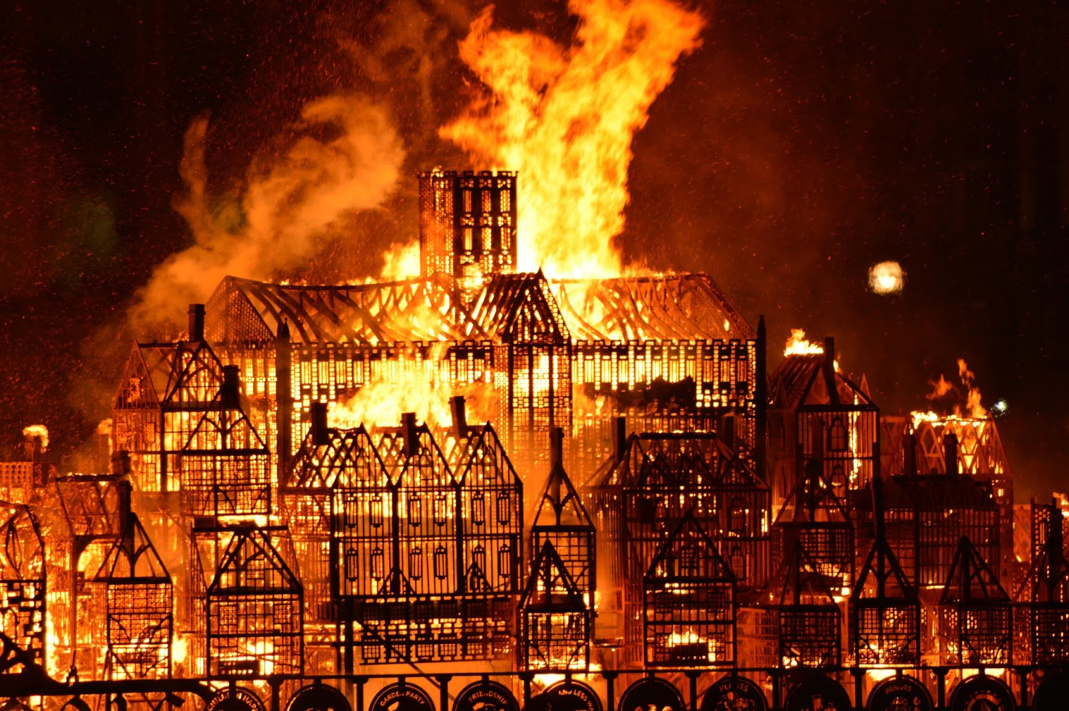
Some of our topic books are about the Great Fire of London.
Next time you look at them, see if you can find any more interesting facts.
Write down anything else you learn and we will put it on the topic wall.

