Slide 1
Monday 1st March
We hope everyone has had a lovely weekend and looking forward to Spring!
This PowerPoint is going to include each day’s phonics and grammar activities. This will make sure we are practising our spelling and grammar rules whilst you are working at home. You will need a pen/pencil and a piece of paper.

Slide 2
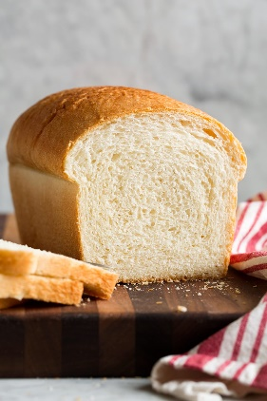
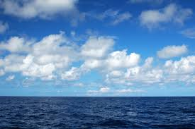
Let’s start!
Can you remember the alternative
phonemes(sounds) for the ea grapheme (spelling)?
Let’s make two columns. How many words can you add?
sea bread

Slide 3
Did you get any of these?
head eat cheat
dead treat tread instead
lead sweat weather
measure cheap steamy

Slide 4
Now we will practise this weeks common exception words (CEW).
Reveal the words
one by one. Look/write/check.
Mr
Mrs
only
plant
Well done all of you!!
If you already know your Year 2 CEW look for the Super Spelling Challenge on the
website and practise 6 x words a week. We have some fantastic new badges
for when you come back to school! Have you been practising?

Slide 5
This week we are going to focus on adding the suffixes ‘less’
We use ‘less’ to mean without and can add it to nouns and verbs to create adjectives.
E.G hope ------hopeless
care ------careless
fear ------fearless
use ------ useless

Slide 6
Can you add ‘less’ to these nouns and verbs so that the sentence is correct.
The clown was hope_______ at balancing on the ball.
She was so fear____________ when she climbed the highest mountain.
He was unhappy because his broken arm was use___________.
The children were so care____________ with their spelling.
(Not Diamonds and Pearls though!!!!)

Slide 7
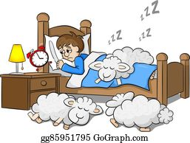
ABC . ! ?
Now make
up your own sentence using the words from the picture!
That’s all for today. Well done!!
Clue- think what the boy is trying to do!

Slide 8
Tuesday 2ndMarch
Hello everyone! Let’s revise some words which have the grapheme ‘g’ but have an alternative phoneme.
See how many you can think of. The g can be anywhere in the word.
giant angry

Slide 9
Did you think of any of these?
giraffe garden magic
game sledge danger
huge goal orange

Slide 10
Now have a go at practising this weeks CEW. Remember there are 4 of them (or practise your super spellings).
Go back to slide 4 to check.

Slide 11
Today we will be practising adding the suffix ‘less’ to root words.
home--------
harm--------
colour-------
spot--------
thought-------
rider-------

Slide 12
Can you write the word that goes with the definition?
Something that is very clean
Something that doesn’t have any colour
A horse without a rider
Someone who doesn’t think carefully
Something that doesn’t hurt you
A person who doesn’t have a home

Slide 13
ABC . ! ?
Now make
Up your own sentence
using the words from
these pictures!
That’s all for today.
Well done!!
Can you use a conjunction in your sentence?

Slide 14
Wednesday 3rd March
Today I would like you to listen to these sentences and write them in your neatest handwriting. Try to join your letters.
The plant looked harmful but it was really harmless.
Mrs Smith was speechless when she opened her letter.
The horse was only riderless on Saturdays.

Slide 15
Thursday 4thMarch
Hi everyone! Today we are going to revise words where the ‘y’ grapheme makes a long ‘i’ sound at the end of words.
I’ll start you off……….
sky

Slide 16
Did you get any of these?
cry, fly, fry, shy, spy, try, sty, sly, dry, by, my, why.

Slide 17
Have a go at writing as many words as you can with the suffix ‘less’.
Can you guess these ones?
_ _ _ mless sp_ _ _ _less
_ _ _ less t_ _ _ _ _ _ less

Slide 18
ABC . ! ?
Now make up 2 sentences using the words from the list you have made.One of the sentences needs to be a question.

Slide 19
Friday 5thMarch
Rather than ticking please write the answer.

Slide 20
Which word in the sentence below can be replaced by the word if?
My friend and I ride our bikes to school
when the weather is good.
That’s right when!

Slide 21
Time for some spelling practise! Please ask your grown up to check that you can spell the words below!
harmless
speechless
sure
useless
children
careless
sugar
giant
magic
spread
Well done everyone!!!

Slide 22
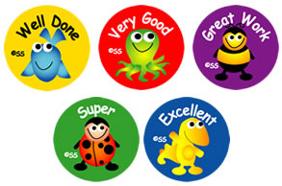
Well done everyone! We hope you have a lovely weekend.

