Slide 1
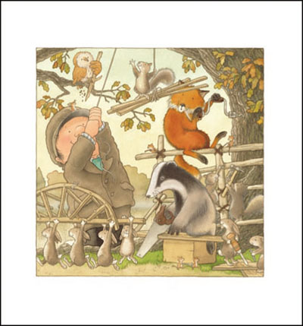
What do you think they are saying to each other?

