Slide 1
Today we are going to carry on learning about London in the 1660s.
What can you remember?

Slide 2
Great Plague
1665
Thousands died
Carried by fleas on rats
Doctors wore costumes with beaks
Sometimes people were locked in their houses
Great Fire
September 1666
Only about 6 people died
Started in a bakery in Pudding Lane
It spread because houses were wood and wind was strong
13,000 houses were destroyed and about 90 churches

Slide 3
Last week we learned about the fire by watching some videos.
This week we are going to use a different source of information…
Pictures

Slide 4
This is the most famous painting of the Great Fire.
How would it have felt to be there?
What would you be worried about?
Would this be the same for children and adults?
Would it be the same for rich and poor people?

Slide 5
Another one from a bit nearer the Tower.

Slide 6
This is from the other direction.

Slide 7
This is one of the old gates to the City.
Pretend you are someone who lived in London.
Turn to your talk partner.
What would you say?
Let’s share your thoughts…
Take a speech bubble and write down what you have just said…

Slide 8
A more modern interpretation. Look at the “skeletons” of the wooden houses.

Slide 9
Look at the roofs of the burnt out houses.

Slide 10
The houses all had wooden frames and were very close together…
https://www.youtube.com/watch?v=SPY-hr-8-M0
This video gives you a tour round London as it might have been. Look closely at the buildings…

Slide 11
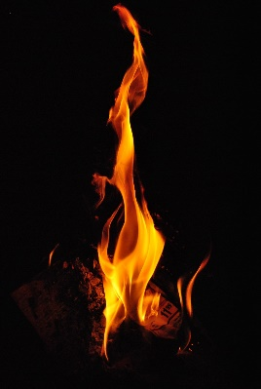
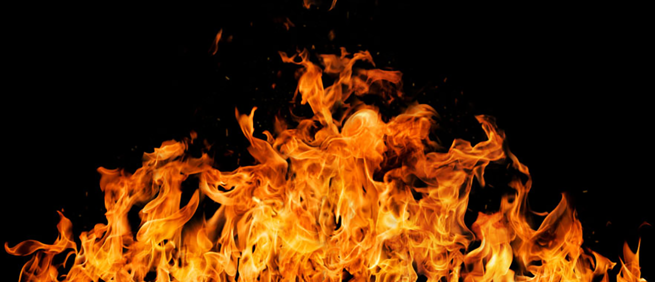
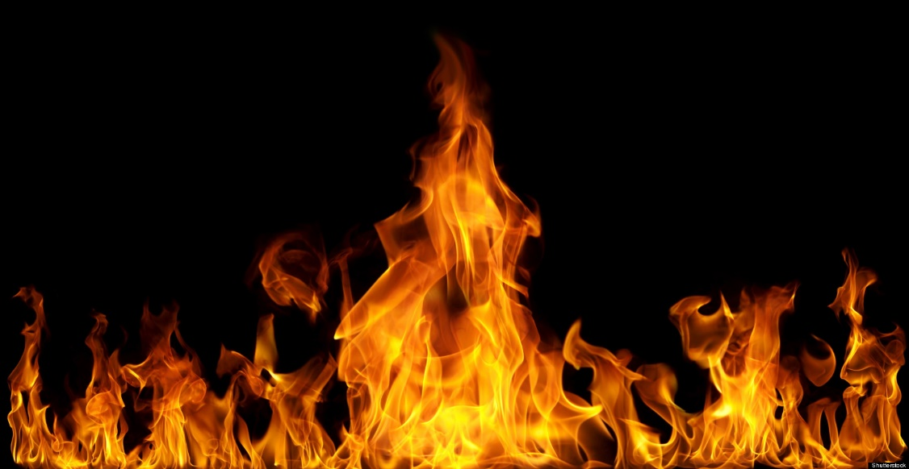
Today we are going to make pictures of the Great Fire.
We are going to use tissue paper to replicate the flames.
Flames are not even in size so we are going to tear not cut.

Slide 12
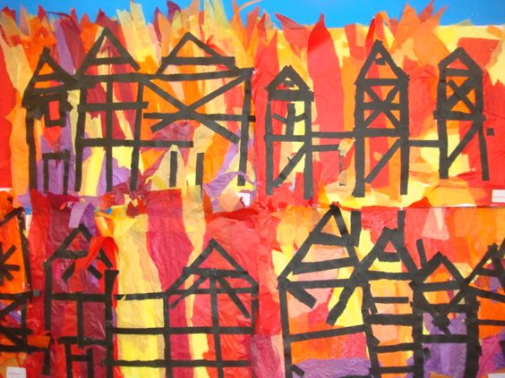
Then we are going to use strips of black paper…
…to replicate the burnt out buildings.
Success criteria
Tear strips of tissue
Stick tissue (glue on big sheet not tissue)
Arrange strips of paper and cut
Stick strips

Slide 13
Let’s find out more facts
https://www.bbc.co.uk/teach/class-clips-video/history-ks1-why-did-the-great-fire-of-london-happen/znp9r2p
https://www.bbc.co.uk/teach/class-clips-video/history-ks1-what-happened-during-the-great-fire-of-london/zpwfp4j
https://www.bbc.co.uk/teach/class-clips-video/history-ks1-what-happened-after-the-great-fire-of-london/zcsd96f

