Slide 1
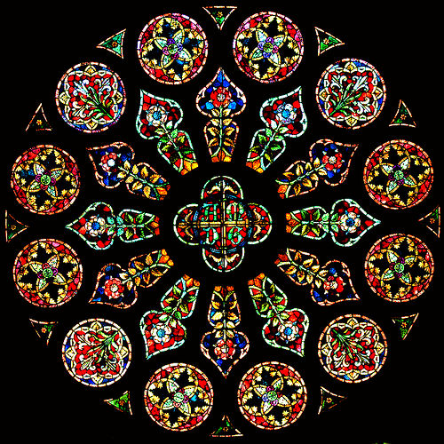
Stained Glass Windows

Slide 2
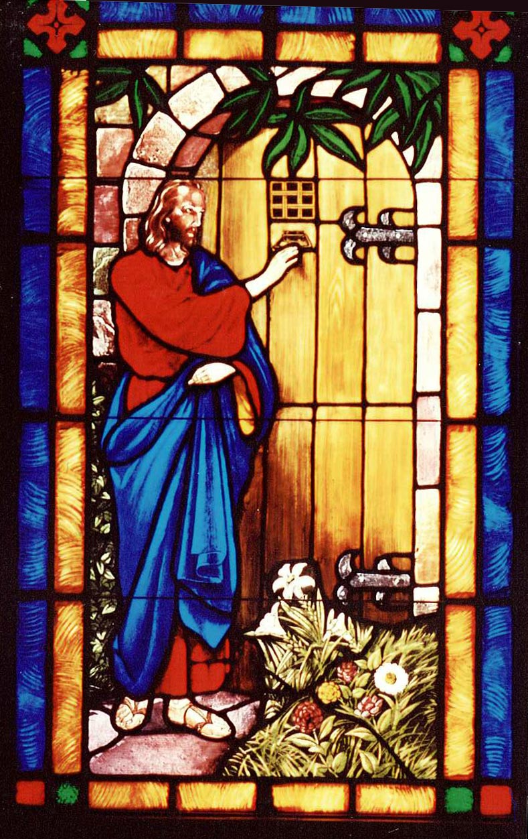
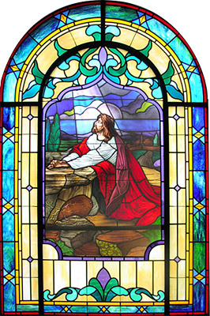
They often show scenes from the bible.

Slide 3
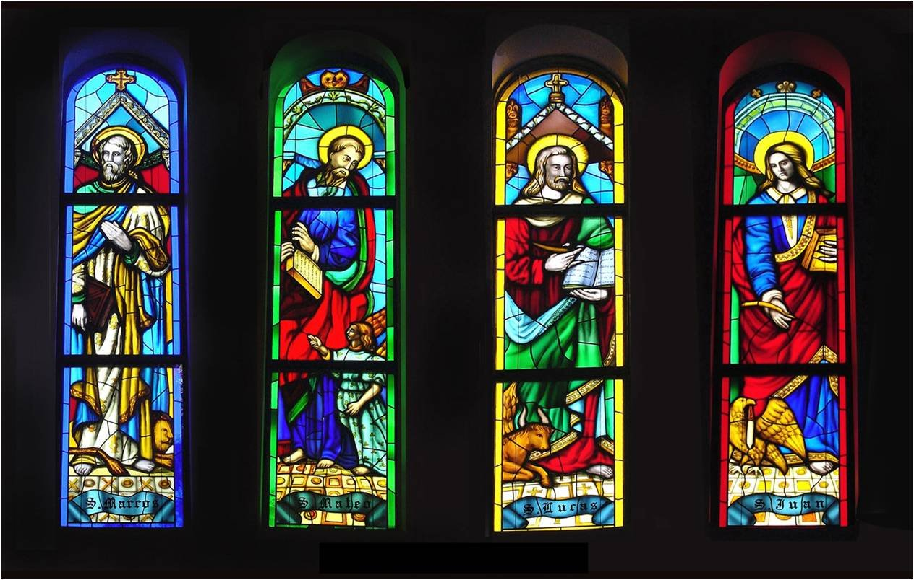
St Mark St Matthew St Luke St John
This window shows the four people
who wrote about Jesus.

Slide 4
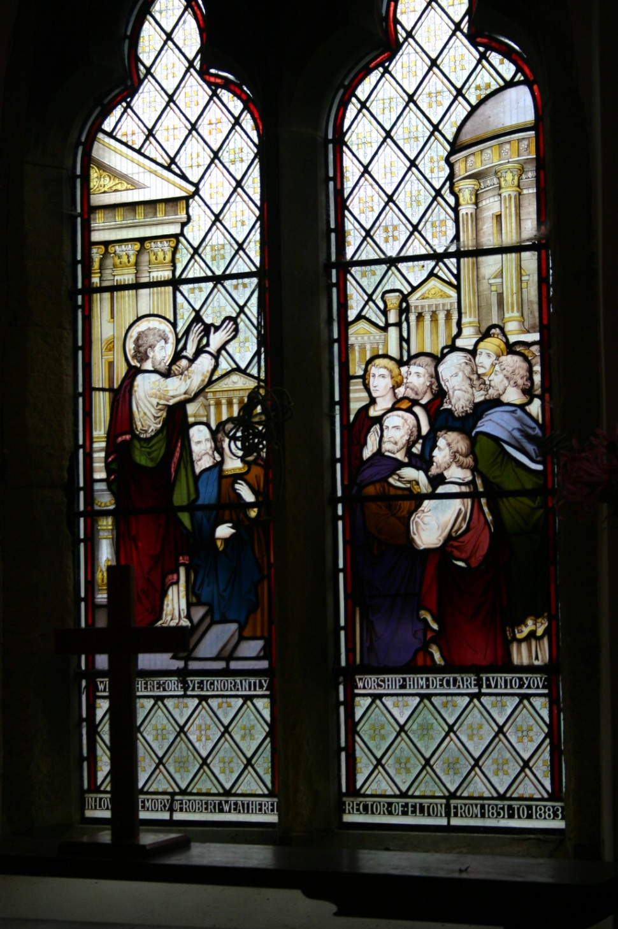
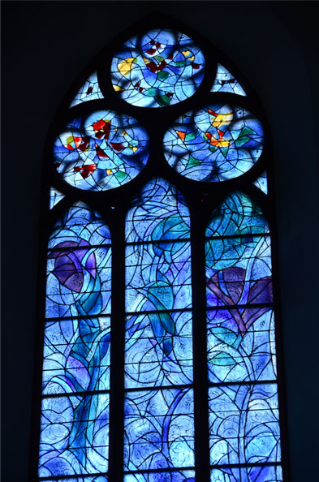
They have different patterns.
Can you see how different
the patterns are?

Slide 5
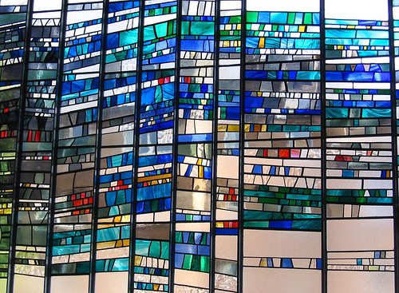
Some are modern and abstract.

Slide 6
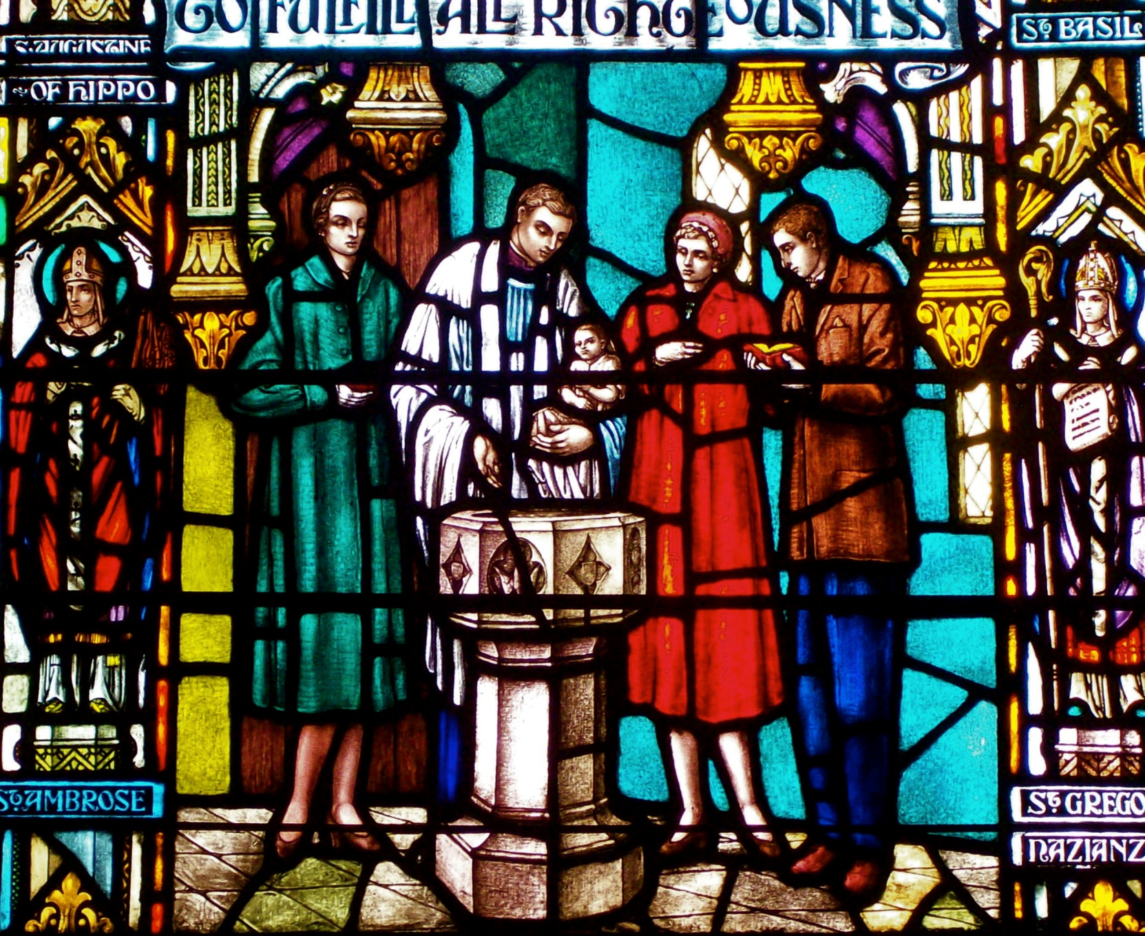
This one looks traditional and old.
Do you think it’s very old?

Slide 7
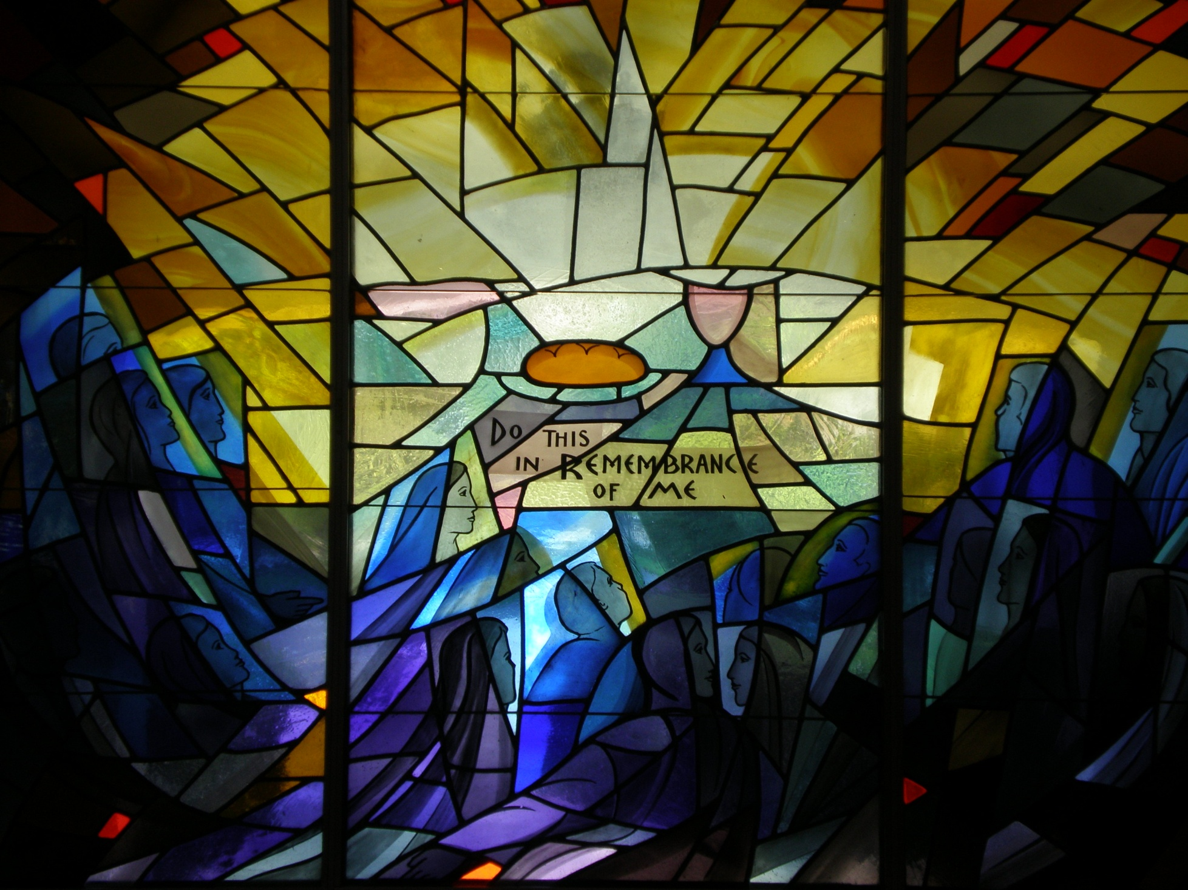
What do you think about this stained glass window?

Slide 8
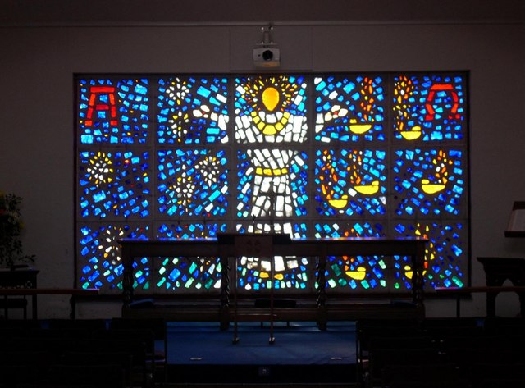

Slide 9
We will make or colour our own stained glass windows!
Get black paper.
Fold it in half and shape it.
Cut out some shapes from the folded edge.
Apply tissue paper on the back to make the glass.
Alternatively, colour one of the pictures that follows. Make sure you stay inside the lines and choose bold colours.

