Slide 1
Although this is history, we are going to start with some maths!
Can you put these numbers in the right order on a number line?
Did you get the order right? Smallest on the left?
87
77
66
86
69
66
69
77
86
87

Slide 2
Why do you think I chose those numbers?
Look what happens if I put “10” in front of each number…
I have made a Norman timeline!
66
69
77
86
87
1066
1069
1077
1086
1087

Slide 3
A timeline is just like a number line. It puts dates or pictures or objects in time order.
The earliest date or the object from longest ago goes on the left.
The latest date or the one nearest to now goes on the right.
We all know this date now:
What happened then?
The Battle of Hastings!
1066

Slide 4
Let’s have a think about the other dates
1069 – This was when William “harried” the north. He burned land and buildings so that people could not live there.
1077 – the Bayeux Tapestry was completed.
1086 – Domesday Book was made.
1087 – William the Conqueror died. The next king was his son, who was also called William. He became William the second.

Slide 5
Sometimes, 2 or more important things happen on a year.
Then you have to look at the months!
Can you put these in order?
October 1066
Battle of Hastings
December 1066
William crowned king
January 1066
King Edward died
September 1066
Harald of Norway is beaten
January 1066
King Edward died
September 1066
Harald of Norway is beaten
October 1066
Battle of Hastings
December 1066
William crowned king

Slide 6
Not all years have “10” in front of them.
Here are 2 other famous English dates:
These come after 1066, because they have 16 and 19 hundreds but 1066 only has 10!
1666
The Great Fire of London
1966
England won the World Cup
1066
The Battle of Hastings
1666
The Great Fire of London
1966
England won the World Cup

Slide 7
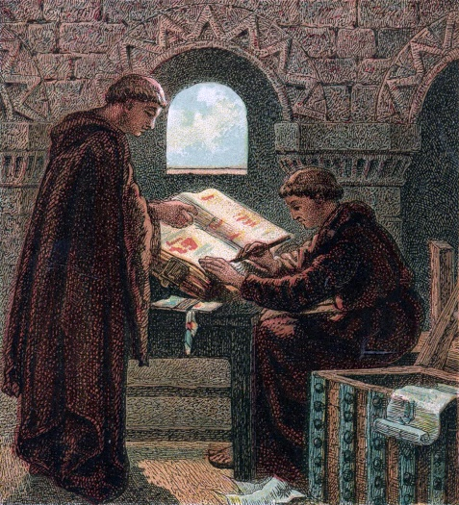
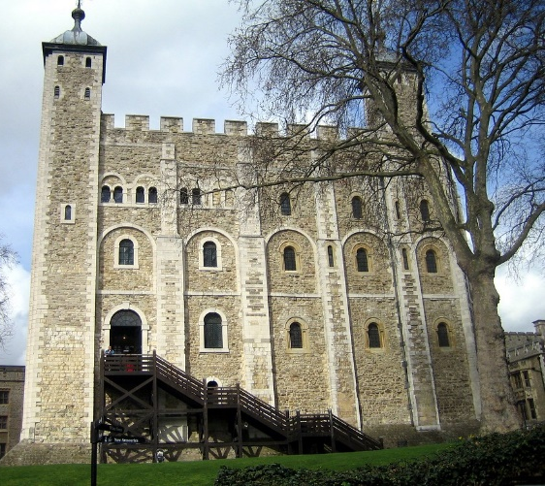
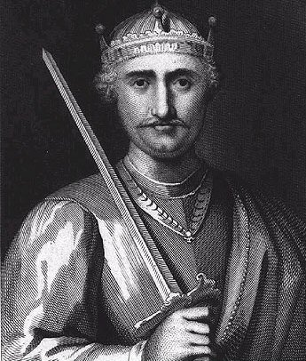
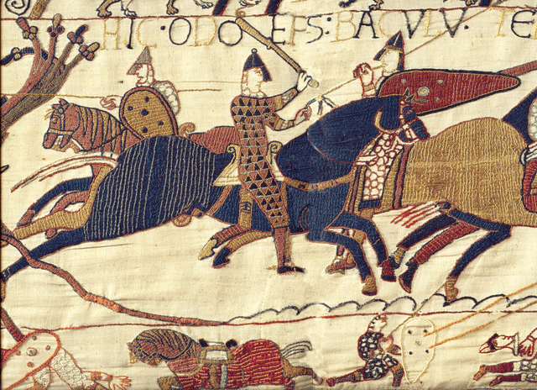
Your job today is to make a Norman timeline!
Put dates in order
Match pictures with dates
Remember to start on the left.
There is a challenge activity afterwards – order some other Norman dates that we haven’t yet learned about.
Good luck, historians!

