Slide 1
Today we are going to focus on nouns.
What are they?
Nouns are names – N for noun, N for name!
They can be names of people or places. These need capitals.
They can be names of “things” too. These don’t need capitals.
Anything you can touch or pick up in a noun!

Slide 2
Let’s share part of the book.
As we do, think about any “things” that you see in the pictures or hear about in the words…

Slide 3
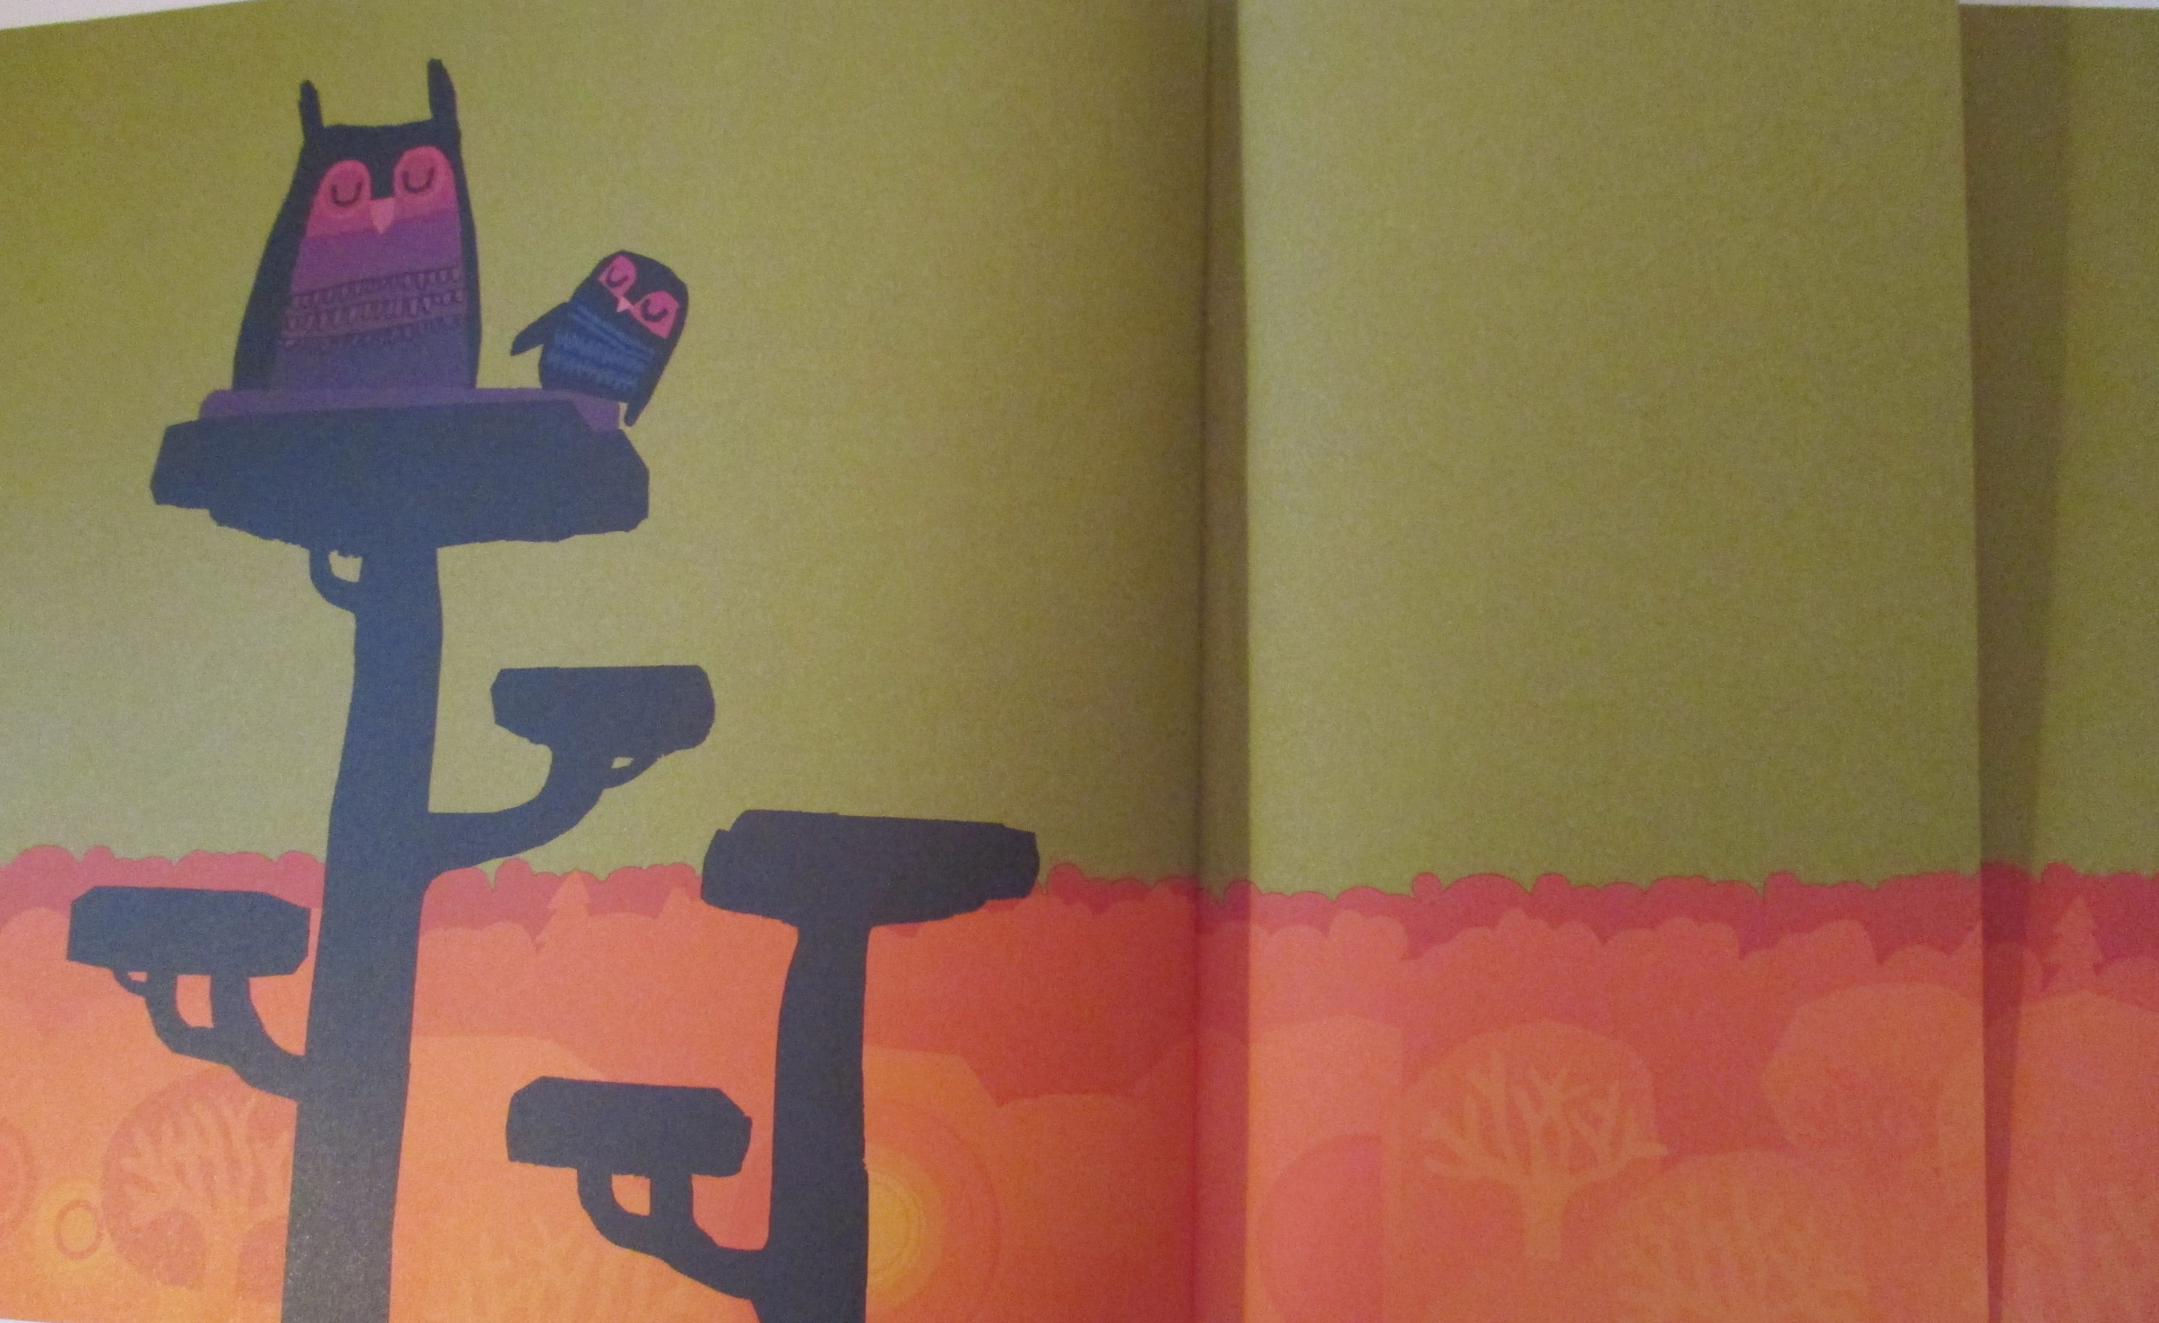
Nouns:
owls
trees
nest
forest
eyes
ears
beak

Slide 4
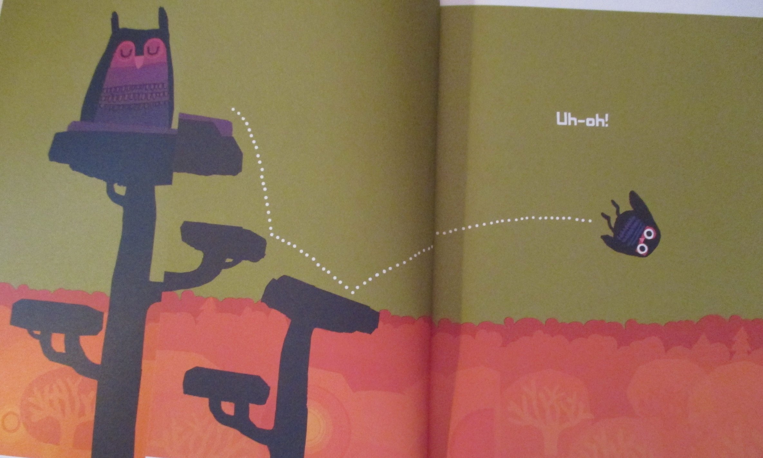

Slide 5
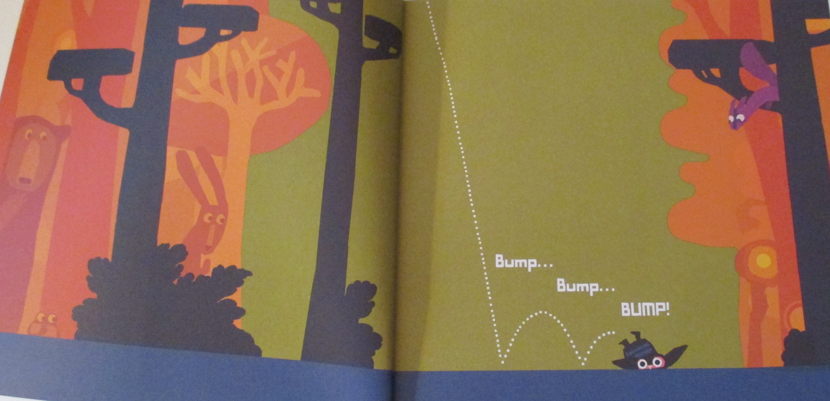
Did you notice the other animals watching baby owl?

Slide 6
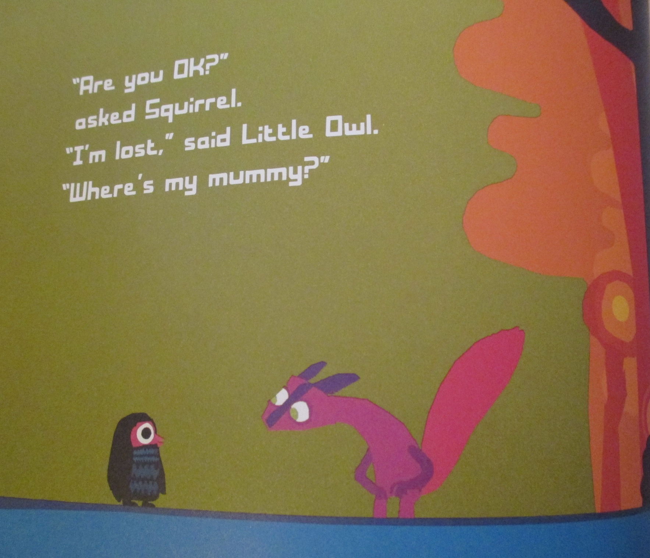

Slide 7
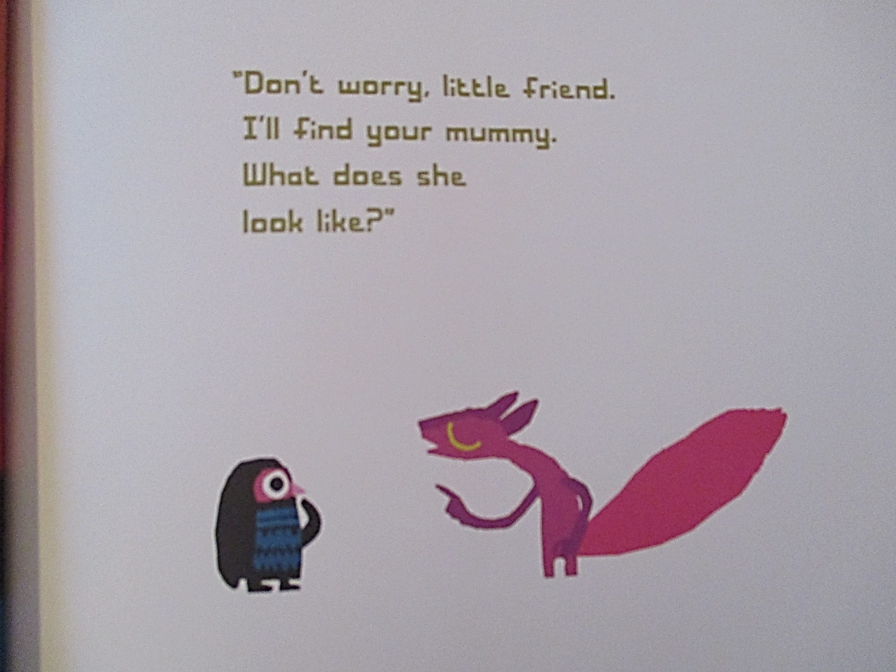

Slide 8
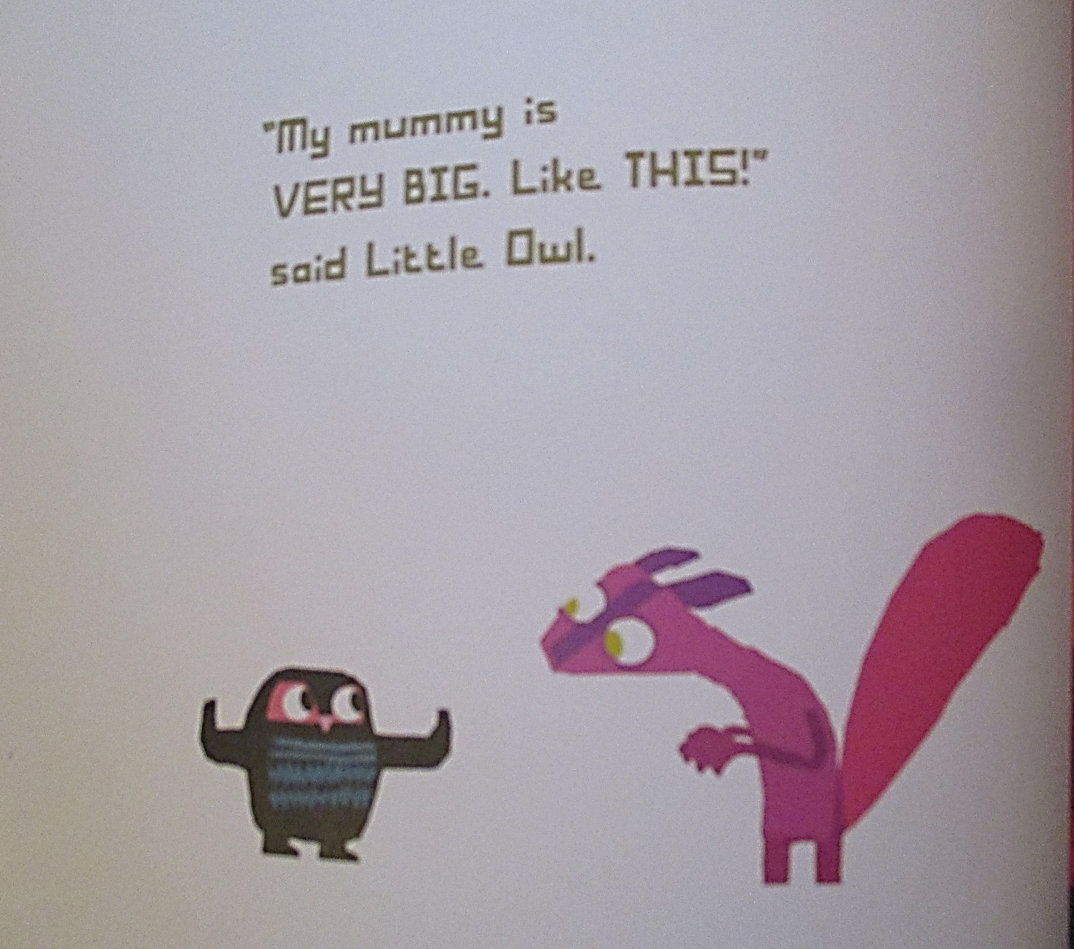

Slide 9
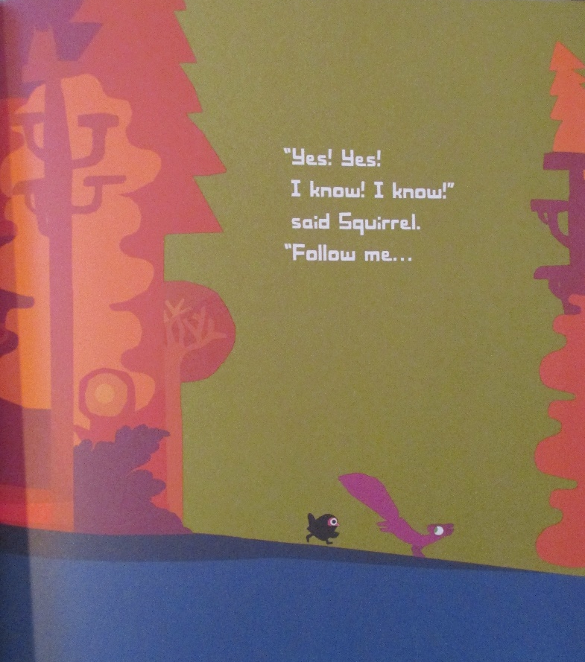

Slide 10
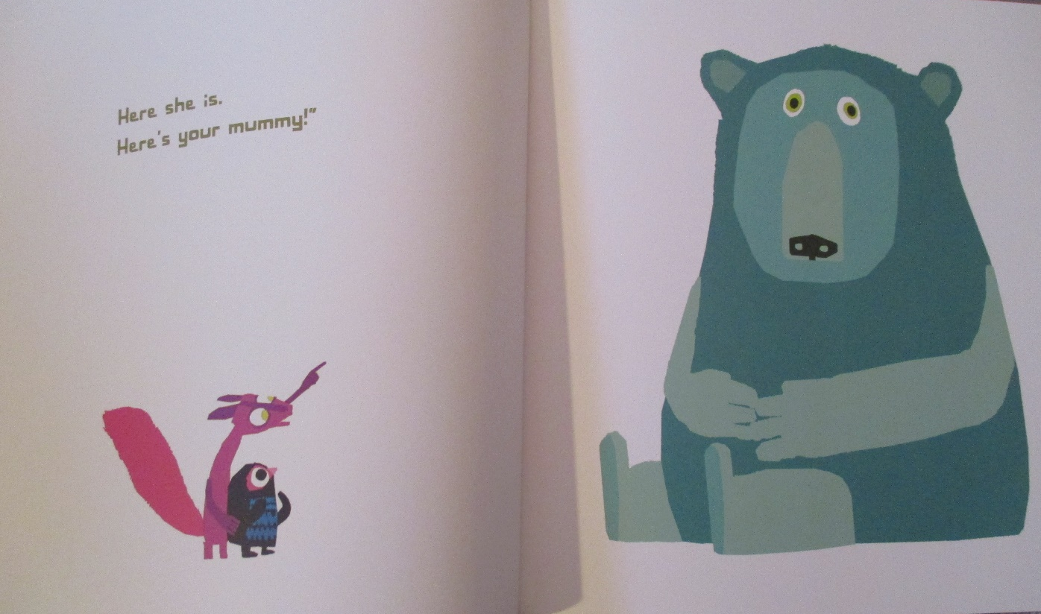

Slide 11
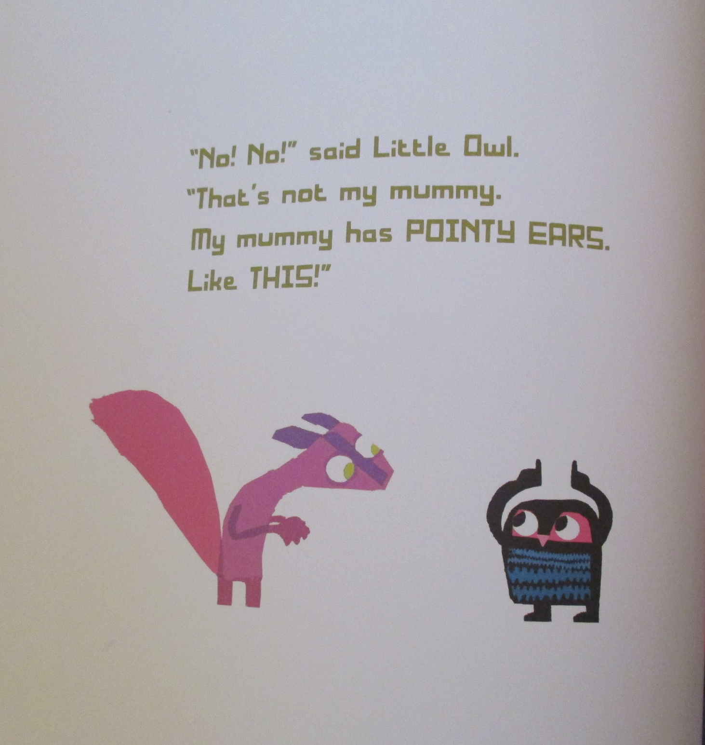

Slide 12
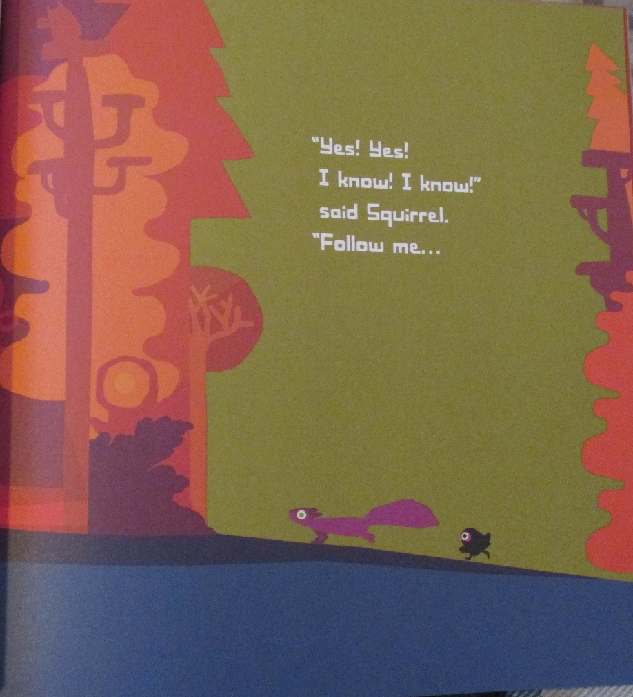

Slide 13
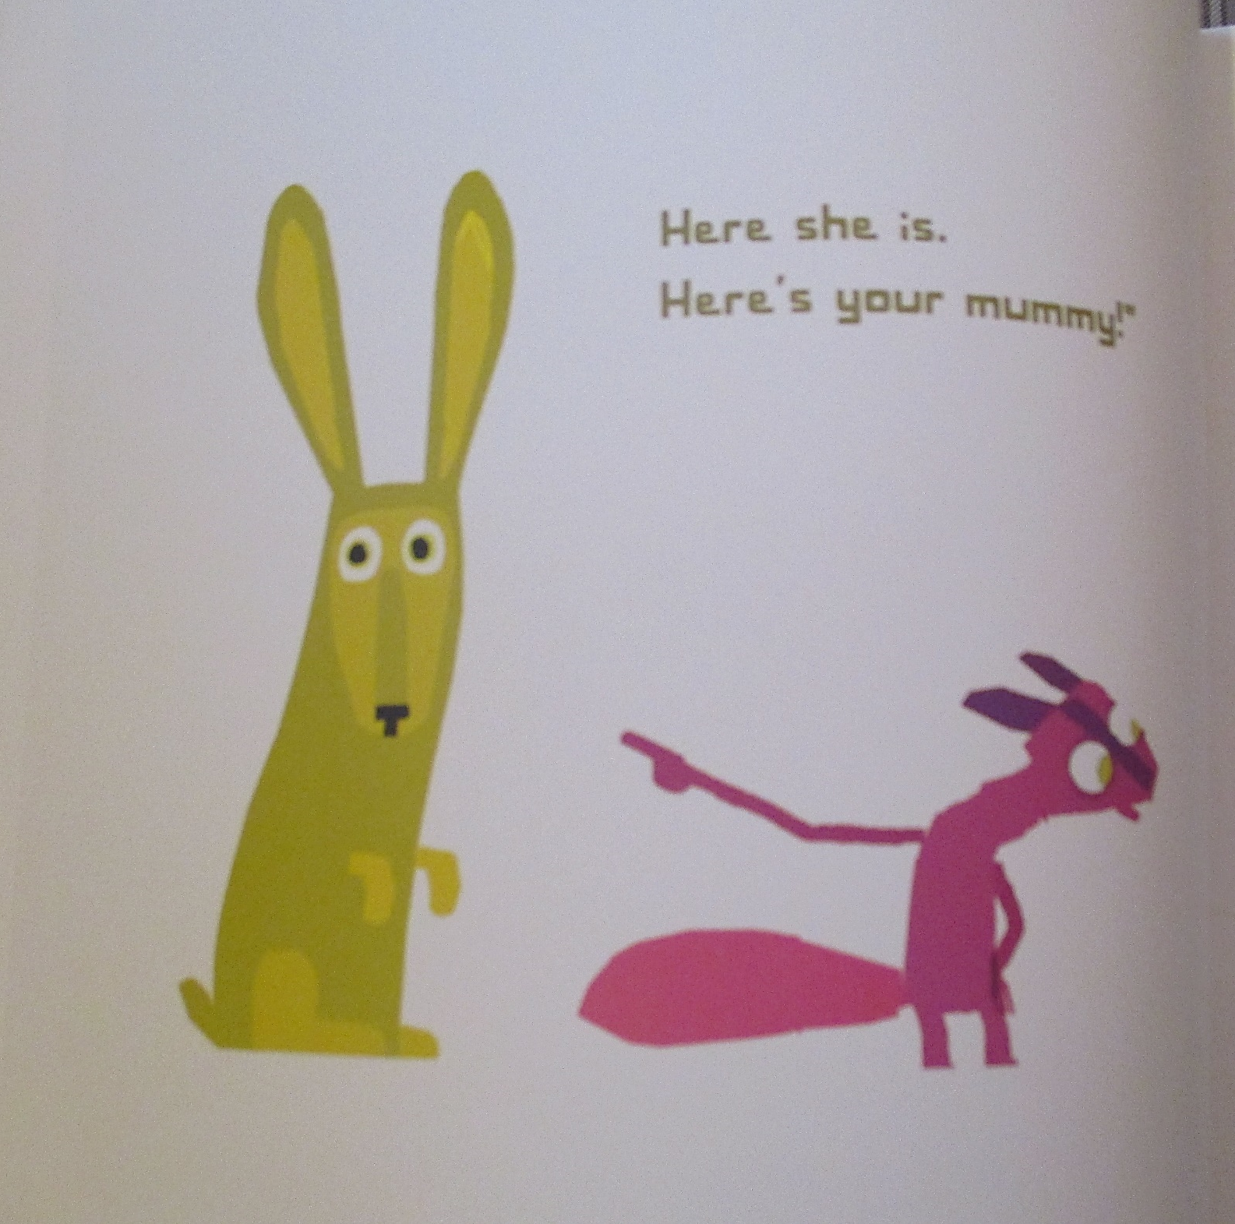

Slide 14
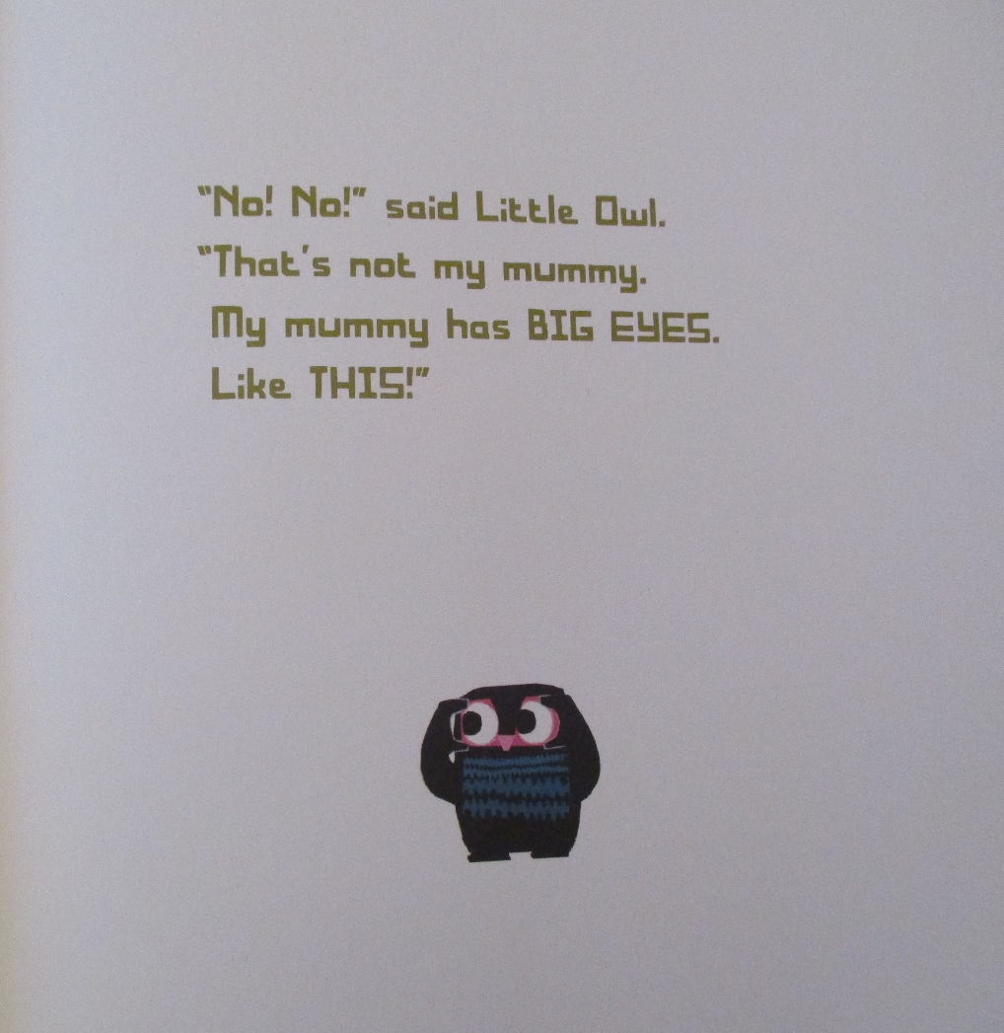

Slide 15
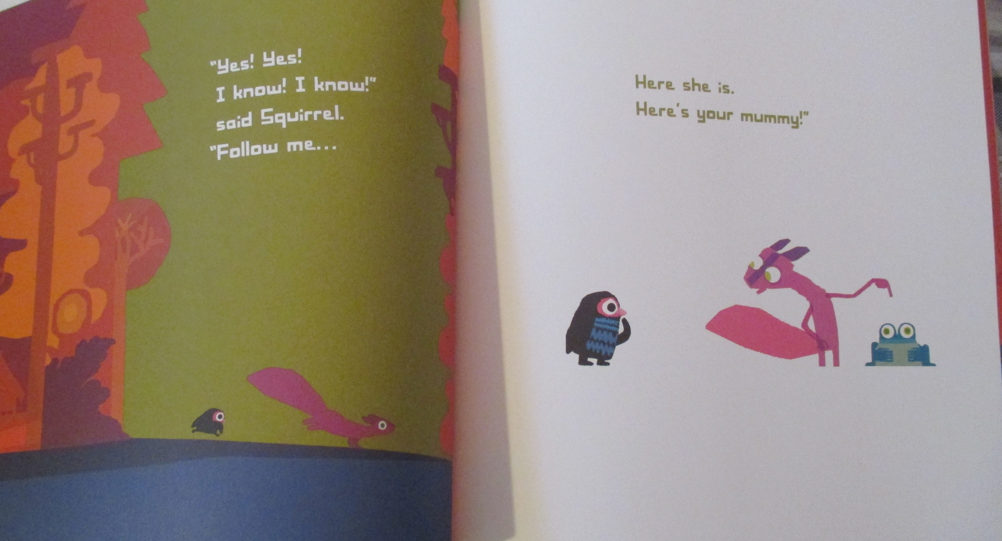

Slide 16
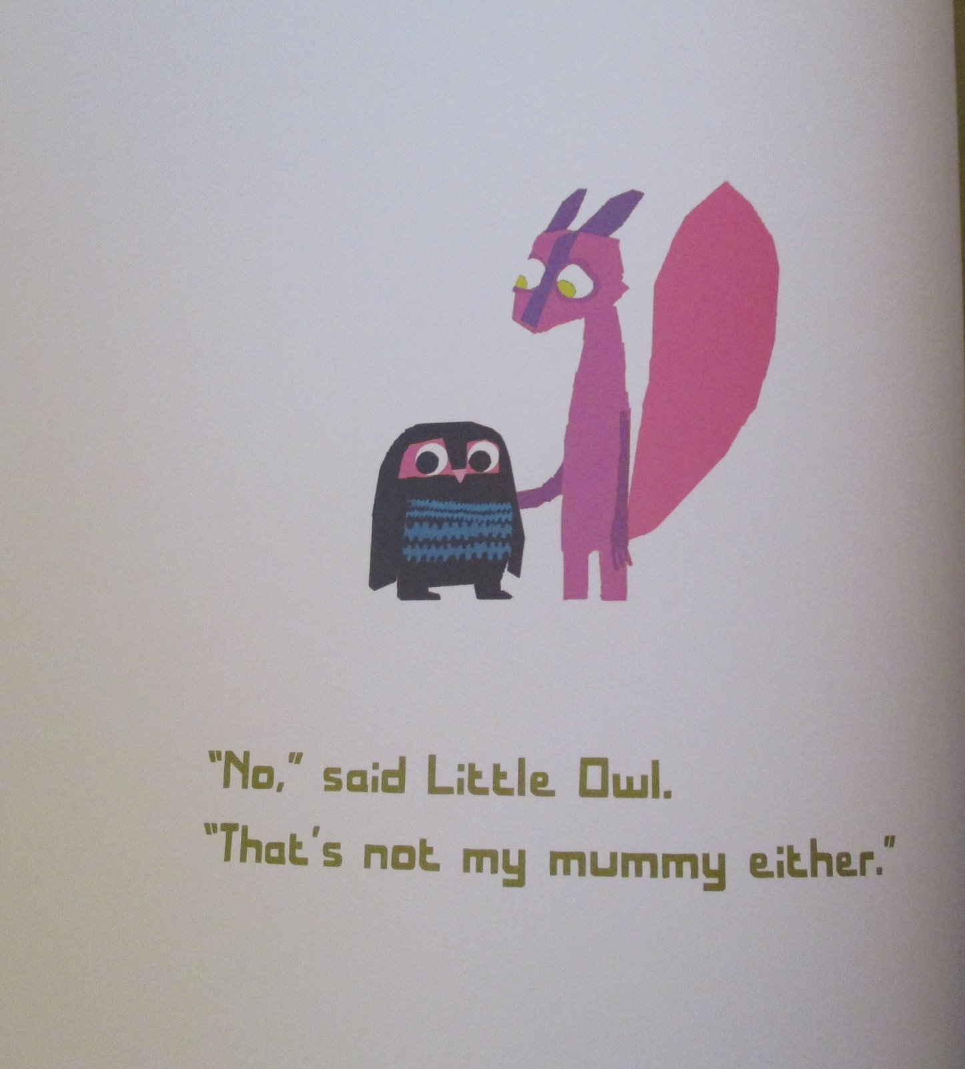

Slide 17
Now write a list of nouns that you spotted.
Did you get these?
owl, squirrel, bear, frog, rabbit,
forest, trees, ground, hedge, nest,
eye, beak, tail finger, beak, ears, feet.

Slide 18
Your job today
Neatly write a list of nouns from the story.
Then write some sentences with some of those nouns and underline the nouns.
Example: owl
An owl nests in a tree.

