Slide 1

Monday 1st February
We hope everyone has had a lovely weekend!
This PowerPoint is going to include each day’s phonics and grammar activities. This will make sure we are practising our spelling and grammar rules whilst you are working at home. You will need a pen/pencil and a piece of paper.

Slide 2
Let’s start!
Today we are going to practise using conjunctions.
I like chocolate and I like juicy apples.
Now try and finish the sentence using but to join your ideas.
I like chocolate but…………………

Slide 3
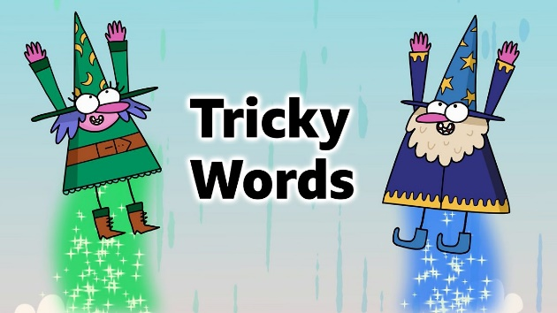
Now we will practise this weeks common exception words (CEW).
Reveal the words
one by one. Look/write/check. kind
mind
find
behind
Well done all of you!!
If you already know your Year 2 CEW look for the Super Spelling Challenge on the
website and practise 6 x words a week. We have some fantastic new badges
for when you come back to school!

Slide 4
This week we are going to focus on words where the ‘ur’ sound is spelt with an ‘or’.
What do you notice about these words? Where is the ‘ur’ sound?
word work worm world worth worst worse
That’s right! Did you notice the ur sound is spelt with an or after a w?

Slide 5


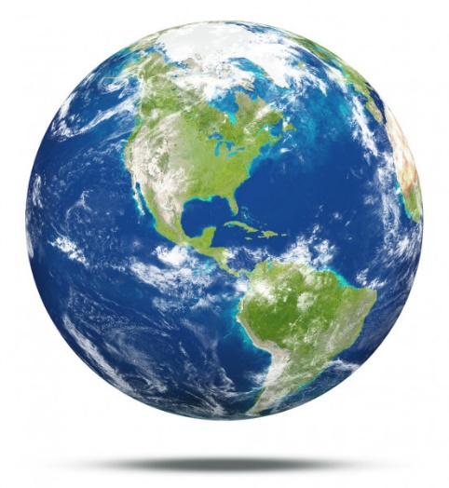
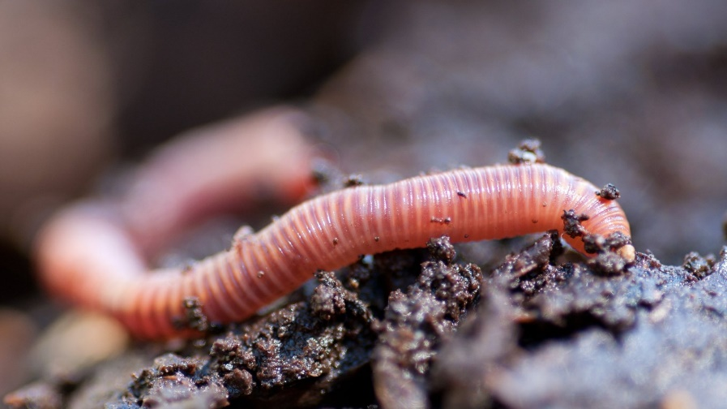
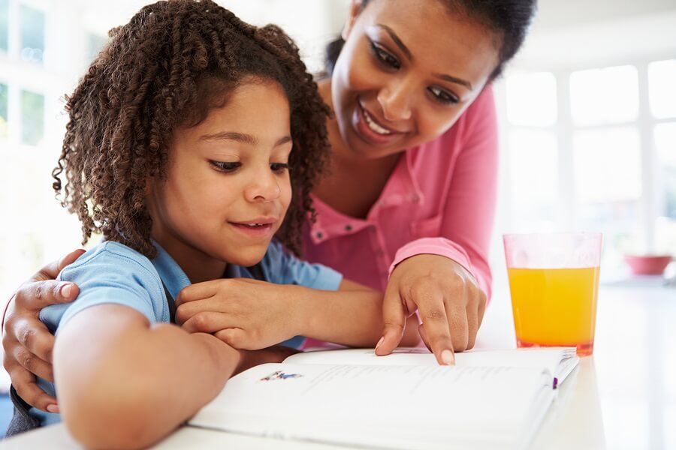
Now lets practise writing some of those words!

Slide 6
Now put the correct word in these sentences. Try to spell them on your own.
The ________________wriggled quickly in the soil.
Please get on with your _______________ quietly.
Can you say that____________________again?
Our _____________________ is a wonderful place to live.
Well done everyone!

Slide 7

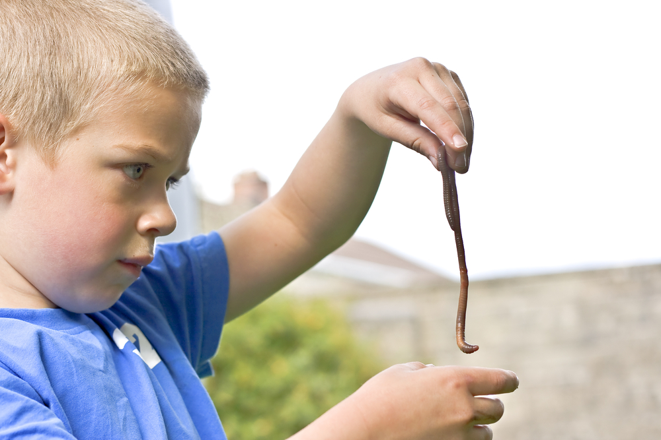
ABC . ! ?
Now make
Up your own question using the picture!
That’s all for today. Well done!!

Slide 8
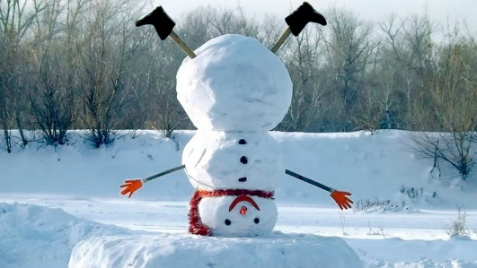
Tuesday 2nd February
Hello everyone! Let’s think about conjunctions again. Try to use or to join two ideas together.
I can choose chocolate or …………………………
Now try to use if to join two ideas together.
I can choose chocolate if ……………..

Slide 9

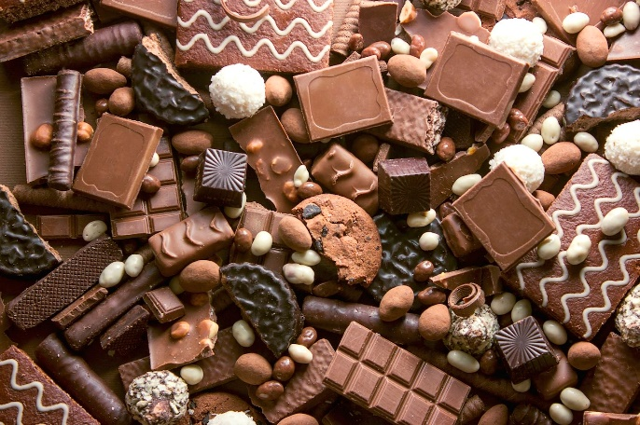
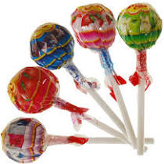
These were my ideas!
I can choose chocolate or I can choose a lollipop at the shops today.
I can have chocolate if I have worked hard all day.

Slide 10

Now have a go at practising this weeks CEW. Remember there are 4 of them (or practise your super spellings).
Go back to slide 3 to check.

Slide 11
Now lets practise writing some of the words from yesterday! Can you work out which ones they are?
____ or ____ _h w ____ ____ s_____
____ or _____ e

Slide 12


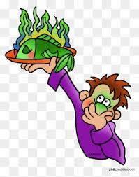
Can you spell the missing word?
My ring was __________ £20.00.
Which smell is the ____________ ?
It smells even ___________ today!

Slide 13
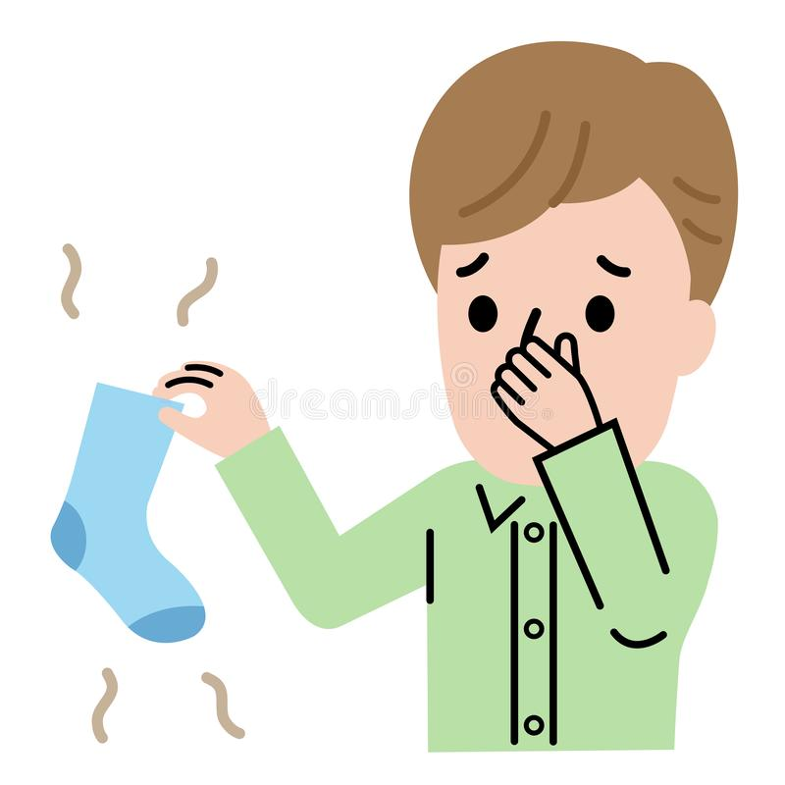
ABC . ! ?
Now make
Up your own sentence using the picture!
That’s all for today. Well done!!

Slide 14

Wednesday 3rd February
Hello everyone! Today’s activity is writing silly sentences using some of the spelling rules we have learnt this week. We would like you to write your sentences very neatly with clear ascenders and descenders and the rest of the letters the same size. Please ask a grown up to read the sentences to you. You will need your paper and pencil.
The children picked up four wriggly worms in the garden.
I like doing work if I can eat chocolate when I’ve finished.
We can see the world when we are sitting on the moon
Well done!

Slide 15
Thursday 4th February
Hello everyone! Let’s practise our conjunctions again!
I like chocolate because ………….
(you can change the word chocolate if you like!)
I like chocolate when……………

Slide 16
Quickly write your CEW words?
Well done!!!

Slide 17
Today we are going to recap the ur sound spelt or after a w. What words can you remember from Monday’s lesson? Have a go at writing as many words as you can remember with this spelling pattern.
word work worm world worth
worst worse
How many did you remember?

Slide 18
Can you write 2 sentences using one of our new words in the past and present tense.
e.G
I watched the worm in the dark soil.
I watch the worm in the dark soil.
Have a go at changing the verb.

Slide 19

Friday 5th February
Time for some quiz questions!
Which is the correct option to complete the sentence below.
_________going to Jasvir’s party.
Were’
W’ere
Wer’e
We’re
We’re – We are

Slide 20
What type of word is underlined in the sentence below?
We saw the boat move across the pond.
a verb
a noun
an adjective
an adverb
A noun –is there another one too?

Slide 21
Which conjunction would you pick?
It was raining heavily, ________Tara went out to play.
but
if
or
that
but

Slide 22
Now lets practise the spellings we have learnt this week. Ask a grown up to read out these spellings for you. If you are finding them tricky remember to write them out a few times!
kind
behind
world
mind
worm
find
worst
worth
word
worse

Slide 23
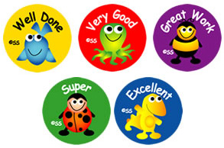
Well done everyone! We hope you have a lovely weekend.

