Slide 1
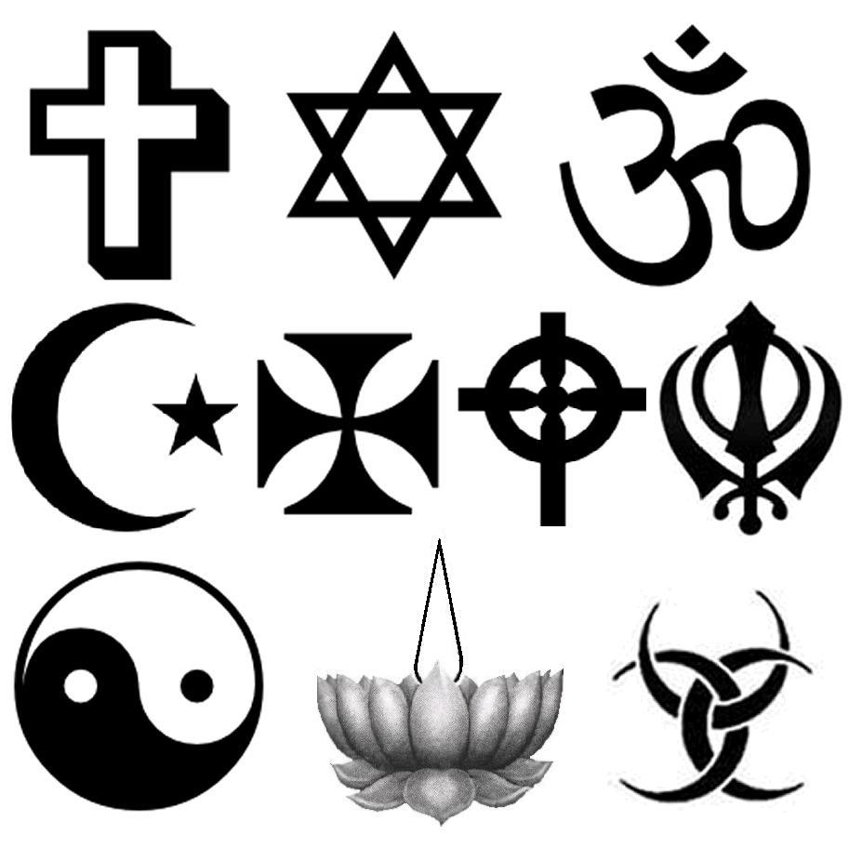
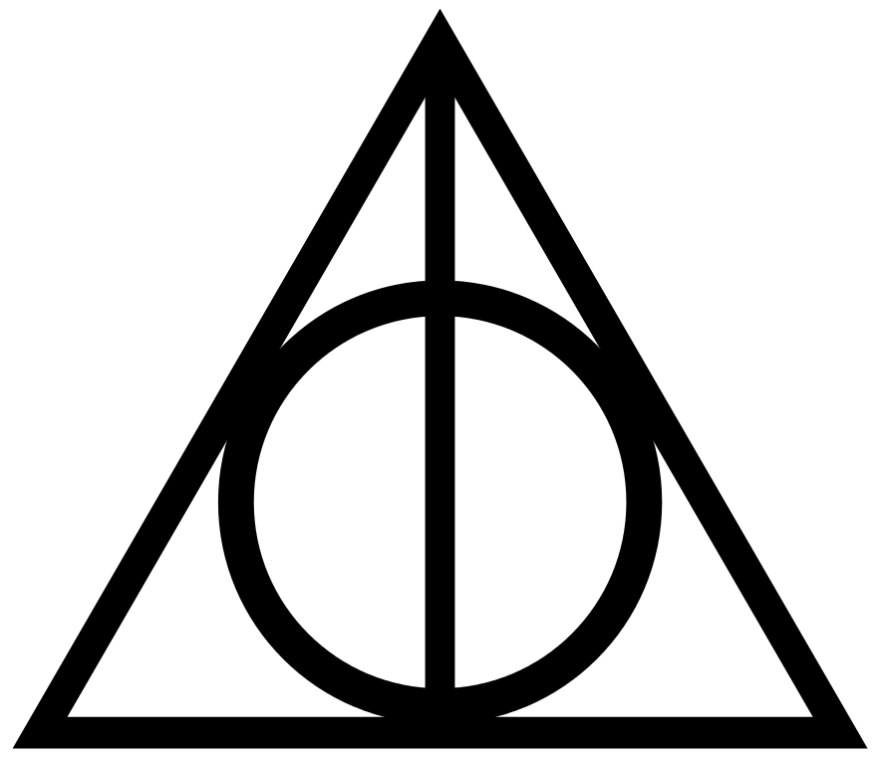
What is a symbol?
Can you draw any?

Slide 2
Today we are going to learn what a symbol is and recognise symbols used in every day life.
We are also going to recognise an important Sikh symbol and learn about it.
Finally we are going to design our own symbol to represent ourself.

Slide 3
A symbol is a picture that has a special meaning.

Slide 4
The Khanda is the symbol of Sikhism.
It is made up of 3 objects that are
important to Sikhs.
What objects can you see?

Slide 5
The Khanda….
…. is a double edged
sword that shows that
Sikhs believe in one God.

Slide 6
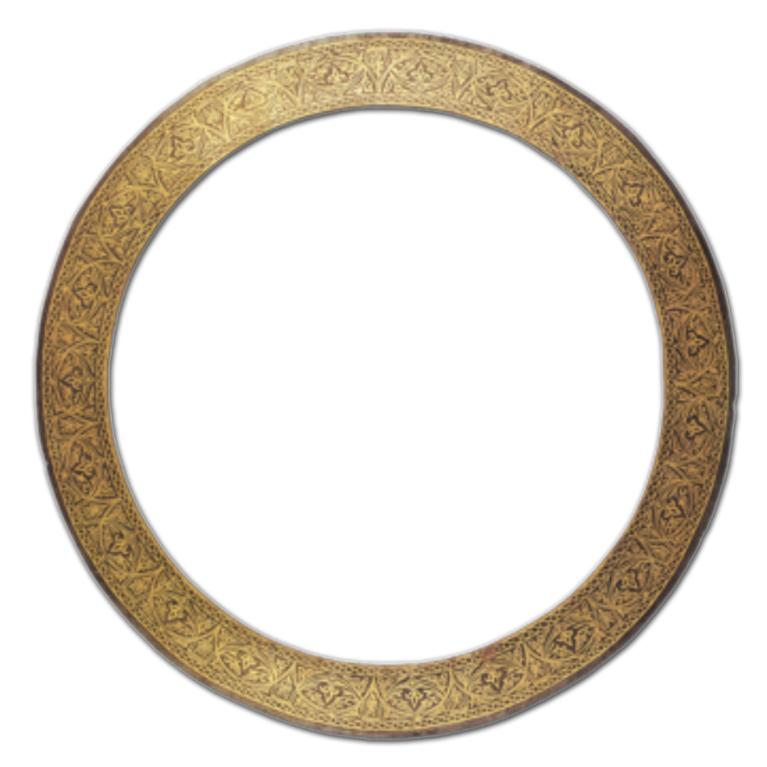
The Chakkar….
….is like the Kara,
a steel band that
Sikhs wear.
It reminds Sikhs…
that God is
without beginning
or end and
b) to stay within
God’s rules.

Slide 7
Two crossed Kirpans (swords)…
…. which represent spirituality and political power.

Slide 8
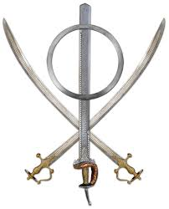
These 3 things come together to make the
Sikh symbol…
…. the Khanda.

Slide 9
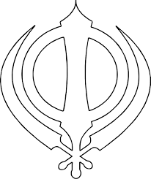
Draw the outline of the khanda symbol.
Can you add labels and what it means?
Can you mention
Label
the Khanda
2) the Chakkar
3) The Kirpans

Slide 10
Design your own symbol!
Think about your own identity and belonging:
- What you look like
- What you enjoy doing
- What you believe is important
Design your own symbol to represent you as a person.
Label the symbol (and name it if you wish).
Explain what the symbol means.

