Slide 2
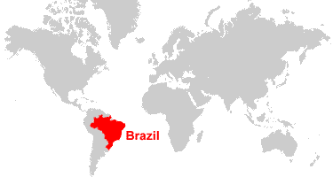
Where Is Brazil?
Brazil is the largest country in the continent of South America and the fifth largest country in the world!
UK
It has a long coastal border with the Atlantic Ocean and borders with ten different countries.

Slide 3
Fast Facts About Brazil
Population: 196.6 million
Capital city: Brasilia
Largest city: São Paulo
Currency: Real
Main religion: Catholicism
Official language: Portuguese*
*although there are about 180 indigenous languages!

Slide 4
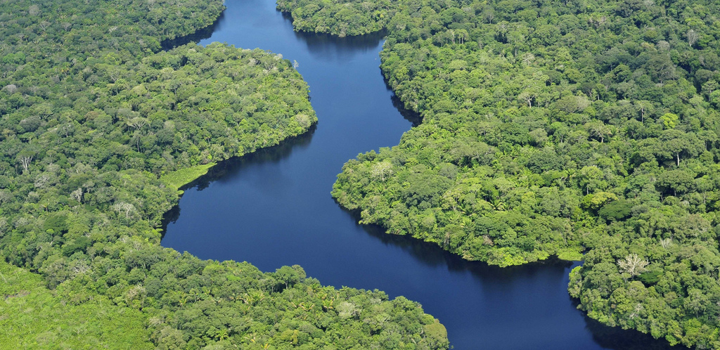
The Amazon River
The Amazon is thought by some to be the longest river in the world, although some believe this to be the Nile in Africa. The Amazon contains the highest volume of water of any river in the world and the Amazon rainforest is the largest tropical forest in the world.

Slide 5
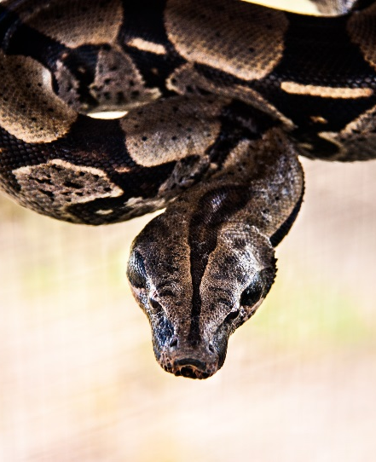
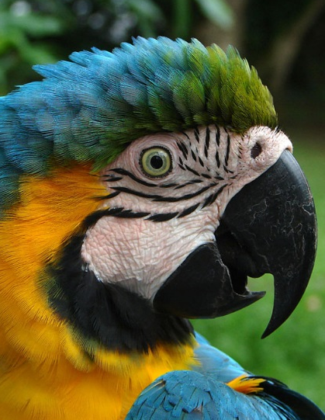
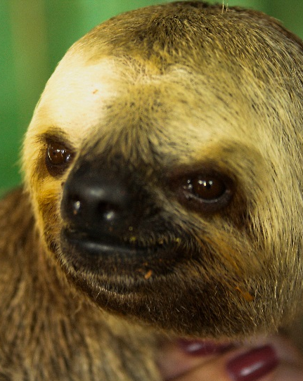
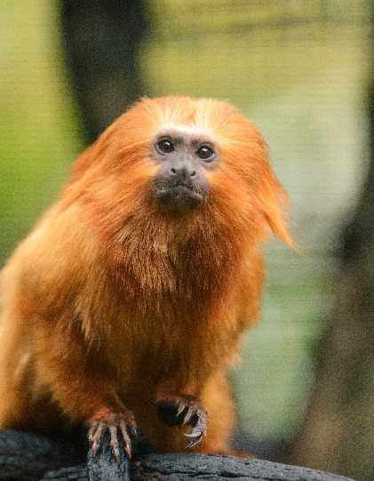
Amazon Rainforest
The Amazon rainforest covers more than 50% of the country.
It is the world’s largest jungle.
The Amazon rainforest is very important for the health of the whole planet.
It is full of plants, animals and insects. Some exmaples of animals are jaguars, sloths, poison dart frogs, snakes, toucans orang-utans and river dolphins!

Slide 6
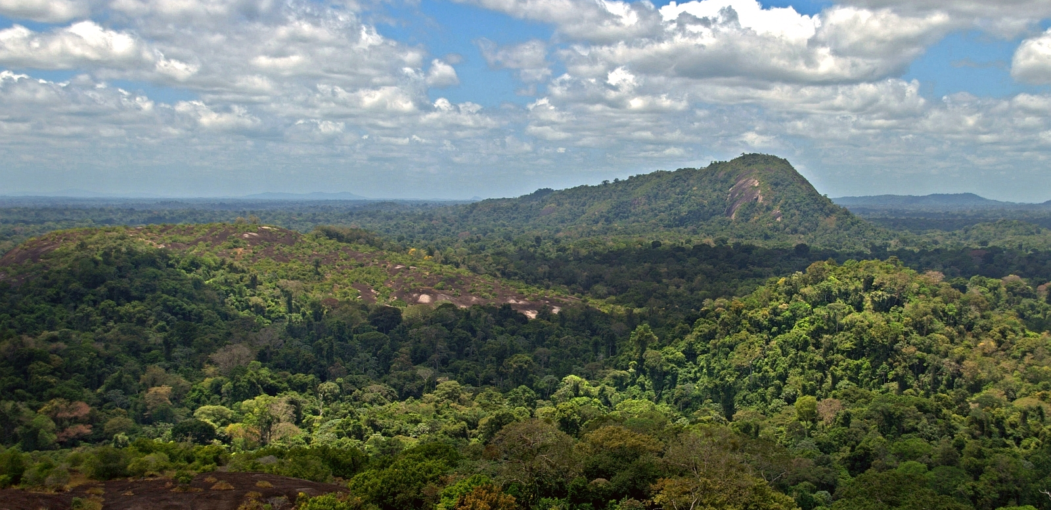
Climate of Brazil
It’s summer in December – it’s extremely hot!
It is winter in June – but Brazil doesn’t get much snow!
Photo courtesy of Daveness_98o (@flickr.com) - granted under creative commons licence – attribution

Slide 7
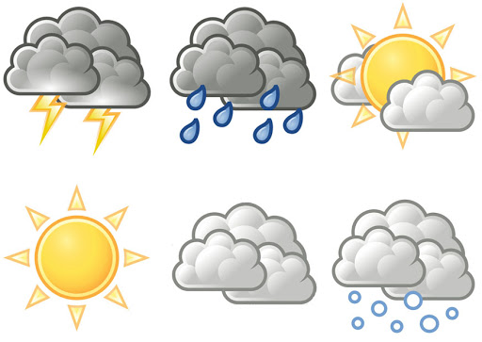
The Weather in Brazil
Most of Brazil has a tropical climate. This means it is warm for most of the year although it does have colder and warmer seasons like in the UK. The weather in Brazil doesn’t get as cold as it does here in the UK and the summers are much hotter!

Slide 8
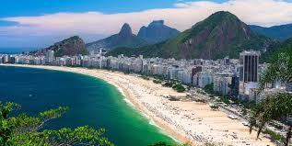
Beaches in Brazil
Brazil has a large coastline and therefore a lot of beaches.
The beaches are very beautiful with golden sand and crystal clear waters around them.
Copacabana is the name of one of Brazil’s most famous beaches. You can see it here in the picture.
It looks very different to the beaches we have here in the UK.

