Slide 1
Tuesday 23rd February
We hope everyone has had a lovely half term holiday.
This PowerPoint is going to include each day’s phonics and grammar activities. This will make sure we are practising our spelling and grammar rules whilst you are working at home. You will need a pen/pencil and a piece of paper.

Slide 2
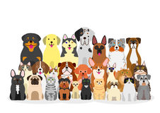
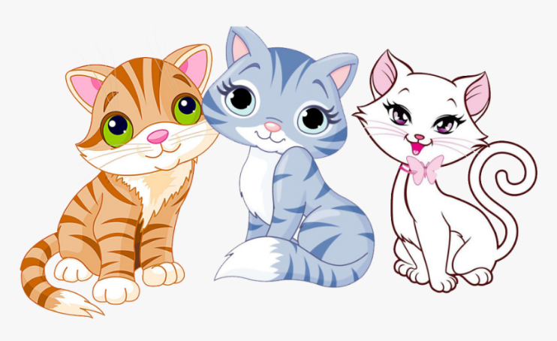
Let’s start!
Can you remember what a plural is?
A plural is when there is more than one of something.
For many words we simply need to an ‘s’ to them e.g. toy --→ toys. Can you write a list of nouns that are plurals spelt by adding only an ‘s’?

Slide 3
Now we will practise this weeks common exception words (CEW).
Reveal the words
one by one. Look/write/check.
sure
sugar
child
children
Well done all of you!!
If you already know your Year 2 CEW look for the Super Spelling Challenge on the
website and practise 6 x words a week. We have some fantastic new badges
for when you come back to school!

Slide 4
This week we are going to focus on adding the suffixes ‘er’ and ‘est’ to words.
We use ‘er’ and ‘est’ to compare 2 or more thigs.
When we add ‘er’ it means more e.g. He is taller than me.
When we add ‘est’ it means most e.g. He is the tallest.

Slide 5
Can you add ‘er’ or ‘est’ to these adjectives so that the sentence is correct. Think carefully about if the sentence is implying more(er) or most(est).
A baby is small than an adult.
Mount Everest is the tall______ mountain in the world.
The Arctic is the cold_____ place on Earth.
Chocolate is sweet_____ than potatoes.
Birds can fly high_____ than insects.
Pearl class and Diamond class are the great______ classes of all!

Slide 6
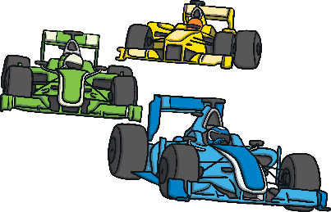
ABC . ! ?
Now make
Up your own sentence using the words from these pictures!
That’s all for today. Well done!!

Slide 7
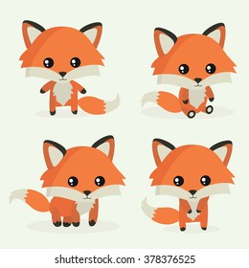
Wednesday 24th February
Hello everyone! Let’s revise some more plurals. Sometimes if a noun ends in a
s ss x ch sh z zz
Then we need to add ‘es’ to make the plural e.g. glass --→ glasses. Can you write a list of nouns that are plurals spelt by adding ‘es’?

Slide 8
Now have a go at practising this weeks CEW. Remember there are 4 of them (or practise your super spellings).
Go back to slide 3 to check.

Slide 9
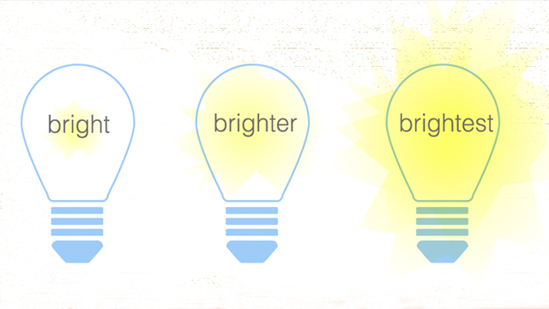
Today we will be practising adding the suffixes ‘er’ and ‘est’ where there is no change to the route word. The main body of the words stays the same and we simply add the suffix to make the new word.
e.g. bright -→ brighter -→ brightest

Slide 10
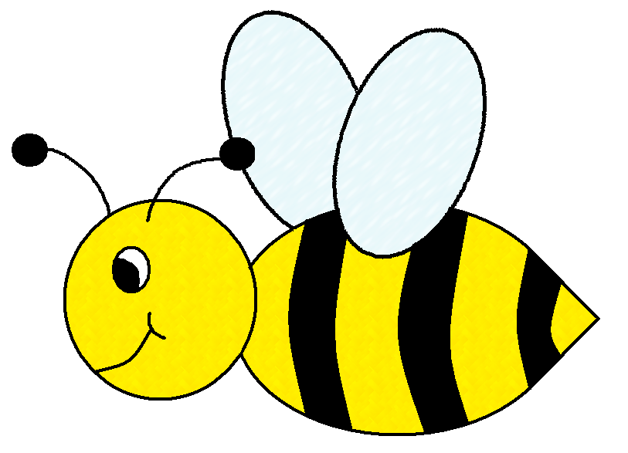
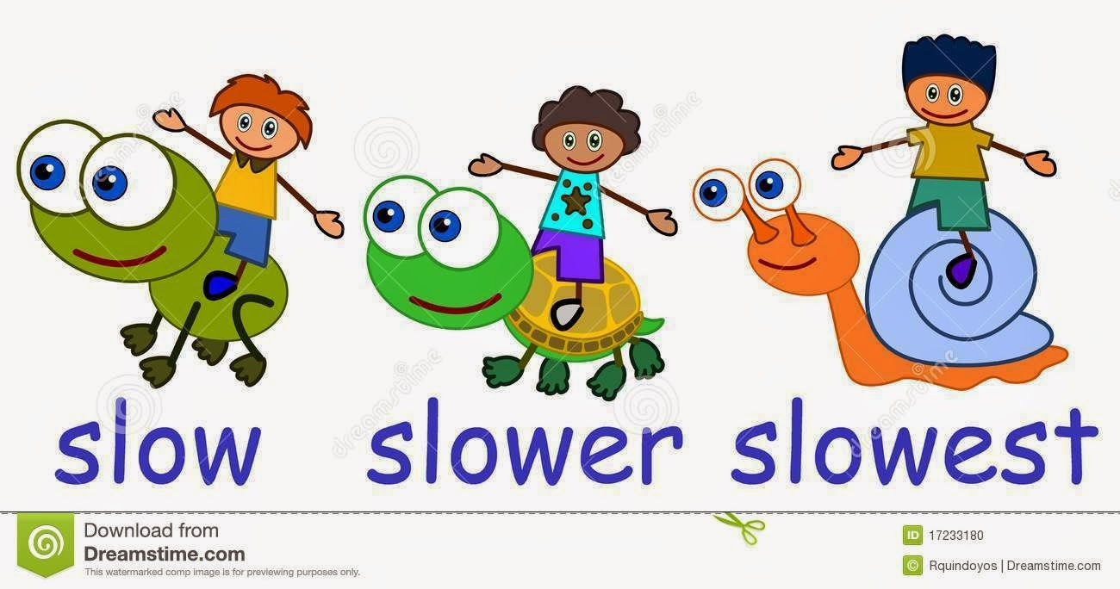
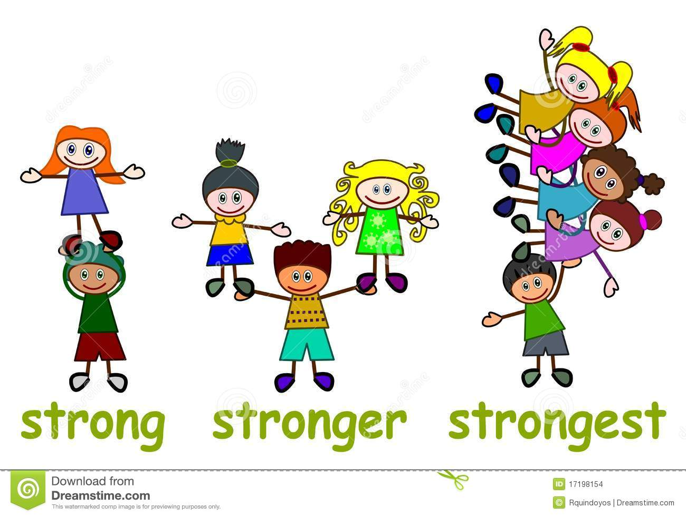
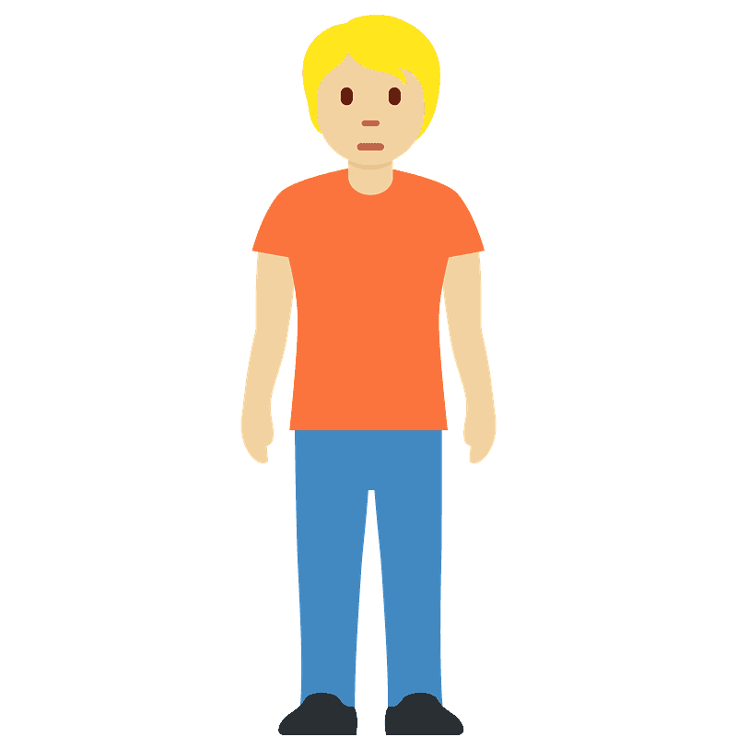
small → →
slow → →
short → →
strong → →

Slide 11
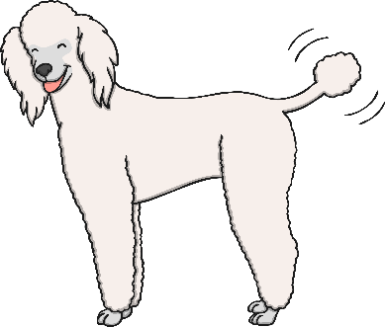
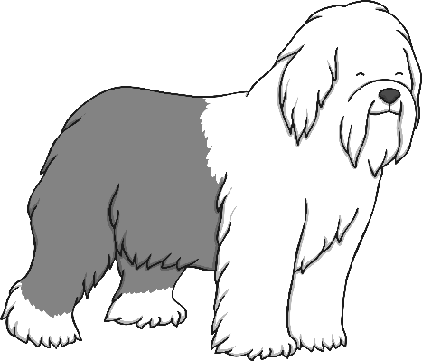
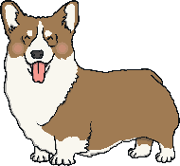
ABC . ! ?
Now make
Up your own sentence using the words from these pictures!
That’s all for today. Well done!!

Slide 12
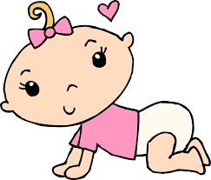
Thursday 25th February
Hello everyone! Let’s revise some more plurals.
Sometimes if a noun ends in a ‘y’ we need to chop of the ‘y’ and add ‘ies’
e.g. baby -→ babies
Can you write a list of nouns that are plurals spelt by adding ‘ies’ after chopping off the ‘y’.

Slide 13
When an adjective ends with one vowel and one consonant we need to double the final consonant before we can add the ‘er’ or ‘est’.
e.g. Big → bigger → Biggest
The ‘i’ is the vowel and ‘g’ is a consonant so we need to double the ‘g’ before we can add er/est.

Slide 14
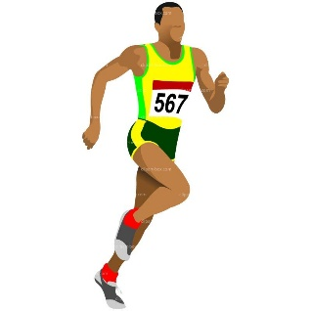
His soup is hot_____ than mine.
Athletes are the fit_____ people.
Mountains are big_____ than hills.
August has the hot____ days!

Slide 15
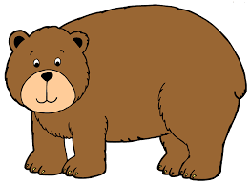
ABC . ! ?
Now make
Up your own sentence using the words from these pictures!
That’s all for today. Well done!!

Slide 16
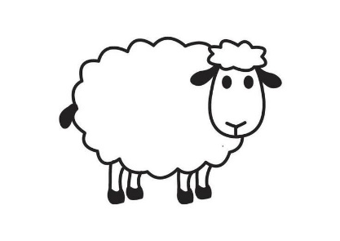
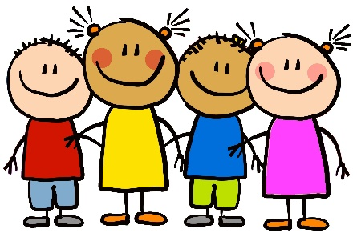
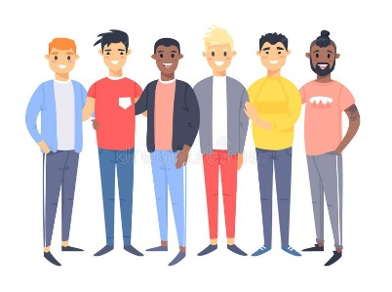
Friday 26th February
Hello everyone! Let’s revise some more plurals.
Sometimes a plural is very naughty and doesn’t follow the rules we have learnt. These are called irregular plurals.
Can you think of any unusual plurals that don’t follow the rules of adding ‘s’, ‘es’ or ‘ies’?

Slide 17
When an adjective ends with the letter ‘y’ we need to take of the ‘y’ and change it to an ‘i’ before we can add ‘er’/’est’.
e.g. happy → happier → happiest

Slide 18
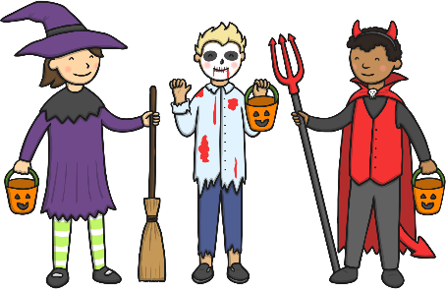
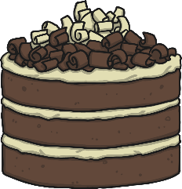
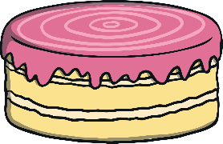
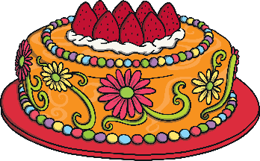
scary → →
funny → →
pretty → →
spicy → →

Slide 19
ABC . ! ?
Now make
Up your own sentence using the words from these pictures!
That’s all for today. Well done!!

Slide 20
Well done everyone! We hope you have a lovely weekend.

