Slide 1

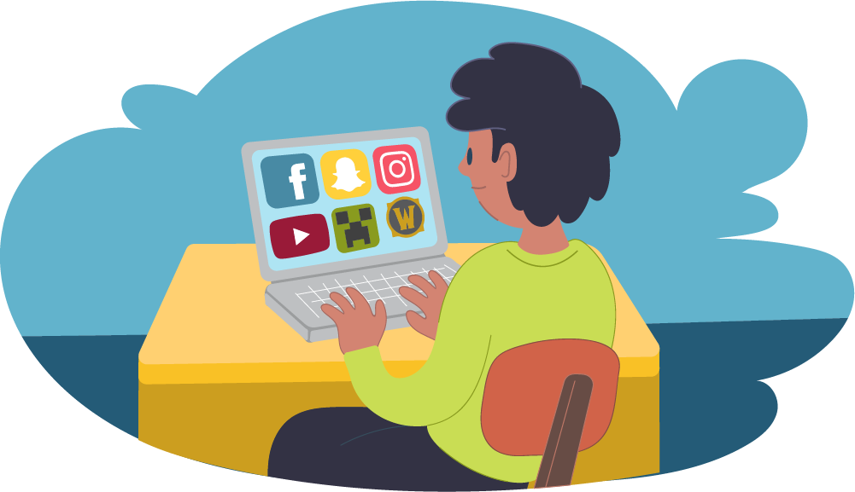
Online Internet Safety

Slide 2
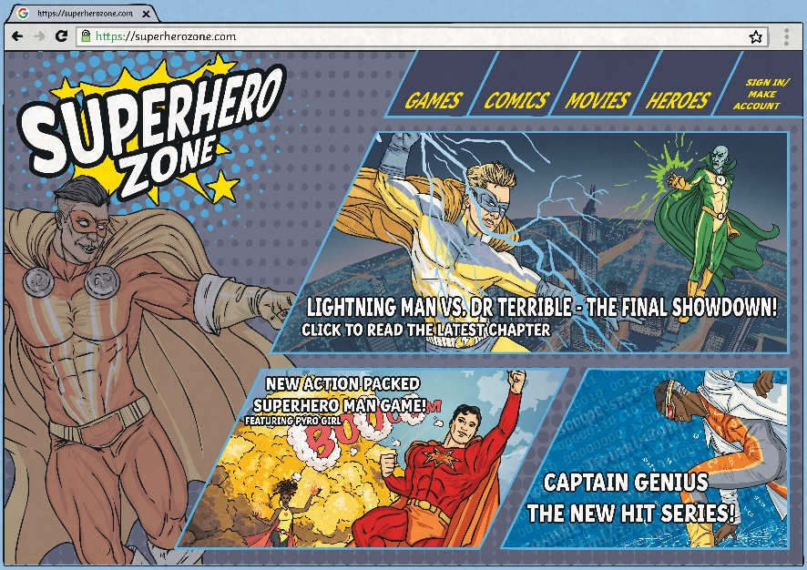
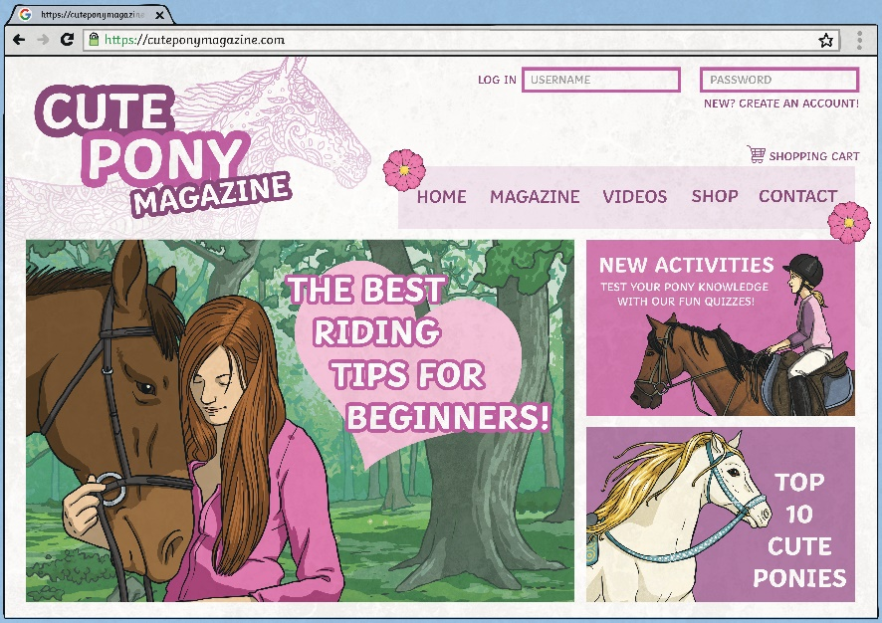
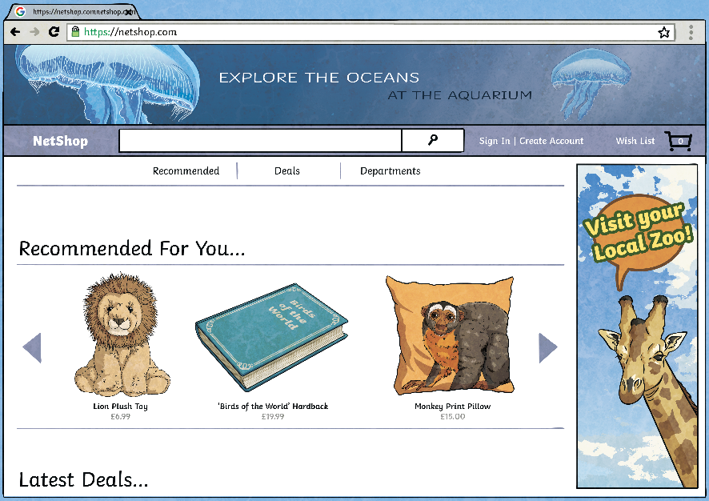
The Internet is great because…

Slide 3
















What uses the internet?

Slide 4

Your cousins live across the world,
A thousand miles away.
But thanks to WiFi, face to face,
You see them every day!

Slide 5
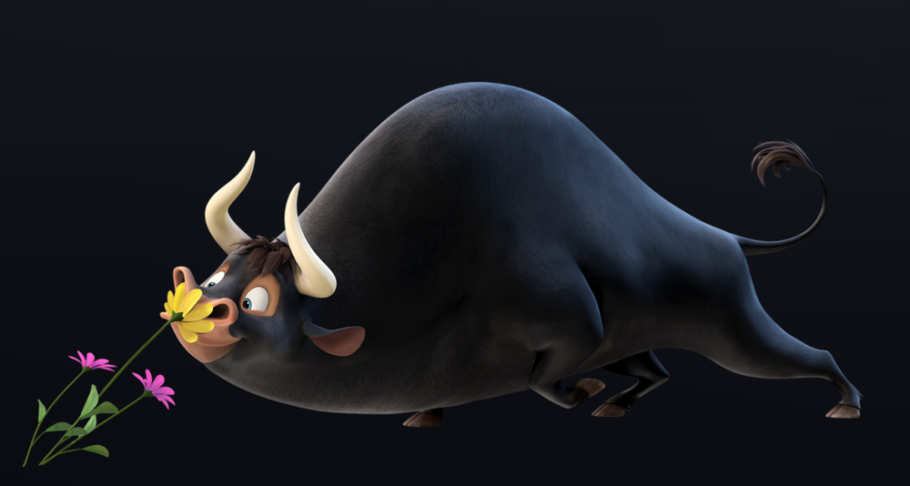
You’re off on hols, the drive is long,
To pass away the hours,
You watch a film about a bull,
Who loved to smell the flowers.
© 2017. 20th Century Fox

Slide 6
How can I enjoy games online and keep safe?
Safe
Meeting
Acceptable
Reliable
Tell

Slide 7
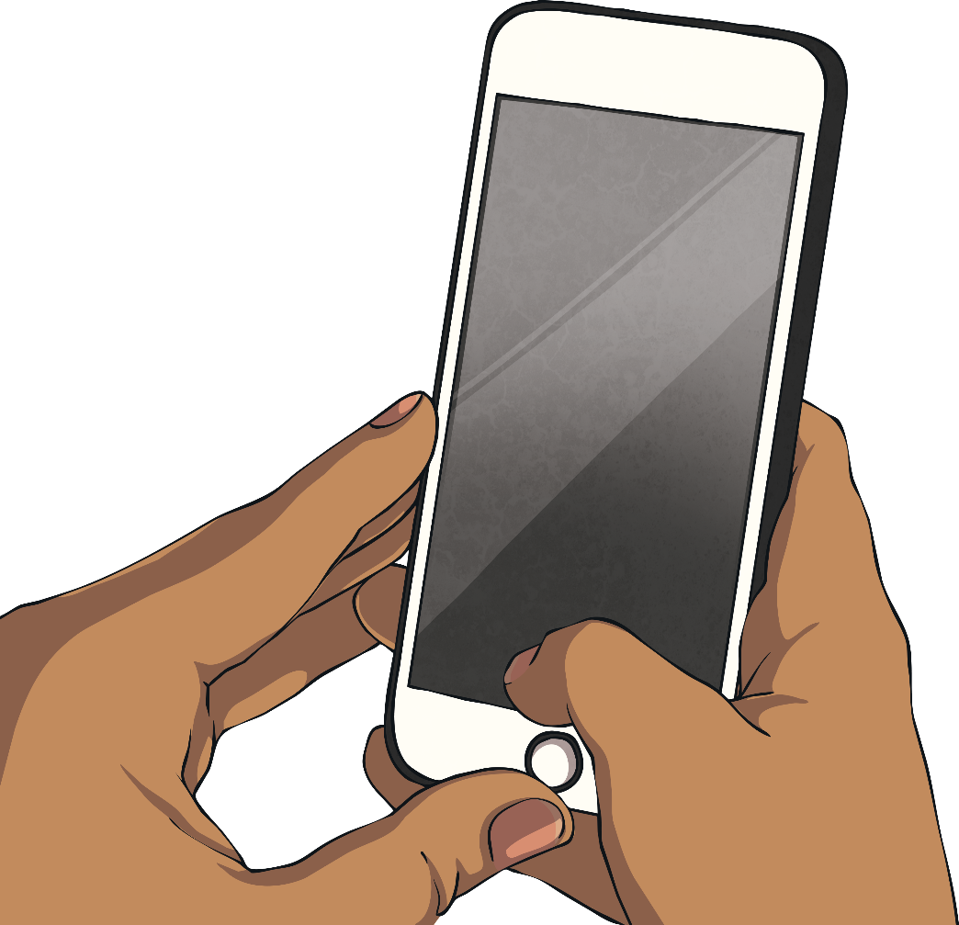
Follow the SMART rules
Keep your personal information safe!
If you wouldn’t say it to a stranger on the street, don’t share it with strangers on the internet…

Slide 8
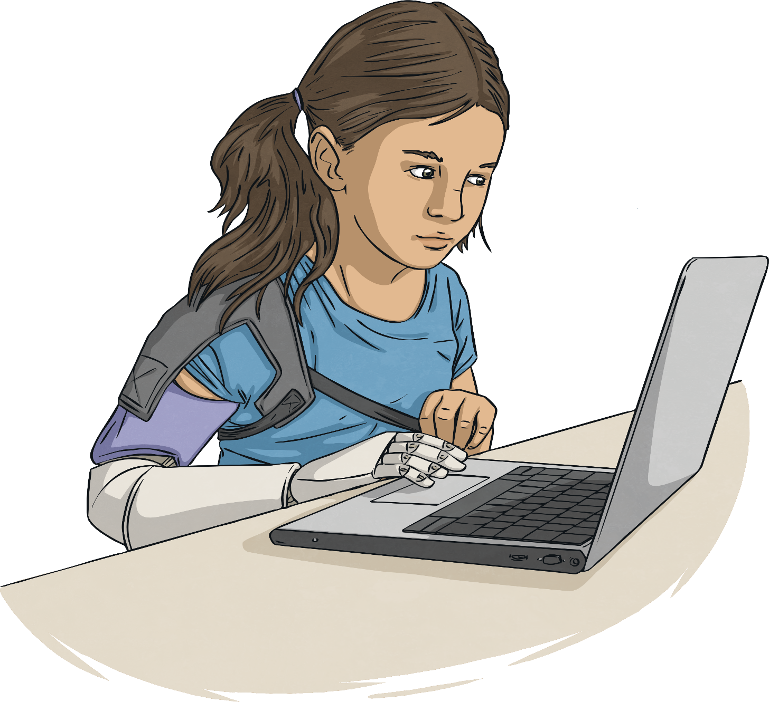
Follow the SMART rules
Don’t meet up!
Online games can be a great place for chatting to your friends. Always know who you are talking to. If an person who you don’t know ever asks you to meet up, say no and report it…

Slide 9
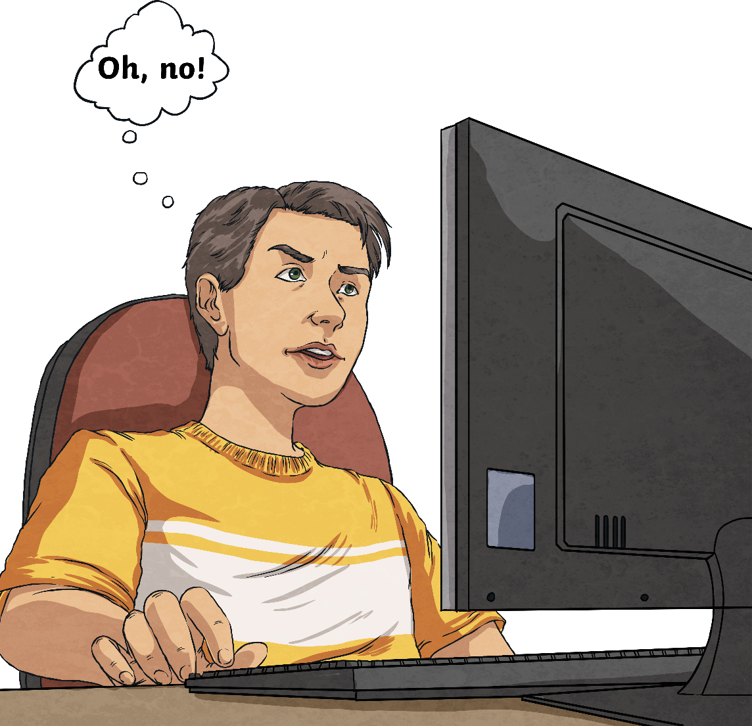
Follow the SMART rules
Accepting
Think before you accept something from someone online e.g. a file, a download, a picture etc. It may contain a virus. If you don’t know who it’s from, and it has an attachment… DELETE IT!

Slide 10
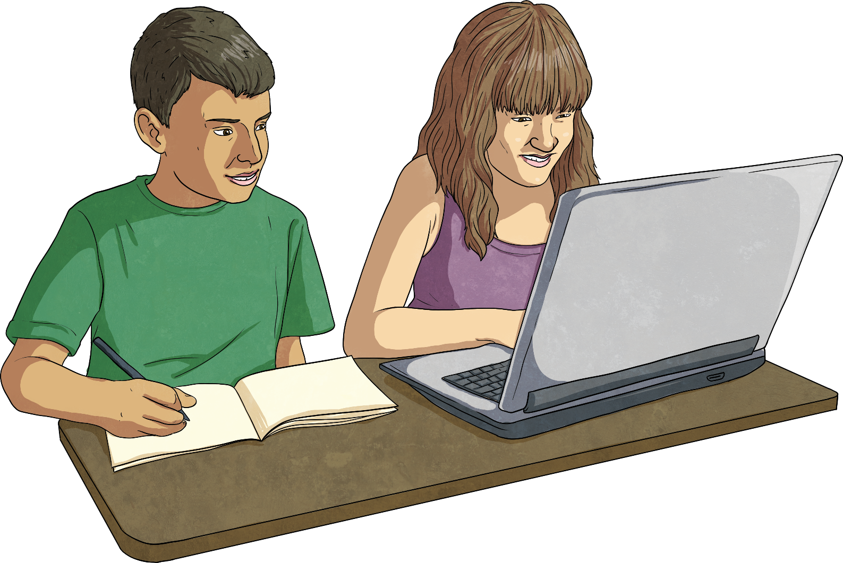
Follow the SMART rules
Reliable
Not everyone online is trustworthy. Somebody may be lying about their age and who they are. Make sure you know who you are talking to and use reputable sites and services to protect you and your computer.

Slide 11
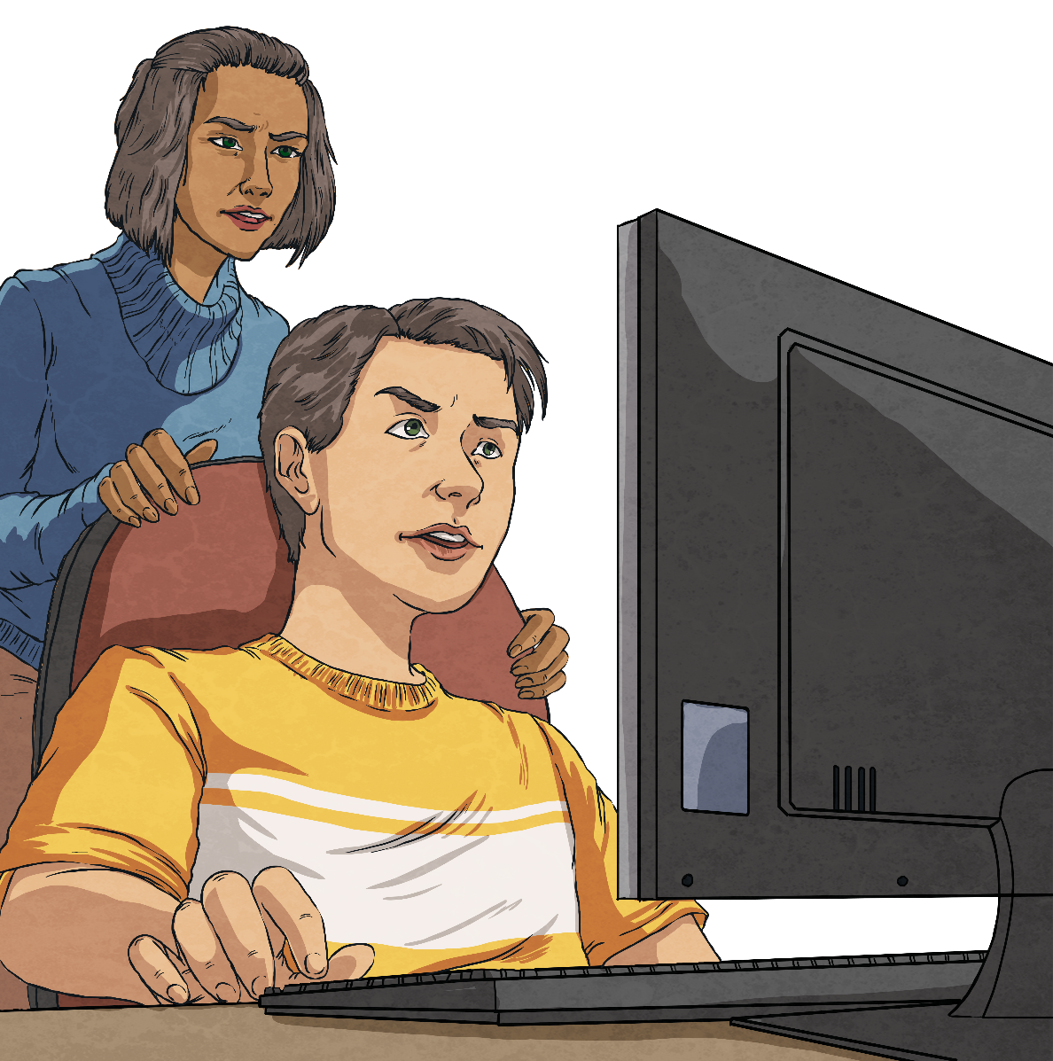
Follow the SMART rules
Tell
Tell a parent, carer or trusted adult if someone, or something makes you feel worried or uncomfortable online. Also, tell someone if a friend of yours needs help online too.

Slide 12
Which Rule Should
You Remember?
You are playing your favourite game online and one of your friends starts to be unkind to you. They use bad language during the game and begin to call you names in the messages you send to each other afterwards. You are really upset and don’t go on the website again, even though you don’t want to stop playing because you’re doing really well and getting high scores!
What should you do?
Who can you tell?
What can you do on a website if this happens?

Slide 13

Report Abuse
REPORT ABUSE
click here
The ‘report abuse’ button on a website allows children to report any suspicious individuals or threatening behaviour directly to the police, quickly and easily.
Avoid using any websites that DO NOT have this button.

Slide 14
Which Rule Should
You Remember?
You have been playing your favourite online game for 6 months and have met a new player. You often arrange to be online at the same time and regularly message each other about your scores. You’ve become good friends.
Your online buddy says they live quite close and would like to meet to play a new game that they have. You’ve not got it yet and it’s a brilliant one that you’d love to try out!
What do you say to your buddy?
Should you meet them to play the game?
Give reasons…

Slide 15
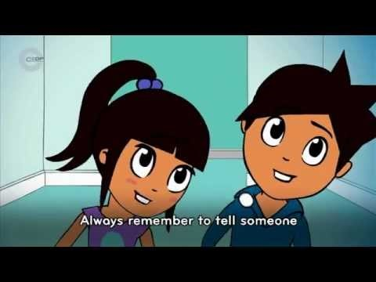
https://www.youtube.com/watch?v=-nMUbHuffO8

Slide 16
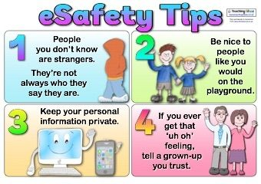

Slide 17


The internet’s a super place,
To play, to learn, to chat.
A space for us to be ourselves,
So let’s remember that.

Slide 18
Useful Websites
https://www.thinkuknow.co.uk/
www.childnet.com/

