Slide 2
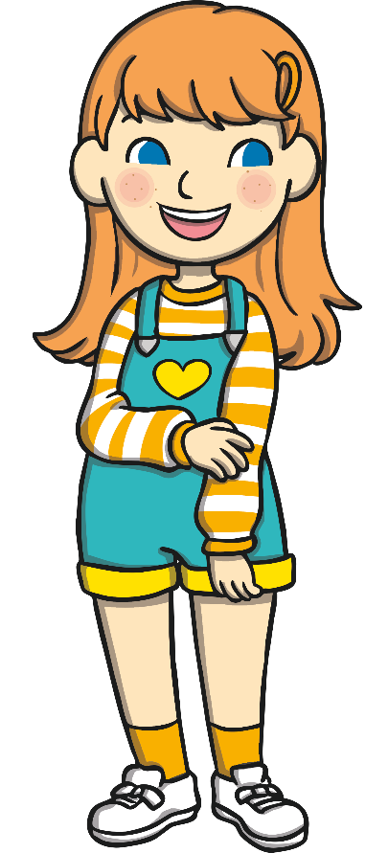
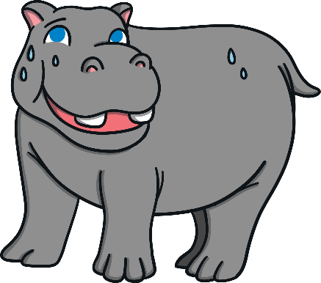
The Hope-o-potamus
The Hope-o-potamus is a rhyming story written by Greg James and Chris Smith.
It can be found inside The Book of Hopes.
Start

Slide 3
The Hope-o-potamus
In a drought, in the dust, in a dry river bed
A sad hippopotamus hung his grey head.
He’d had nothing to drink since the start of this week.
If he didn’t find water things could get quite bleak.
The hippo was sad and the hippo was hot.
But did he sit down and give in? Of course not!
He remembered the words of a wise old giraffe,
That he’d heard long ago, when he’d been a young calf:
Back
Next

Slide 4
The Hope-o-potamus
‘There’ll be times in your life when your road will be tough.
You’ll be tempted to say that you’ve had quite enough.
‘There’ll be people that try and convince you to stop,
And you’ll feel that you’re just about ready to drop.
But those are the times when you’ve got to keep moving,
And with every small step you will see things improving.
Just point any way that seems hopeful to you,
You move one foot forwards, then foot number two.
Back
Next

Slide 5
The Hope-o-potamus
Then follow this up with your other two feet,
Then return to foot one, and repeat and repeat.
Remember these words,’ said the wise old giraffe,
To our hero the hippo, when he was a calf.
So the hippopotamus nodded his head.
‘I’ll keep plodding and see where I get to,’ he said,
And he look all around at the arid terrain,
And thought, ‘Will I ever find water again?’
Back
Next

Slide 6
The Hope-o-potamus
Ahead, a high mountain rose up in the distance.
It looked rocky and steep, but with hippo-persistence,
He decided he’d walk it ‘til he had overcome it,
In case there were better things over the summit.
First he came to a desert, which wasn’t too handy.
It was hard to walk through, rather slippy and sandy.
A camel was sitting on top of a dune,
And it told the hippo, ‘You absolute loon!
Back
Next

Slide 7
The Hope-o-potamus
Turn around! Go back! Or you’ll look like a chump.
There’s no water this way, except this in my hump.’
But the hippopotamus shook his head.
‘Just a bit further,’ he boldly said.
One step at a time he continued his journey,
Till he came to a jungle – dark, dank, green and ferny.
The jungle was thick and the creepers were creepy,
And a large sloth hung down from a branch looking sleepy.
Back
Next

Slide 8
The Hope-o-potamus
‘This forest… it goes on for miles,’ he said, yawning,
‘Why don’t you just hang here with me till the morning?’
The hippo – though tempted – again shook his head.
‘Just a bit further,’ he bravely said.
He plunged on through the jungle, and after a while
He arrived at the mountain – the ultimate trial.
Poor hippo was tired, almost giving up hope.
But – one step at a time – he pushed on up the slope.
Back
Next

Slide 9
The Hope-o-potamus
The mountain was rocky and strewn with huge boulders;
Then stones hurt his feet and the sun scorched his shoulders.
A lion sat there on a rocky outcropping,
And the lion called out, ‘You’re much better off stopping.’
But the hippopotamus shook his head.
‘Just a bit further,’ he proudly said.
His heart was so heavy, his feet were so sore,
But he climbed and he climbed – one step, then one step more.
Back
Next

Slide 10
The Hope-o-potamus
And, just when he was feeling ready to drop,
He finally realised that he’d reached the top.
And a splendid sight met his eyes when he looked down:
A wide muddy waterhole, gleaming and brown.
He could see lots of sploshing – someone was there bathing.
A hippo! A friend! And they seemed to be waving.
And the hippopotamus nodded his head.
‘I’m glad that I chose to keep going,’ he said.
Back
Next

Slide 11
The Hope-o-potamus
Then a voice from behind him called out, ‘We were wrong!’
The lion, sloth and camel had followed along.
And the animals cried, ‘You’re more brave than the lot of us.
Hip hip hooray for the hope-o-potamus!’
Back
Next

Slide 12
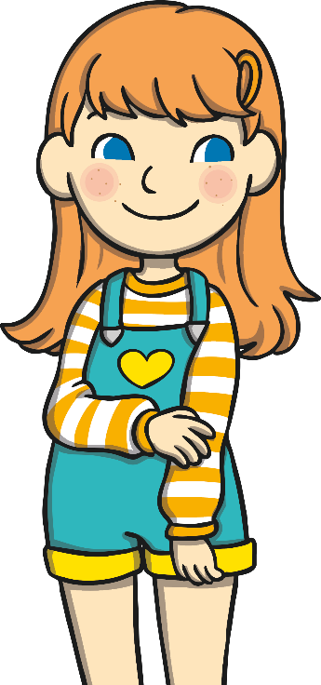
Hippo-Persistence
?
?
?
In the rhyming story, the hope-o-potamus never gives up.
Can you think of a time when you didn’t give up?
Back
Next

Slide 13
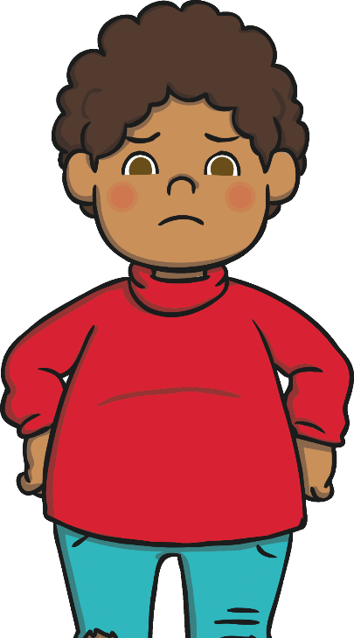
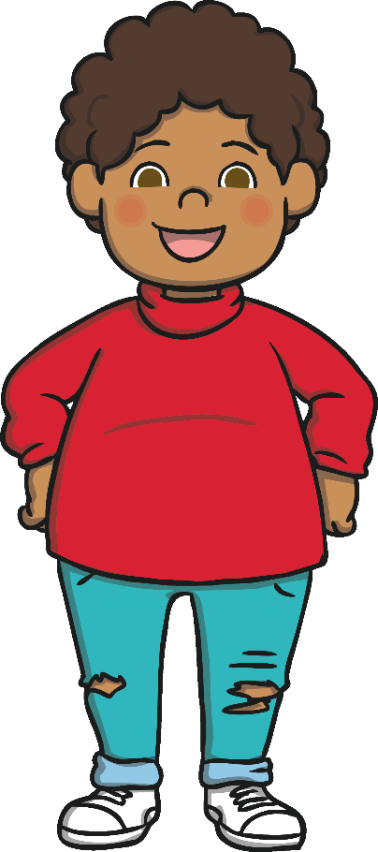
Giving Encouragement
?
?
?
In the rhyming story, the hope-o-potamus meets lots of animals who tell him to give up.
What would you have said to the
hope-o-potamus to help him not to give up?
Back
Next

Slide 14
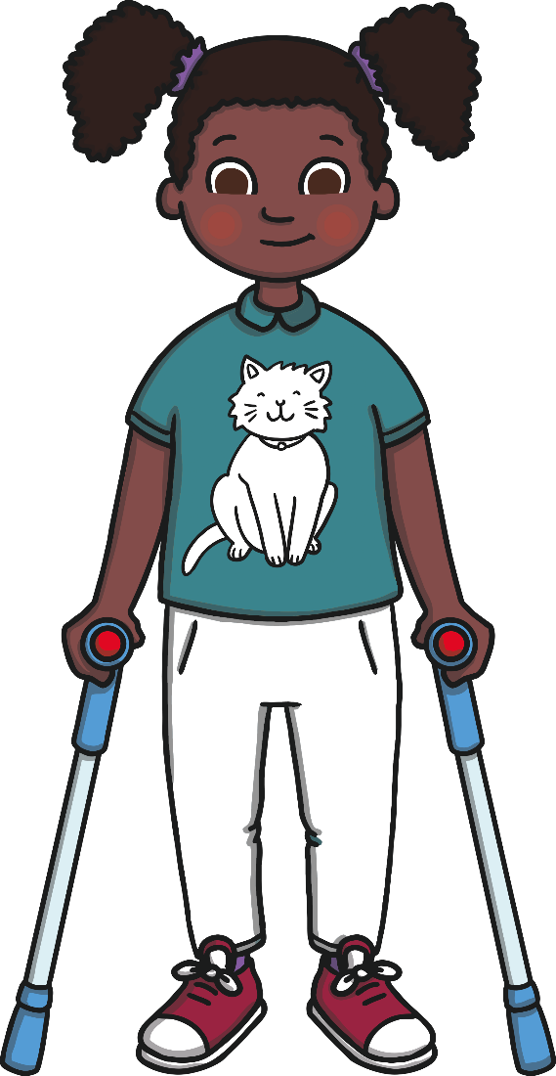
Becoming a Hope-o-potamus
Sometimes, when things are difficult,
you might feel like giving up.
However, just like the hope-o-potamus,
it’s important to keep trying.
Next time you feel like giving up,
try becoming a hope-o-potamus!
Back
Next

Slide 15
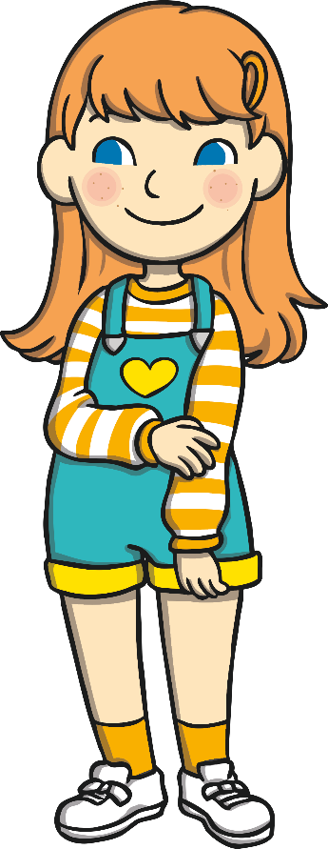
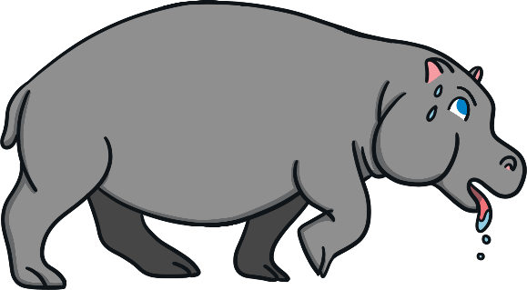
Being a Good Friend
If your friend is about to give up, what could you say to them to help them to become a hope-o-potamus?
You’ll be so proud of yourself when you finish.
You’ve
got this!
How can I help you?
I know you
can do this.
Don’t
give up!
Be a
hope-o-potamus!
Back
Next

Slide 16
The Book of Hopes
To read more amazing stories, exciting extracts or to see some fantastic illustrations from The Book of Hopes, click here.
Back

