Slide 1
Monday 18th January
We hope everyone has had a lovely weekend.
This PowerPoint is going to include each day’s phonics and grammar activities. This will make sure we are practising our spelling and grammar rules whilst you are working at home. You will need a pen/pencil and a piece of paper.

Slide 2
Let’s start!
Can you remember what nouns are?
Nouns are the names of people, places or things.
Time for quick write!
Look around the room. Can you write a list of nouns you can see? You have two minutes!

Slide 3
Now we will practise this weeks common exception words (CEW).
Reveal the words
one by one. Look/write/check.
hold
whole
half
Well done all of you!!
If you already know your Year 2 CEW look for the Super Spelling Challenge on the
website and practise 6 x words a week. We have some fantastic new badges
for when you come back to school!

Slide 4
This week we are going to focus on making the ‘or’ sound in alternative ways. Some of them will be familiar and some are new!
What do you notice about these words. What sound can you hear in each of them?
horn Autumn claw haunted lawn morning
These words all have the ‘or’ sound spelt with the or/au/aw digraphs.

Slide 5
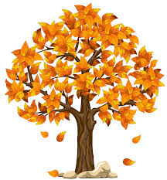
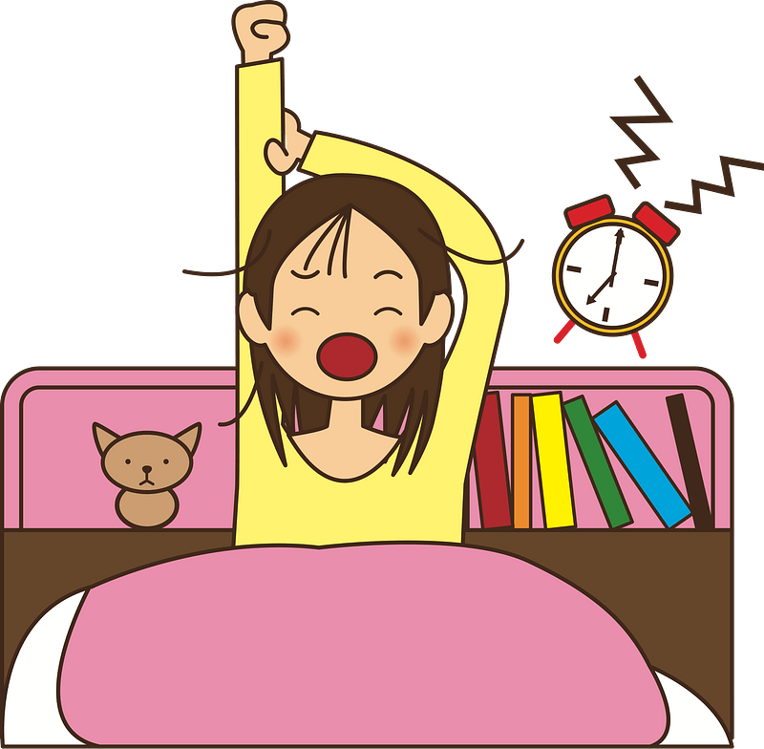
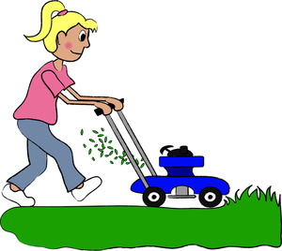
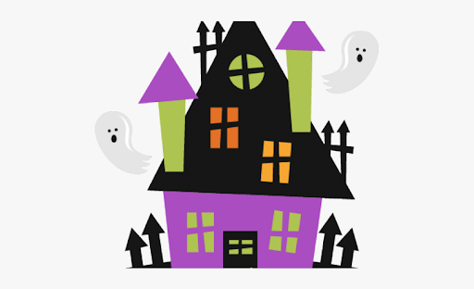
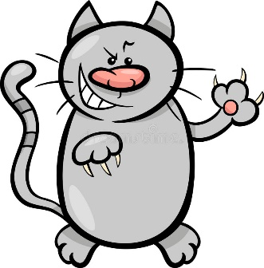
Can you spell the missing word?
________________ is the season when the leaves change colour.
I like to beep the ______________ in my car.
I have to get up early in the _______________ when I go to school.
My cat has very sharp ________________ on its feet.
The ________________ house is very scary!
We need to cut the grass on the _______________.
Well done everyone!

Slide 6
ABC . ! ?
Now make
Up your own sentence using the words from these pictures!
That’s all for today. Well done!!

Slide 7
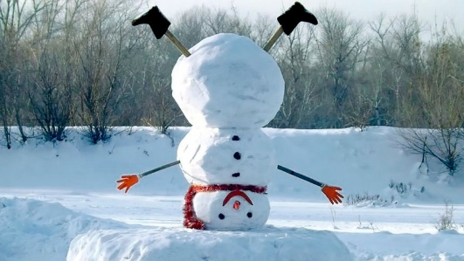
Tuesday 19th January
Hello everyone! Can you remember what adjectives are?
Adjectives are describing words. They add more detail to a noun.
Time for quick write!
Look at your list of nouns from yesterday. Can you add an adjective to each of the nouns? You have 2 minutes!

Slide 8
Now have a go at practising this weeks CEW. Remember there are 3 of them (or practise your super spellings).
Go back to slide 3 to check.

Slide 9
Today we will be learning a new way to make the ‘or’ sound.
Look at these words and see if you can spot the spelling pattern:
Warm wardrobe towards swarm reward warden
The ‘or’ sound is made with an ‘ar’ digraph after the 'w’.

Slide 10
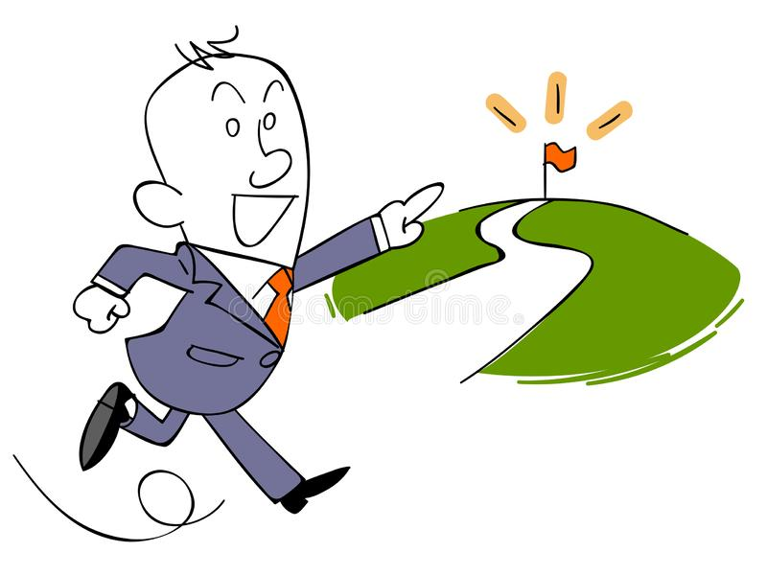
Can you write the correct spelling for each of the pictures? Remember to use ‘ar’ after the ‘w’.

Slide 11
Wednesday 20th January
Hello everyone! Today’s activity is writing silly sentences using some of the spelling rules we have learnt this week. We would like you to write your sentences very neatly with clear ascenders and descenders and the rest of the letters the same size. Please ask a grown up to read the sentences to you. You will need your paper and pencil.
In Autumn the cats scratch their claws in the morning.
The swarm of bees were warm flying towards the hive.
Please hold the whole cake so I can cut it in half.
Well done!

Slide 12
Thursday 21st January
Hello everyone! Can you remember what verbs are?
Verbs are doing words. They tell you what someone or something is doing.
Time for quick write!
You have teo minutes to write down a list of as many verbs as you can think of.
Try to do each verb as you write it e.g. sing (sing once you have written it on your list!)

Slide 13
Quickly write your CEW words?
Well done!!!

Slide 14
Today we are going to recap using ‘ar’ after ‘w’ to make an ‘or’ sound in a word.
What words can you remember from Tuesday’s lesson?
Warm wardrobe towards swarm
reward warden

Slide 15
Can you write these sentences and spell the missing word?
Bees like to fly in a _________________.
The ________________ is in charge of the jail.
We get lots of _____________________ for working hard in school.
In the summer the weather is very _________________.
You need to run ________________ the finish line in the race.
I hang up my clothes in the ____________________.
Well done everyone!

Slide 16
ABC . ! ?
Now make
Up your own sentence using the words from these pictures!
That’s all for today. Well done!!

Slide 17
Friday 22nd January
Hello everyone! Can you remember what adverbs are?
Adverbs describe how you do something. They add more detail to a verb. E.g. sing loudly or run quickly.
Time for quick write!
Look at your list of verbs from yesterday. Can you add an adverb to each of the verbs? You have 2 minutes!

Slide 18
Today we are going to sort these words into the correct columns based on their spelling.
or | au | aw | w- ar
thorn wardrobe chore August
straw born drawing warm
Autumn morning claw award

Slide 19
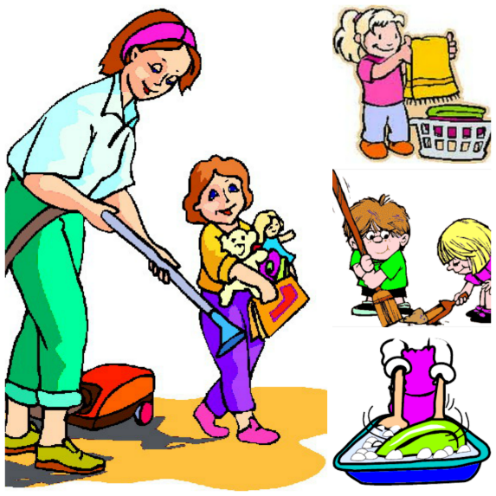
Now let’s practise spelling some of the words we have learnt this week in a sentence! Please write a sentence for each picture below. Remember to think carefully about which ‘or’ digraph to use!
Well done everyone! We hope you have a lovely weekend.

