Slide 1
Welcome to Perryfields Infant School

Slide 2
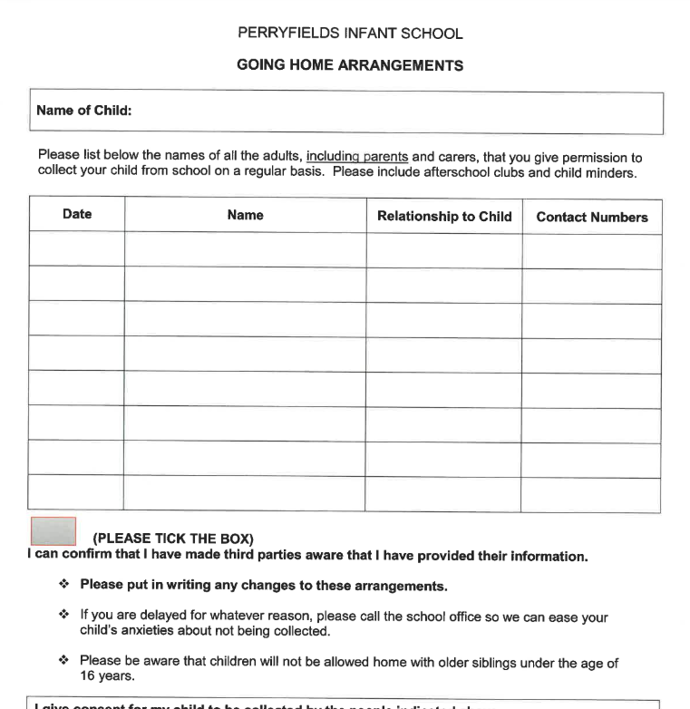
Please ensure you have:
Completed the Going Home Arrangements form
Given your child's birth certificate to the office to copy
Given a utility bill/Council Tax bill to the office to copy
(proof of address)

Slide 3
Free School Meal Eligibility
All new parents/carers are given information regarding applying for FSM. Historically schools have sent a pupil premium eligibility form asking parents to give consent for us to check their status for eligibility for FSM and PPG. Over the last couple of years, we have all moved from either using Essex CC or Southend Council to perform these checks and now use London Grid for Learning (LGFL). The check with LGFL can be done by the parent (or school if we have consent), gives instant results and are free.
Parents who are in receipt of certain benefits may be entitled to Free School Meals. It is important that parents register their children for free school meals if they are entitled as the school receives additional funding known as the Pupil Premium to support the children’s learning.
Your child may be able to get free school meals (in the junior school), additional educational support for English and Maths and financial support with trips, uniform etc if you get any of the following:

Slide 4
Income Support
income-based Jobseeker’s Allowance
income-related Employment and Support Allowance
support under Part VI of the Immigration and Asylum Act 1999
the guaranteed element of Pension Credit
Child Tax Credit (provided you’re not also entitled to Working Tax Credit and have an annual gross income of no more than £16,190)
Working Tax Credit run-on - paid for 4 weeks after you stop qualifying for Working Tax Credit
Universal Credit - if you apply on or after 1 April 2018 your household income must be less than £7,400 a year (after tax and not including any benefits you get)
Children who get paid these benefits directly, instead of through a parent or guardian, can also get free school meals.

Slide 5
The use of the pupil premium is personalised to meet the needs of the children who are entitled to support, such as 1-1 tuition, additional LSA support and intervention groups, access to school visits, Learning Mentor, speech and language assistants, Family Support and Counselling. Also, this funding can support HAF holiday clubs and you can be eligible for free places.

Slide 6
All Reception and Key Stage 1 children do receive Universal Free School Meals, but we are required to identify those children who would have a statutory entitlement to Free School Meals/Pupil Premium.
We will then be able to confirm whether the school is able to claim the Pupil Premium Funding for your child. I have attached details of how you can check your child’s eligibility for Free School Meals.
If you think that you are eligible then please send a copy of the certificate that can be printed at the end of the process to myself at admin@perryfields-inf.essex.sch.uk.
If you require any further information please contact the main school office on 01245 268 714.

Slide 7
Hot School Dinners

Slide 8
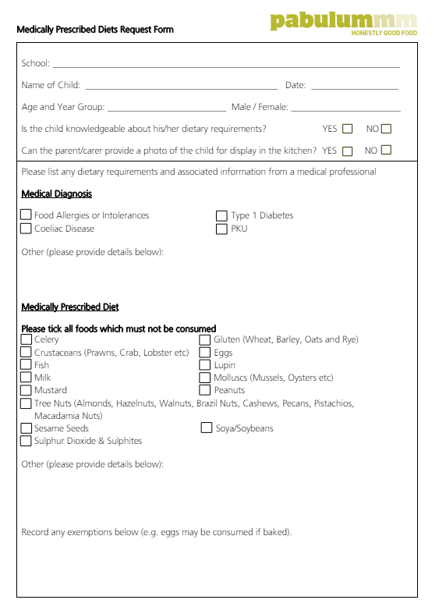

Slide 9
How to order hot school meals
Go to Parent Information
Click on Hot Lunches

Slide 10
Click on the top link to place order

Slide 11
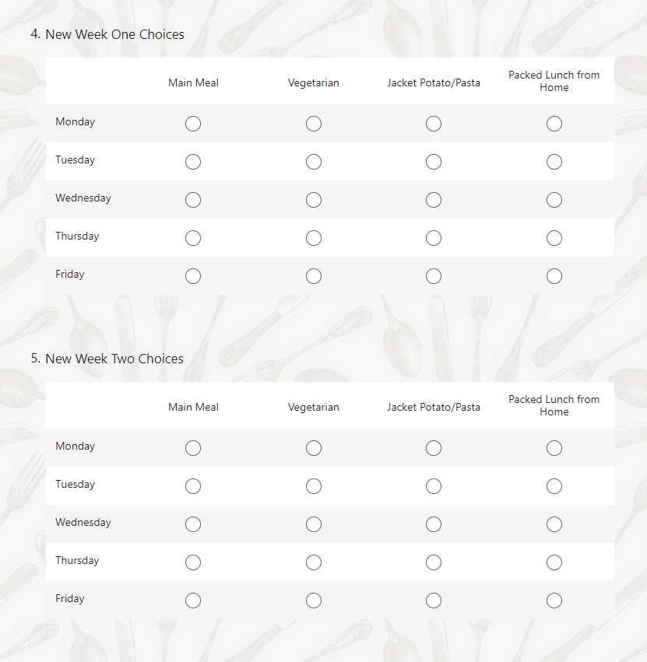

Slide 12
Allergies

Slide 13
Medical Diet Request Form

Slide 14
Open Afternoon
Thursday 11th July
3:30pm – 5:00pm
Come and visit both Infant and Junior schools. Look at your new classrooms and maybe see your new teacher.
Another opportunity to visit.

