Slide 1
Welcome to Foundation Stage
Ruby Class and
Topaz Class

Slide 2
Meet the team…
Class Teacher’s
Miss Williams and Mrs Lovett
LSA’s
Mrs Pope and Mrs Patel
Wednesday Afternoon:
Music with Mrs White
PE with Mrs Bowen
PE with Mr Bowen (Thursday afternoon)

Slide 3
Our Daily Routine
Register and Zones of Regulation
Dough disco and Phonics
Morning Session 1 – adult directed activity (literacy/maths) discovery time (indoors and outdoors)
Milk/Playtime / snack/ story
Morning session 2 - adult directed activity (literacy/maths) discovery time (indoors and outdoors) continued
Lunch
Maths session
Afternoon session – individual reading, adult directed activity (topic), discovery time
Story time
Home

Slide 4
The Curriculum
Cross curricular and topic based approach.
Literacy, phonics, reading and maths every day.
ICT suite every week and access to iPads.
PE twice a week – currently Monday and Thursday.
Please remove earrings before PE days – we are not allowed to tape over anymore.

Slide 5
Reading
Decodable book, shared reading book, Little book of sounds and Tricky word keyring.
Please record a comment when you hear your child read. Useful things to mention are sound recognition, tricky words, blending, engagement and enjoyment with the book.
Weekly whole school reading competition.

Slide 6
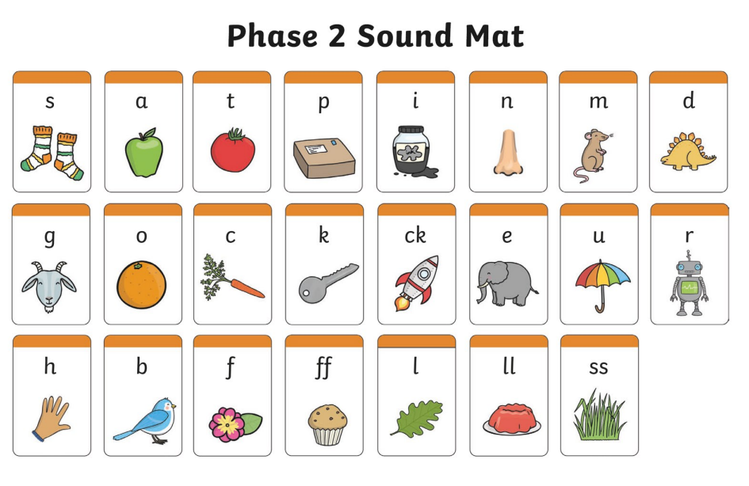
Phonics
The children will begin to learn the first 26 letter sounds. We will also learn a number of tricky words which the children will need to recognise by sight.
Each letter sound has a song and an action which the children enjoy learning. Please encourage them to teach you and sing along at home!
Please check the newsletter as this will tell you which sounds we are focusing on for the week.

Slide 7
Writing
We use print font for our handwriting in reception. This has changed from last year as we previously used cursive script.

Slide 8
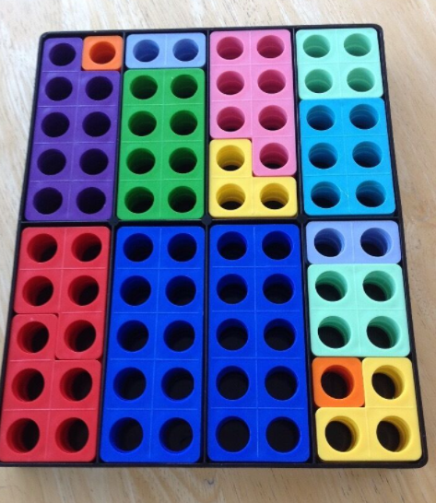
Maths
We follow the White Rose maths scheme
We teach the children in a practical way using a range of resources such as:
Numicon
Number Blocks
Counting apparatus
Natural resources
We like to extend our maths by using the outside area or by active learning e.g. body counting

Slide 9
Foundation expectations
Encouraging greater independence e.g. looking after their own belongings.
Morning – wait sensibly in playground (No adventure playground)
Bring in correct equipment (coat, hat, water bottle, book bag)
Remembering to take all of their items home at the end of the day.
Following the classroom and school rules.

Slide 10
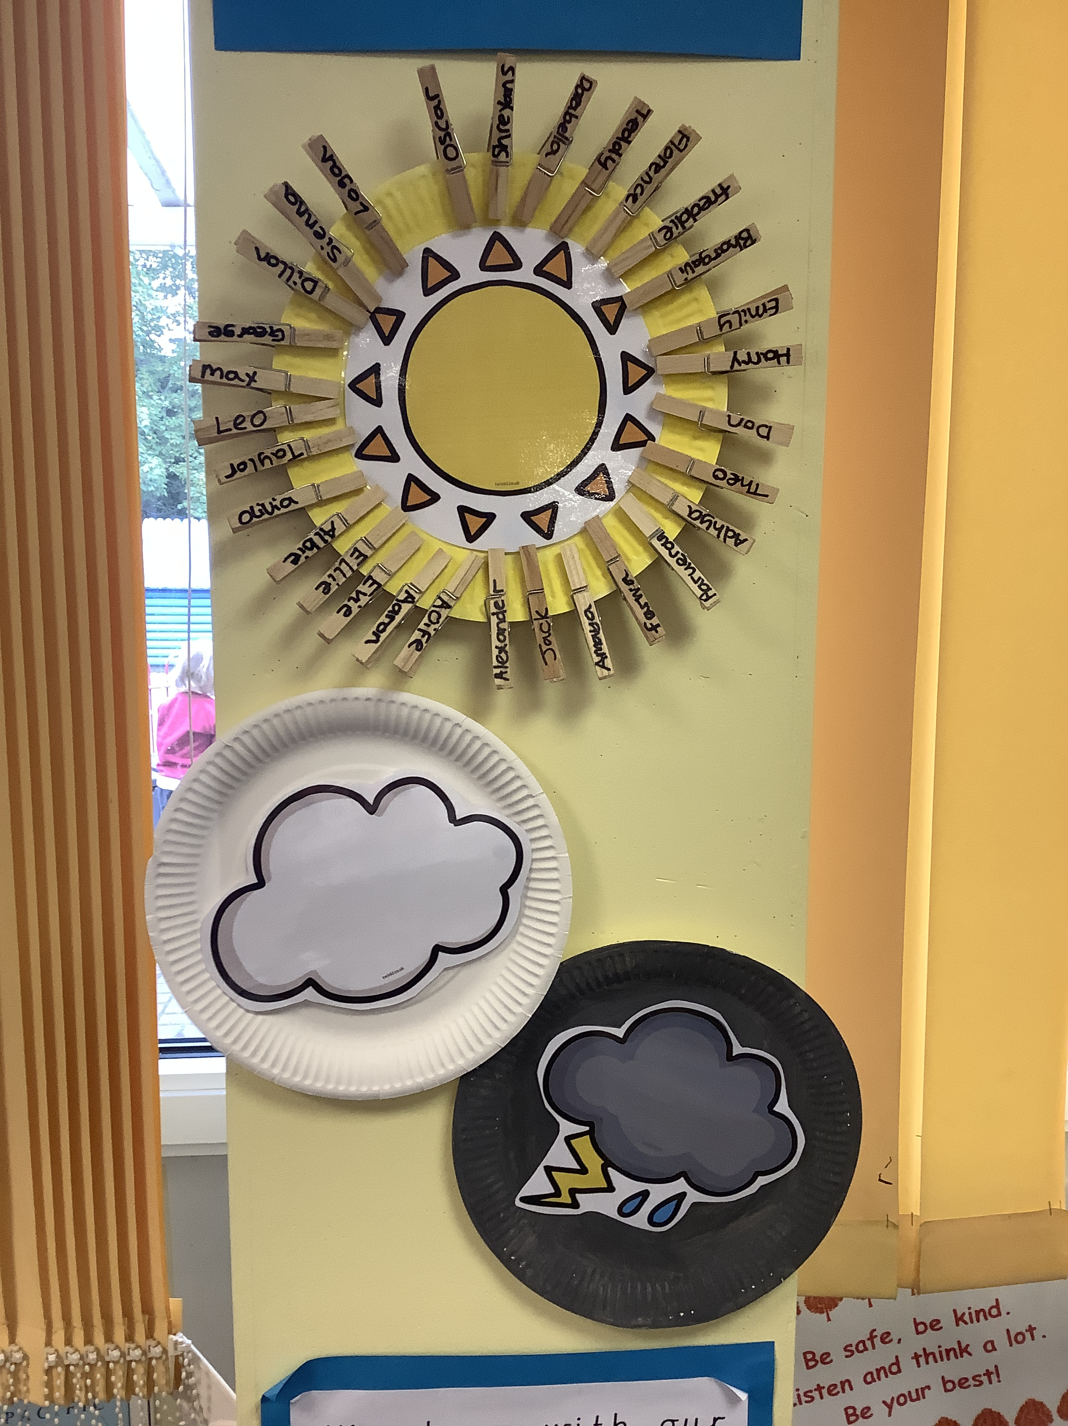
Behaviour
Each class has a set of golden rules. We use a sun/cloud and rain behaviour system.
Positive strategies are used, such as star of the day and week, stickers, lunch time awards and top trophy.
We expect the children to look after the resources and each other.

Slide 11
Homework
Set on Friday and due in on the following Wednesday, this will include handwriting practise a maths activity, or a topic related project
Reading 5 times a week where possible please
Letter sound recognition practise
Tricky word recognition
Name writing practise

Slide 12
Sources of General information
If you have any worries or concern please speak to us after school. You can also make an appointment.
Parents evening Tuesday 1st November and Thursday 3rd November
Weekly Foundation stage newsletter.
Perryfields post
School website
Please label school uniform
Bring in a water bottle every day
Please try to check book bags daily for any letters

Slide 13
Any questions?

