Slide 1
What is a digraph?
A digraph is 2 letters that make 1 sound.
There are a few consonant digraphs:
ch sh th ng qu
wh ph kn

Slide 2
Let’s revise some vowel digraphs
ai ee oa oo
or ur ar oi

Slide 3
Can you read these?
ay ea ie oe
aw ue oy er

Slide 4
A few more!
a-e e-e i-e o-e
ew u-e ey ir

Slide 5
What is a trigraph?
3 letters that make one sound.
What does this one say?
air
So when you see ai, check to see if it is followed by –r, because that will change the sound!

Slide 6
Spot whether these are “ai” or “air” when you read them…
pain pair
fair faint
chain chair
stair stain

Slide 7
What does this trigraph say?
ear
So when you see ea, you also need to check whether it is followed by –r!

Slide 8
Spot whether these are “ea” or “ear” when you read them…
hear heat
feast fear
dear deal
neat near

Slide 9
Can you spot them in alien words too?
strair trear glaips
brean earkots zearpom
ormwair baiv thairtog
Choose 3 words and add sound buttons!

Slide 10
Find the missing “air” or “ear” word!
chair
Ben sat on a huge wooden _____.
My birthday is on the same day each ____.
Sally ran up the ____ two at a time.
You start a letter with the word ____.
If you are too quiet, I will not ____.
I like to eat candyfloss at the ____.
year
stairs
dear
hear
fair

Slide 11
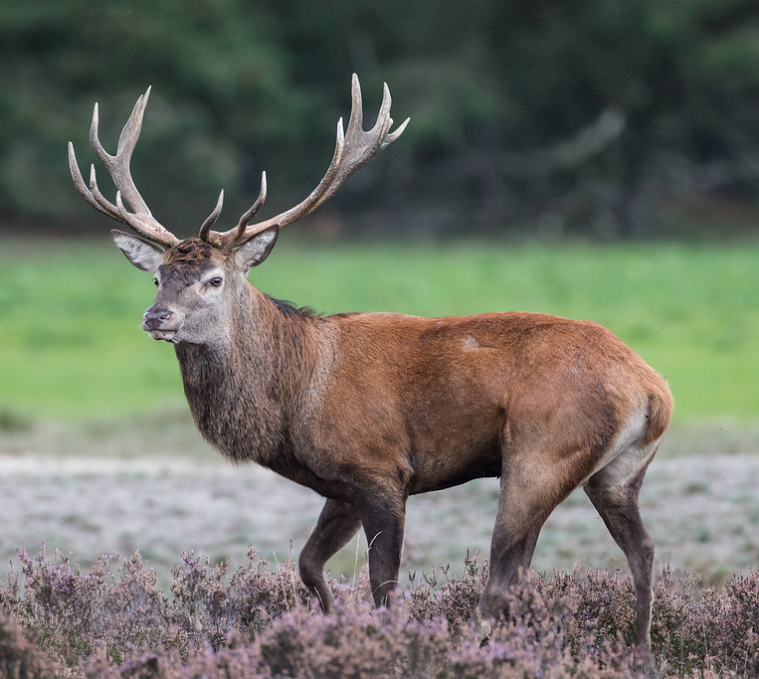
Did you know there are other ways to spell “air” and “ear”?
Some words with the “air” sound are spelled with the letters “are”
spare, care, hare
Some words with the “ear” sound are spelled with the letters “eer”.
beer, cheer, deer

Slide 12
Let’s play Best Guess
chair chare
dair dare
hair hare
chears cheers
fear feer
dear deer

