Slide 1
Start of by practising these words:
hour
minute
before
after
Look closely at how many letters and think about why the words are tricky. Then try to spell them without looking…

Slide 2
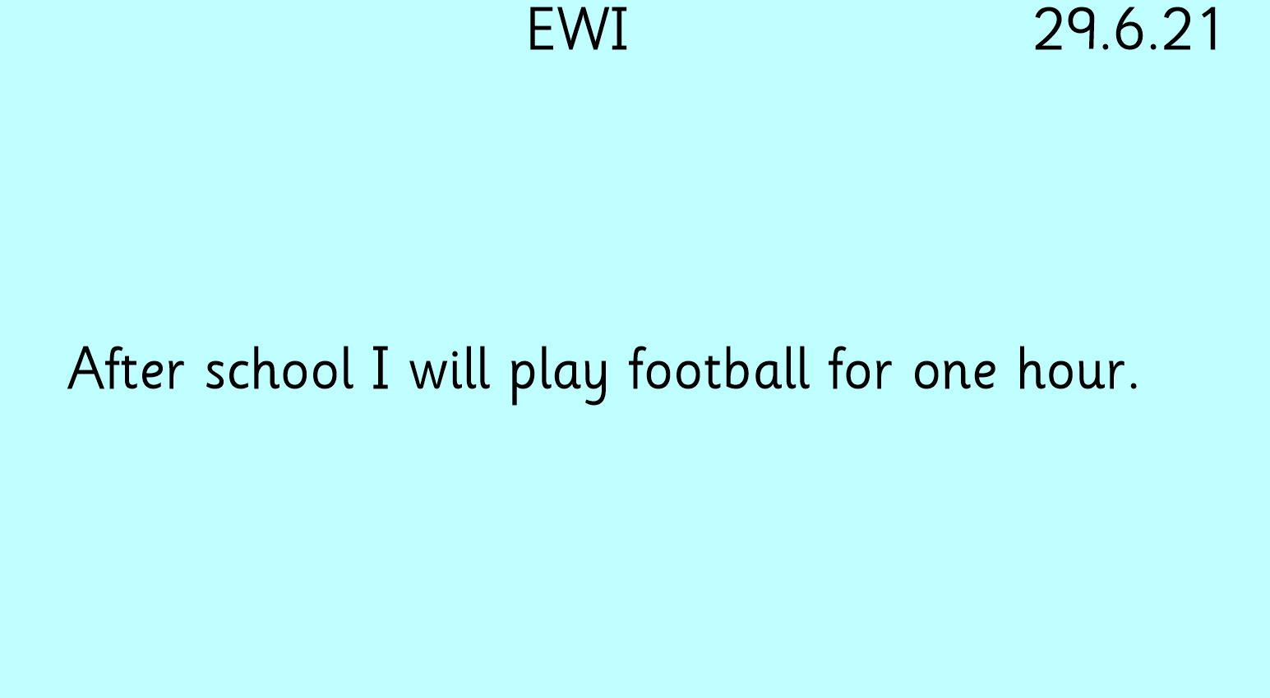
Read it, say it in funny voices, count the words, notice the punctuation.
Then try to write it without looking.
*Challenge: continue with another sentence about what else you like to do. Maybe you can use the word “also”.

