Slide 1
Where have you seen these words before?
move
she
They are tricky words!
come
house
me
of
some
floor
Make sure you read these correctly. Then you have 1 minute to study them before we have a memory test!

Slide 2
How many did you get?
move
she
come
house
me
of
some
floor

Slide 3
This week, we have learnt about the split digraph o-e.
We also remembered that the digraphs oa and oe make the same sound.
BUT!!
There is another sneaky spelling with the same sound.
?
oa oe
o-e

Slide 4
ow
Our other spelling is…
We already know this spelling for the word ‘cow’ and ‘now’ – the same sound as ‘ou’.
But this grapheme is sneaky and has ANOTHER sound…the same sound as oe, o-e and oa.
For example:
show
low
Geraldine can help with this sound here: https://www.youtube.com/watch?v=WPtNBSfCkJA

Slide 5
Have a look at these words and see if you can read them correctly.
show
low
glow
row
blow
slow
grow
snow
window

Slide 6
Check these words and decide which have the correct spelling. Should it be oa, oe, o-e or ow?
loe
low
aloan
alone
shoa
show
Don’t forget the sound does not change!
toa toe
stoan
stone
bone boan
note noat
grown groan

Slide 7
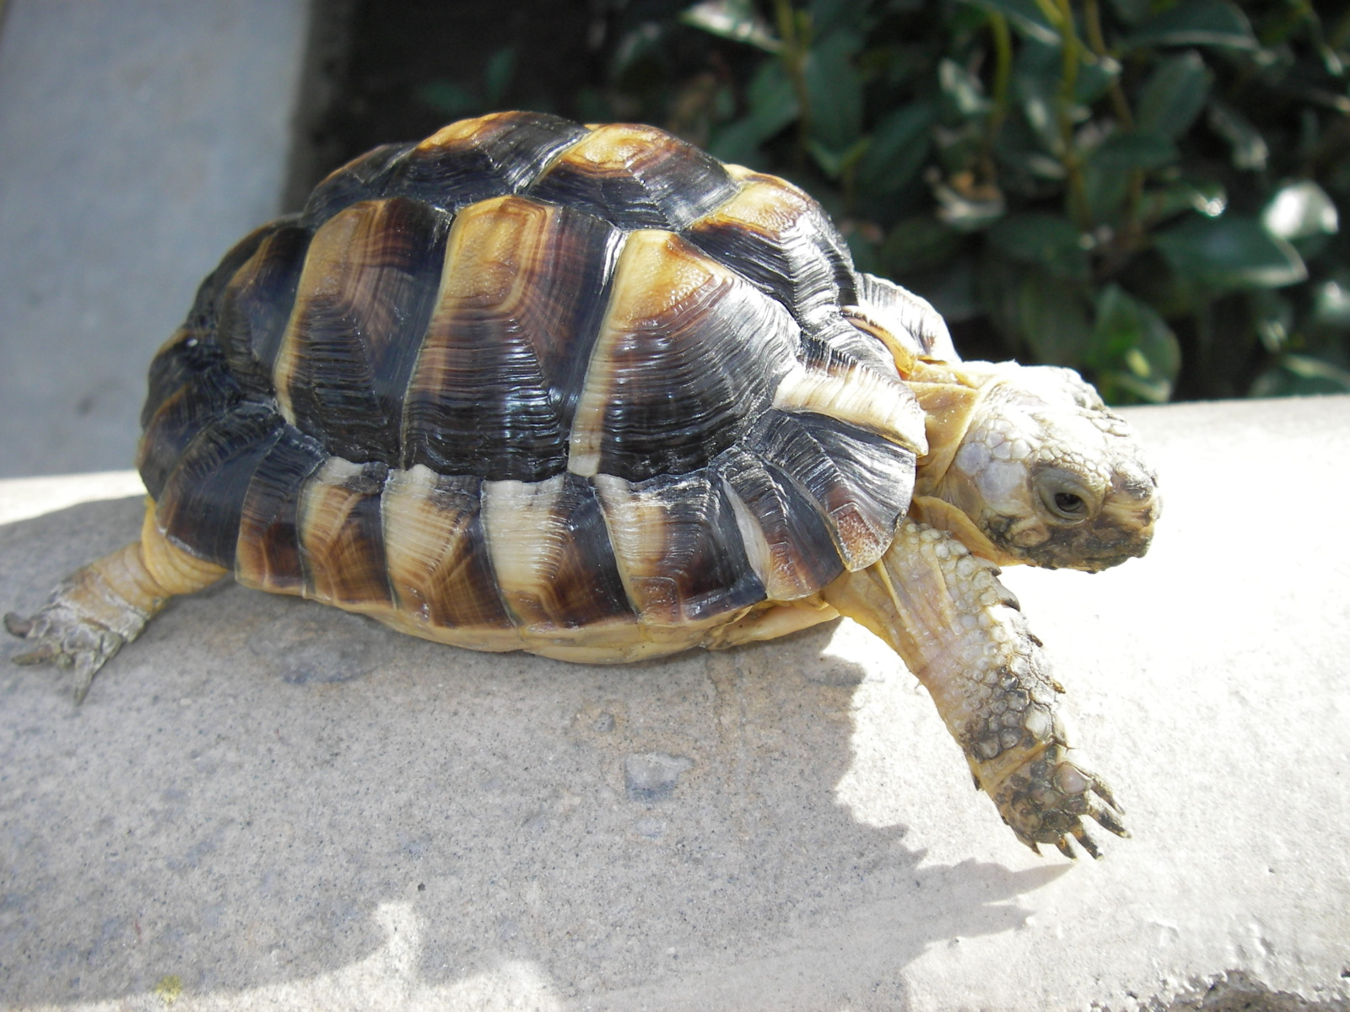
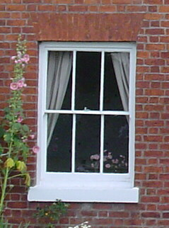
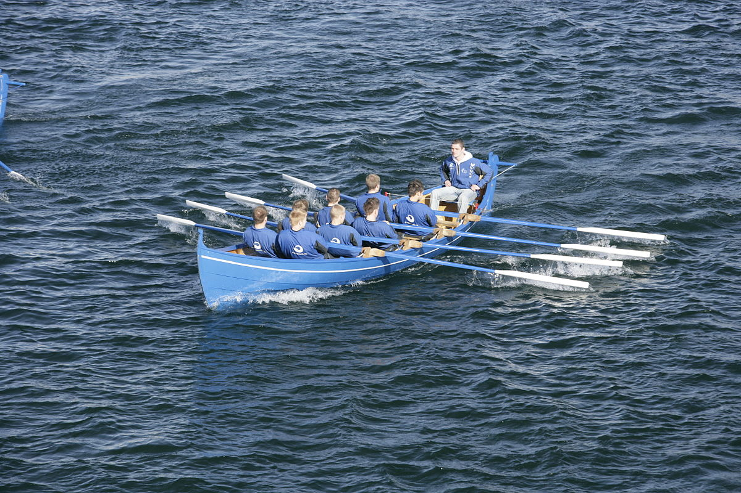
See if you can write the word to match the picture…
s…
g…
s…
w…..
r..

