Slide 1



Perryfields Infants
Phonics and Reading Session
15th October 2024
Mrs Fairbanks
Have you signed in?

Slide 2

Phonics Results
Summer 2024
Phonic Check Results Summer 2024
93% of our Year 1 children reached the expected level in summer 2024.
Compared to 71% nationally.
Year 2 phonics screening retake 2024 –
4/5 children met the expected levels (80%).

Slide 3
Reading Results
Summer 2024
 | Working at or above expected standard |  |  | Working at greater depth within expected standard
Subject | School | National |  | School | National
Reading | 82% | 68% |  | 47% | 19%

Slide 4
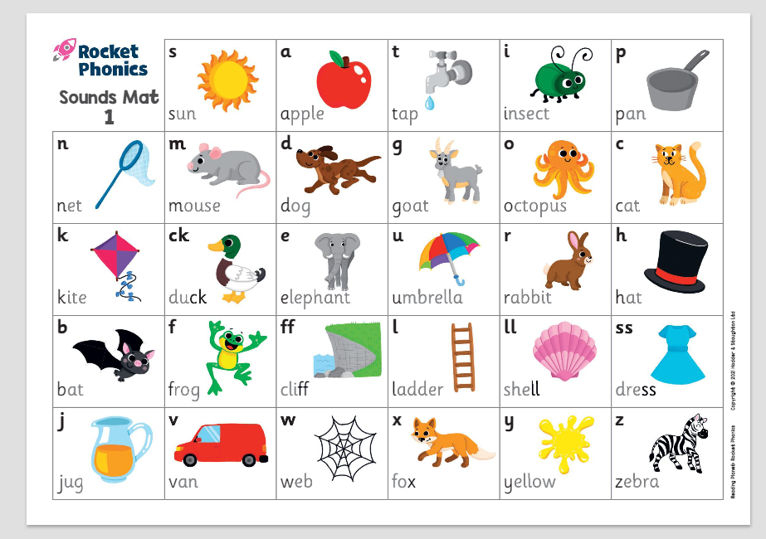
What is phonics?
Phonics is a way of teaching children to read, write and spell. The sounds the children learn are taught in a systematic order – not alphabetically so that children can begin to build words from these sounds as early as possible.
Phonics supports children to hear, identify and link the sounds that letters make (phonemes) to what letters look like when written down (graphemes). This helps children to recognise and read words using knowledge of the sounds to read new words.

Slide 5
The order the sounds are taught…

Slide 6
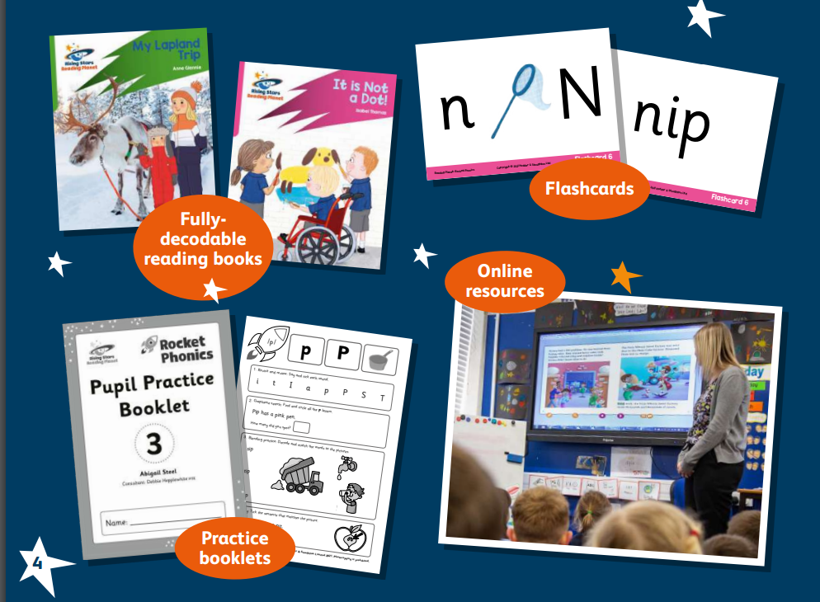

Phonics
At Perryfields, we follow the Rocket Phonics validated
scheme.

Slide 7
Blending and Segmenting
The main skills taught in a phonics session are…
Blending (sounding out) is the fluent joining together of the individual letter-sound correspondence in a word.
With a word like jam, children start by sounding out each individual j-a-m. Then, they slowly blend those sounds together to read the word jam.
Segmenting words involves breaking up words into their separate sounds.
For example in the word fish, we would segment it into its three sounds, also known as phonemes - f-i-sh.

Slide 8
The teaching week….
We split up these two vital skills;
Daily phonics sessions
2 sounds a week – Keep up, not catch up!
There are also consolidation weeks
Monday –Introduce new sound - Blending for reading
Tuesday – Segmenting for spelling and letter formation
Wednesday – Introduce new sound - Blending for reading
Thursday – Segmenting for spellings and letter formation
Friday – Consolidation and common exception words

Slide 9


Flashcards

Slide 10
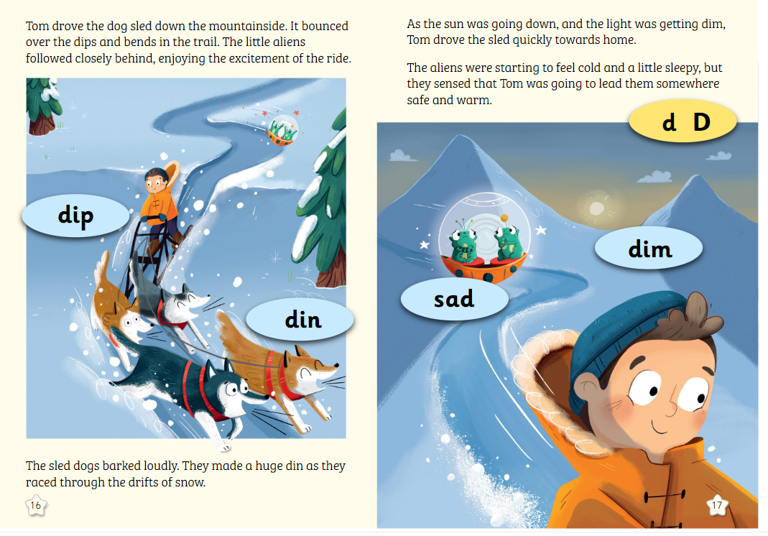
Big book interactive story…

Slide 11
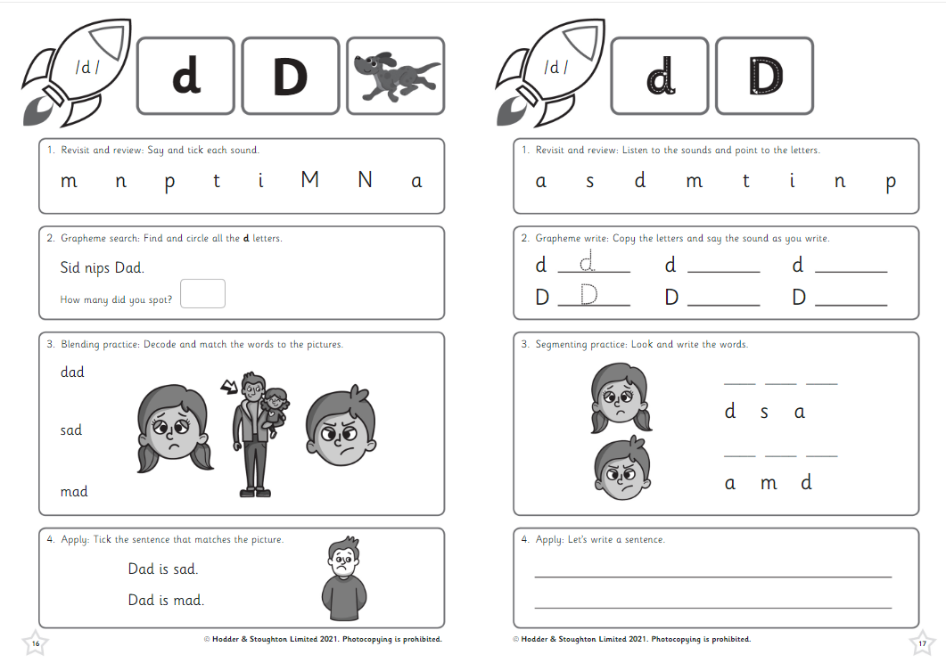
Practise booklets
Foundation Stage

Slide 12
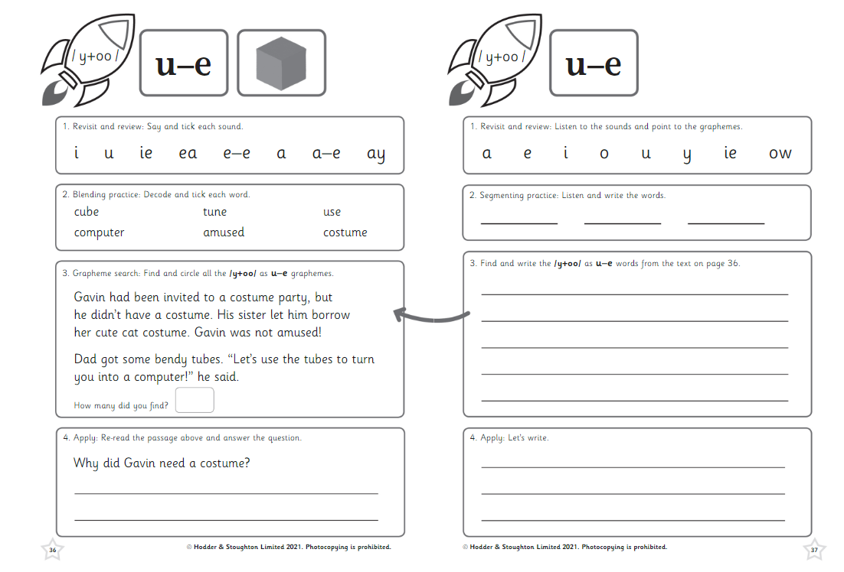
Practise booklets
Year 1

Slide 13
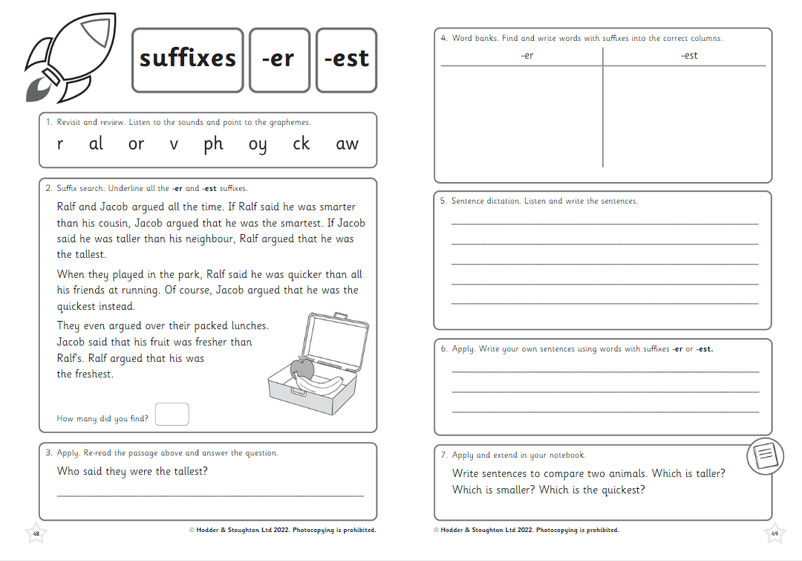
Practise booklets
Year 2

Slide 14
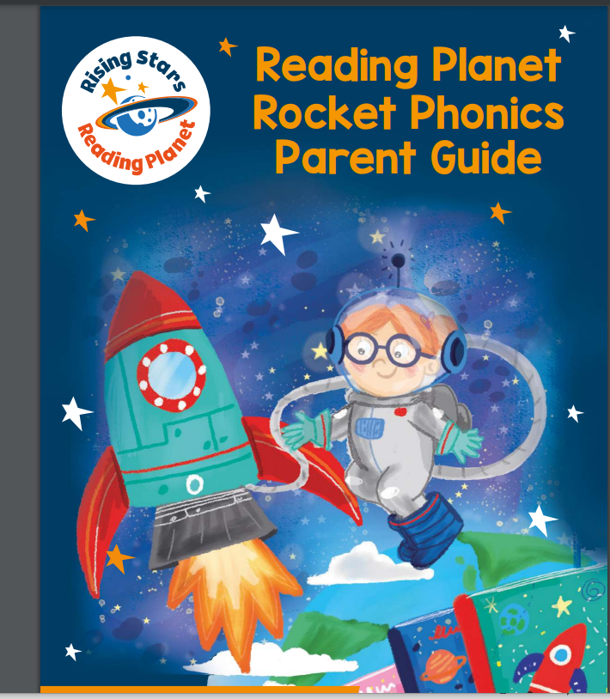
How can you help?
https://www.risingstars-uk.com/subjects/reading-and-ebooks/rising-stars-reading-planet/reading-planet-reception-and-ks1/rocket-phonics/phonics-parent-support
https://www.risingstars-uk.com/media/Rising-Stars/Reading/New%20Phonics%202021/Rocket-Phonics-Parent-Guide.pdf

Slide 15

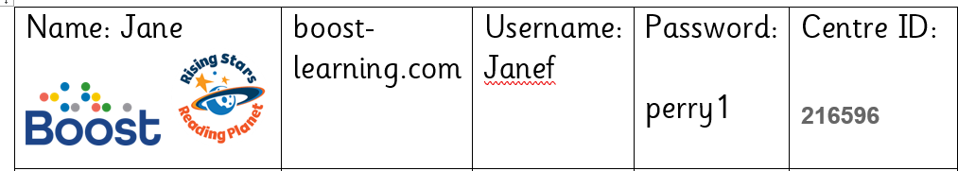
How can you help?
Practise sounds being taught at home;
In the FS, children have a little red books of sounds and some words to sound out and blend. They also have tricky words on a keyring and sound mats.
KS1– Sounds being taught are shared within the blurb about the week given with the homework.
Whole school have access to Spelling Shed and Rocket Phonics e-Books.

Slide 16

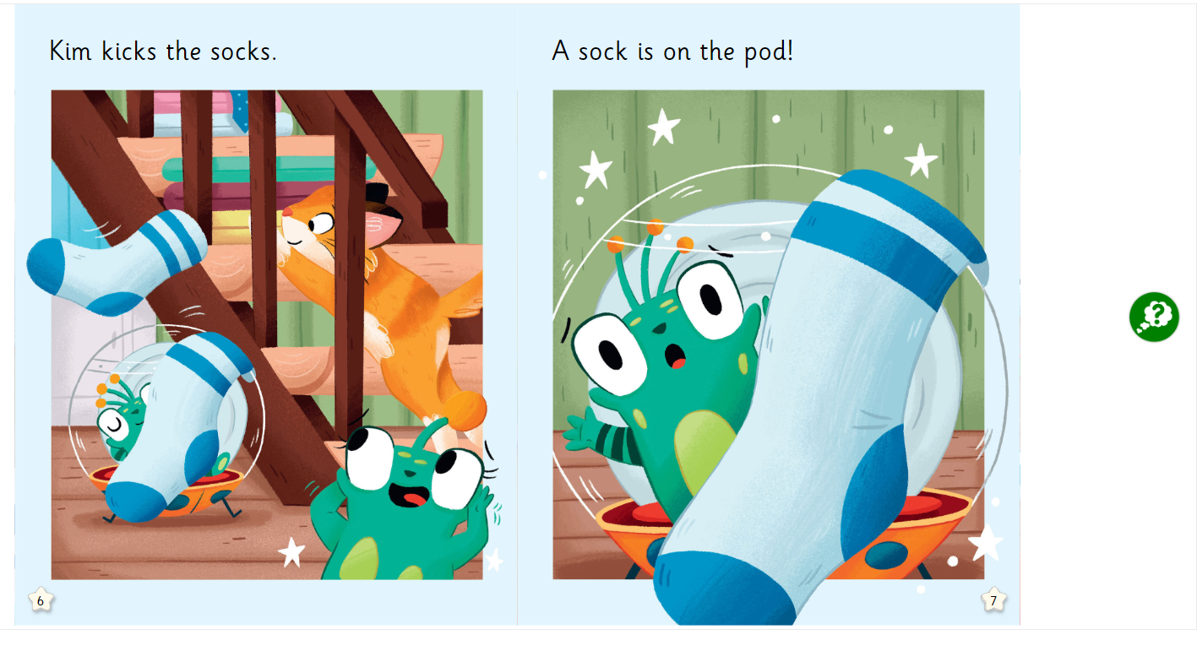
e-Books

Slide 17
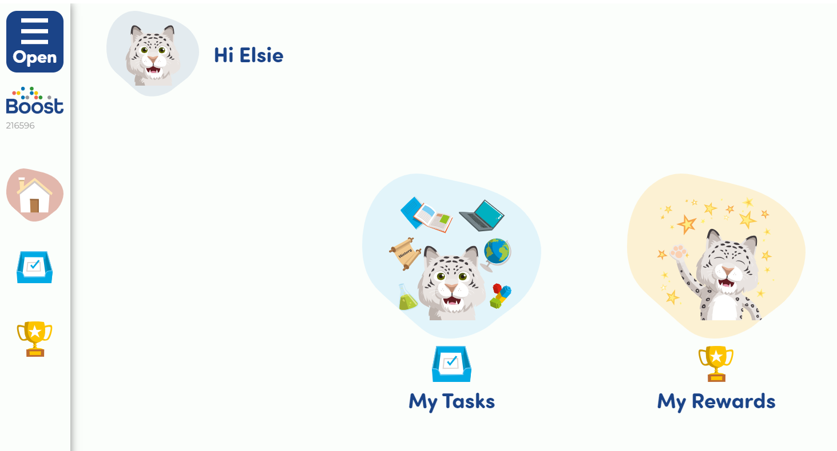
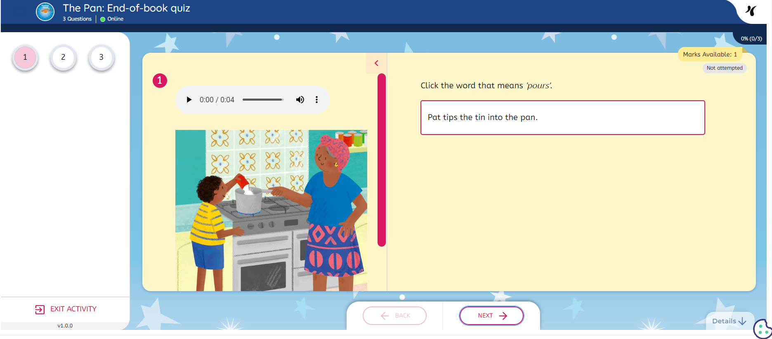
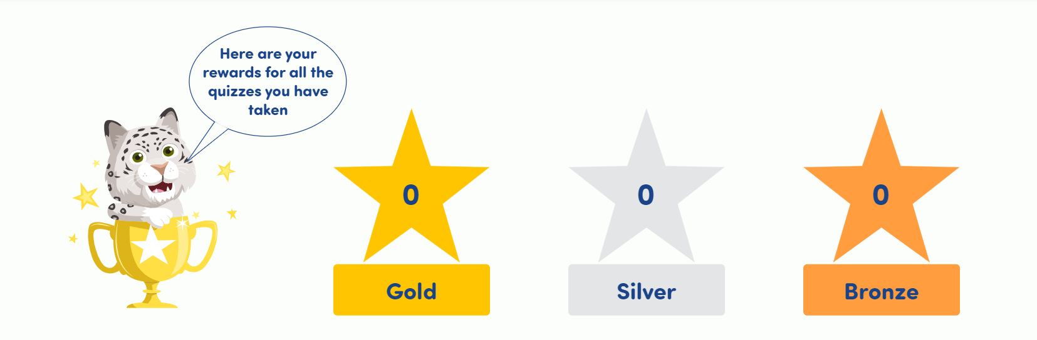
Welcome page
Fun quizzes
Rewards

Slide 18
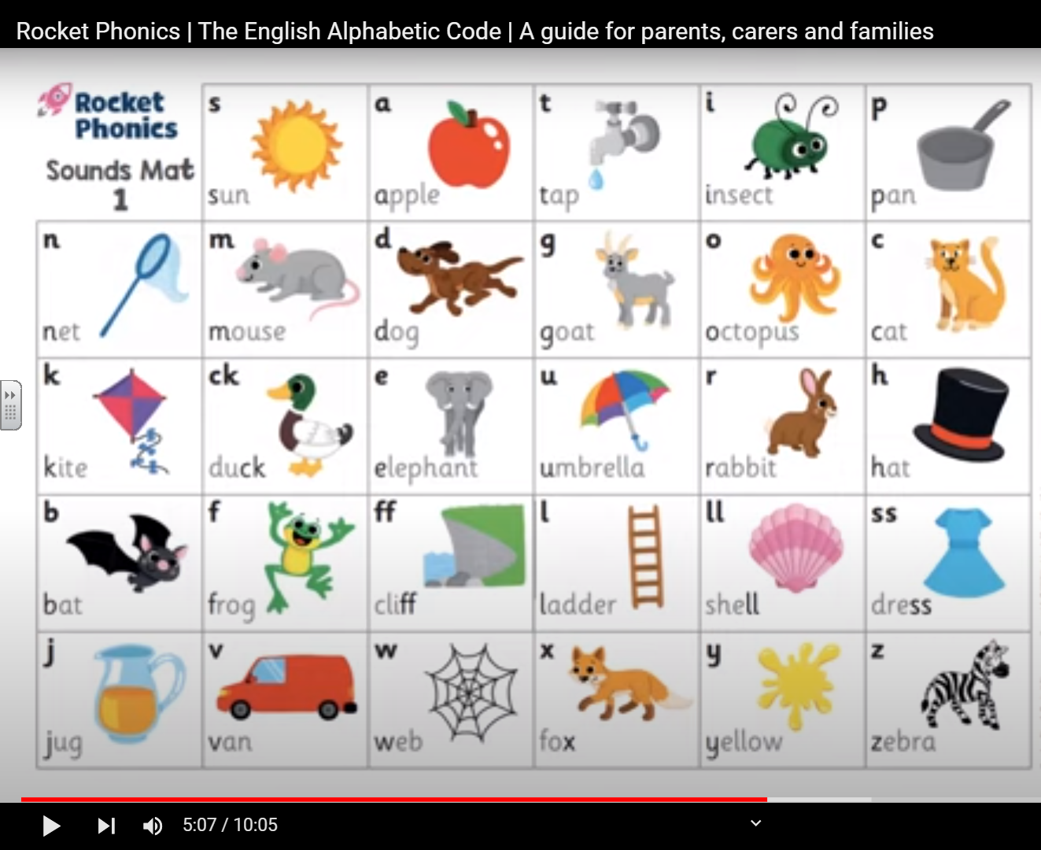
Pronouncing Phonemes
https://www.youtube.com/watch?v=nyGQY_GHtoQ

Slide 19
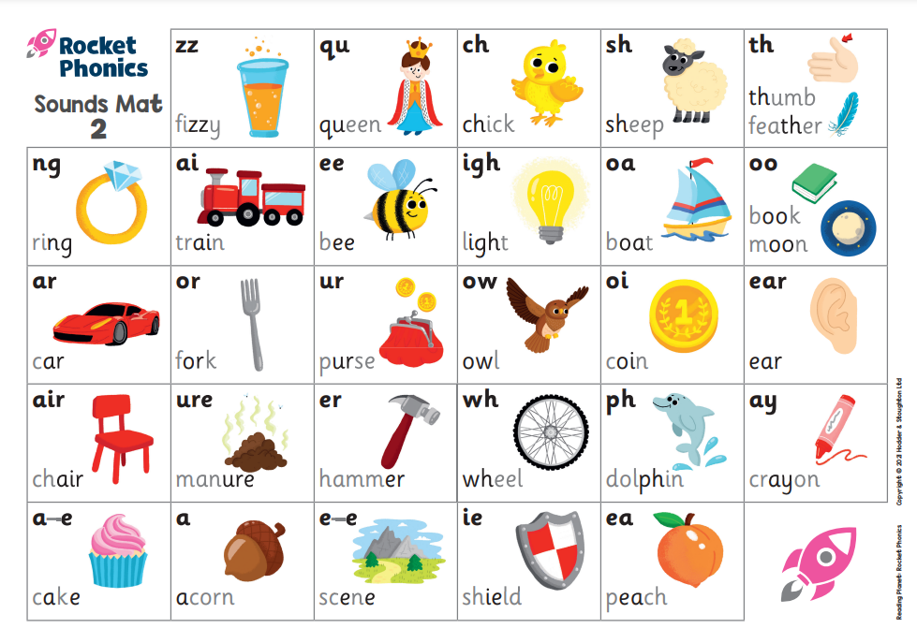
Digraphs, trigraphs and split digraphs!

Slide 20
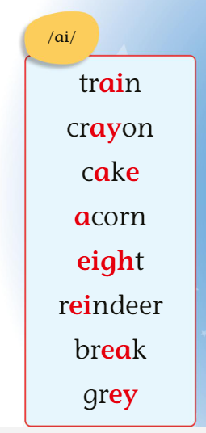
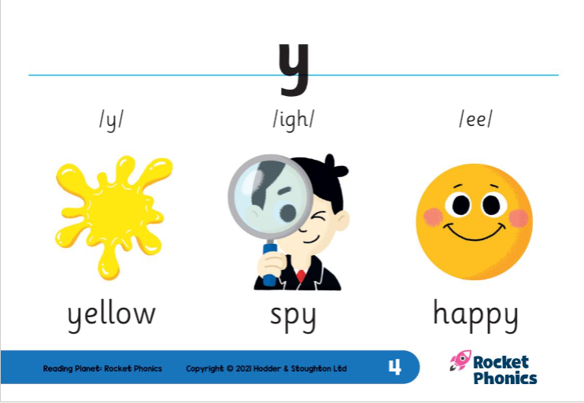
The tricky bit….
This phoneme can be represented by many different graphemes.
This grapheme can be represented by different phonemes.

Slide 21
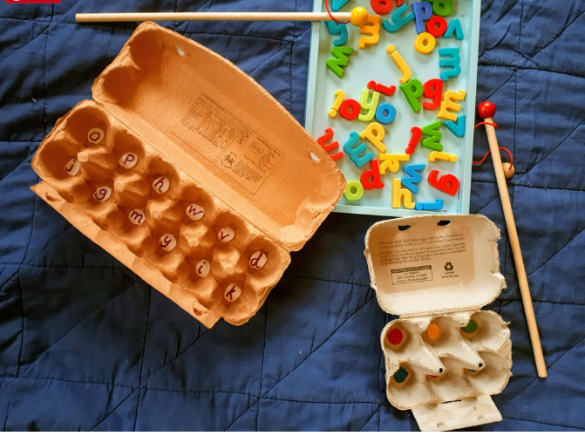
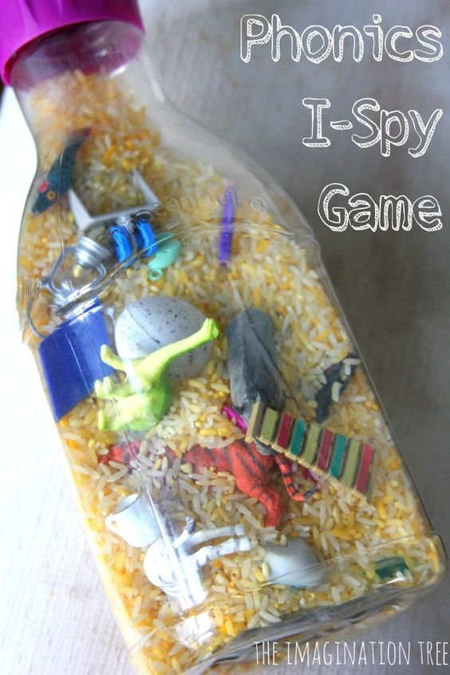
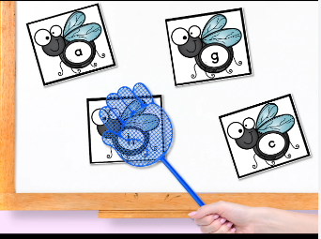
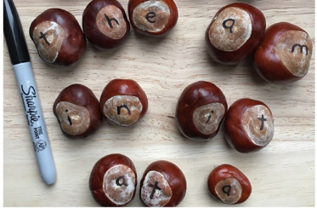
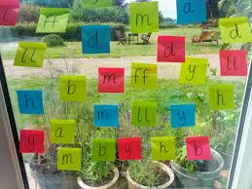
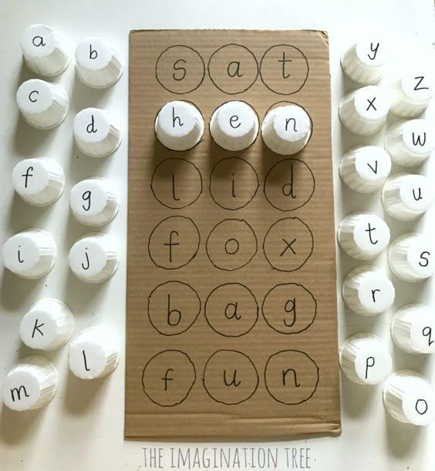
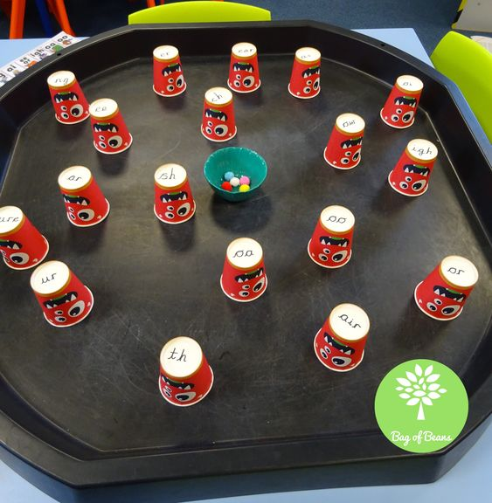
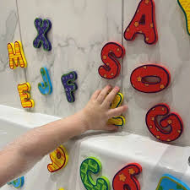
Some ideas for learning sounds at home…

Slide 22
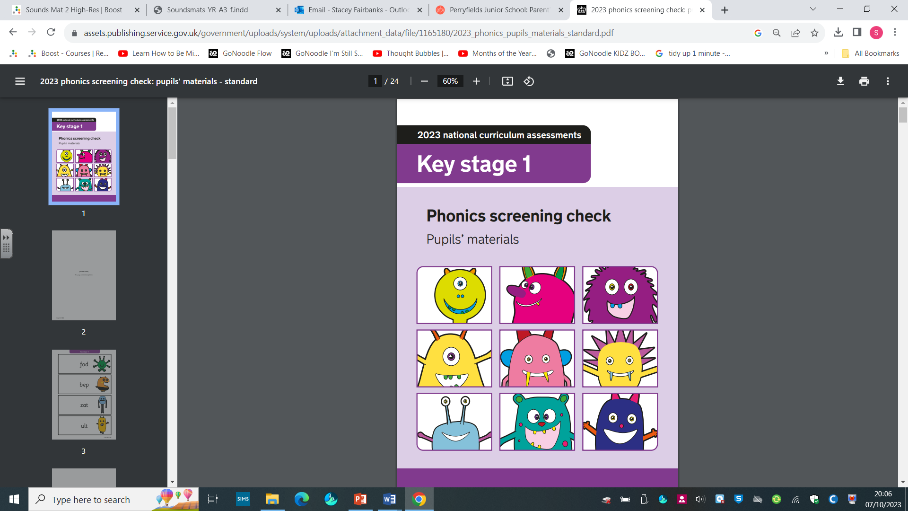
Year 1 Phonics Screening Check

Slide 23
Year 1 Phonics Screening Check
What is the phonics screening check?
The phonics screening check is a government statutory requirement for year 1 children. It is a quick and easy check of your child’s phonics knowledge.
It takes place in the summer term of year 1.

Slide 24
Year 1 Phonics Screening Check
How does the check work?
One to one in a quiet room
Class teacher
5-8 minutes
Fun and informal delivery
Children read 40 words
20 real words and 20 ‘alien’ words

Slide 25
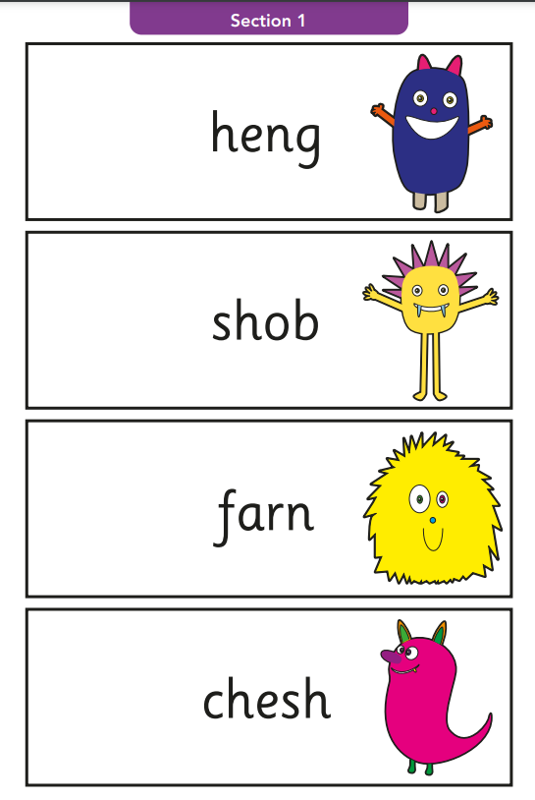
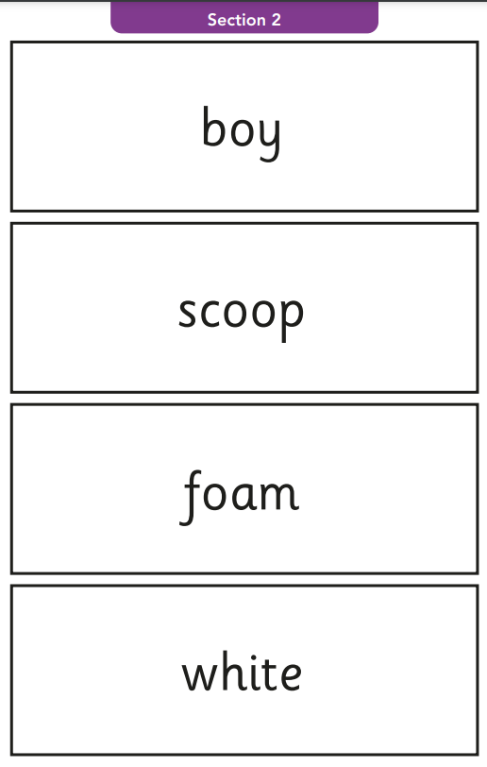
Year 1 Phonics Screening Check
20 alien words
20 real words

Slide 26
Year 1 Phonics Screening Check
After the check
We will inform you if your child has met or not met the expected level in their end of year report.
If your child does not meet the expected level then they will be given extra support.
Those children will then retake the screening check in the summer term of Year 2.

Slide 27
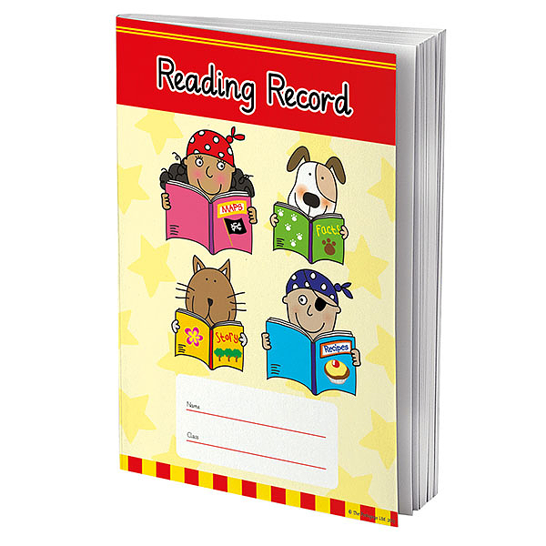
Home/School Reading Routines
Reading diary – Communication between home and school
Foundation Stage;
Take home two books a week;
One shared reading picture book – chosen by child.
One decodable book matched to the sounds they know – chosen by class teacher or LSA.
Year 1;
One shared reading book from the library - colour banded according to their level of difficulty.
One decodable book matched to the sounds they know.
Year 2;
Two reading books from the library - colour banded according to their level of difficulty.

Slide 28
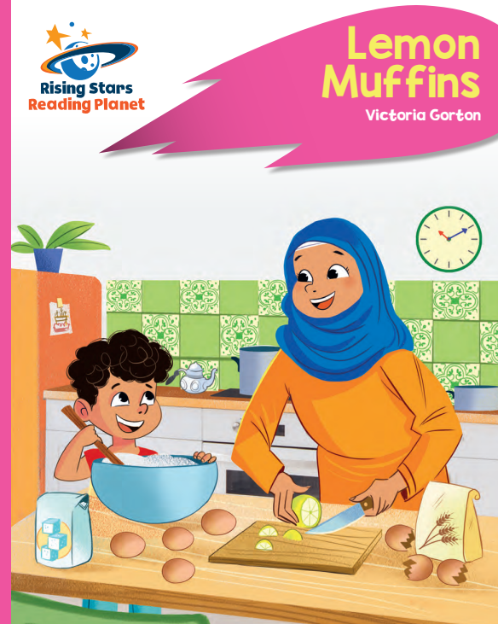
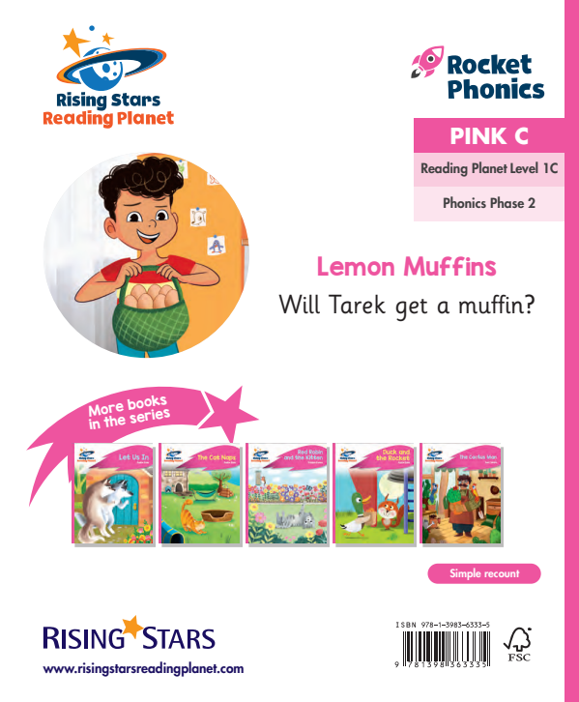
Decodable Books

Slide 29
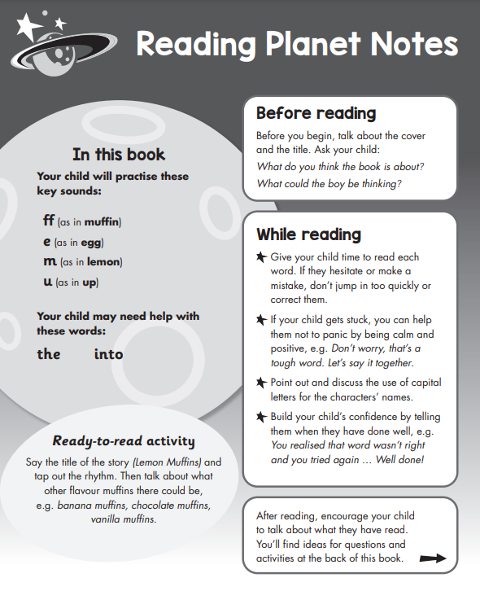
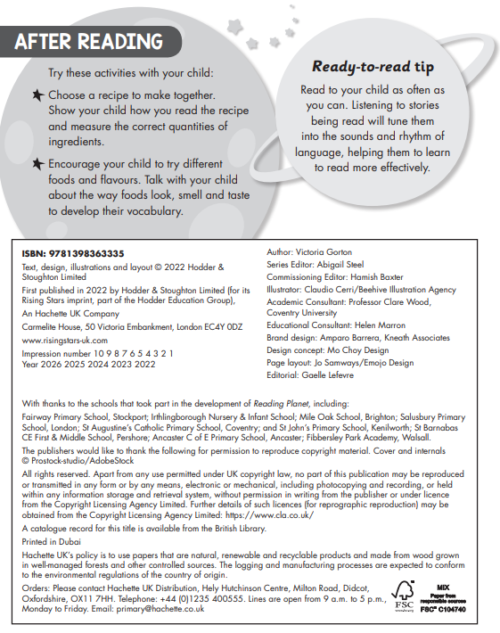
Decodable Books

Slide 30

Shared Books – Foundation Stage

Slide 31
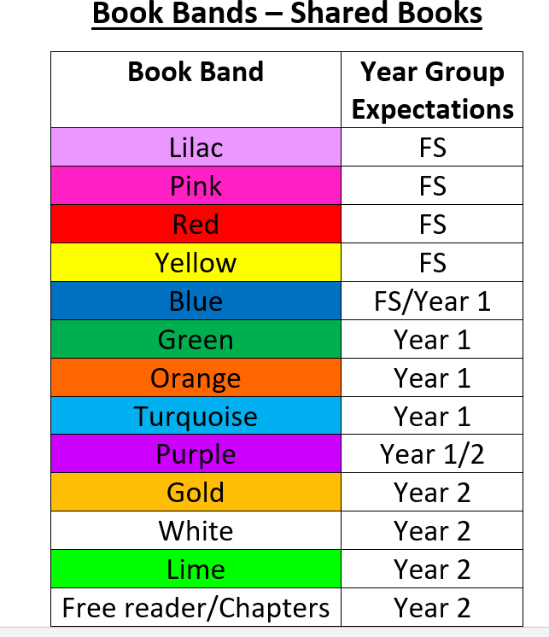
Shared Books – Book Bands
The colours of the phonics decodable book and the shared banded book may not be the same.

Slide 32


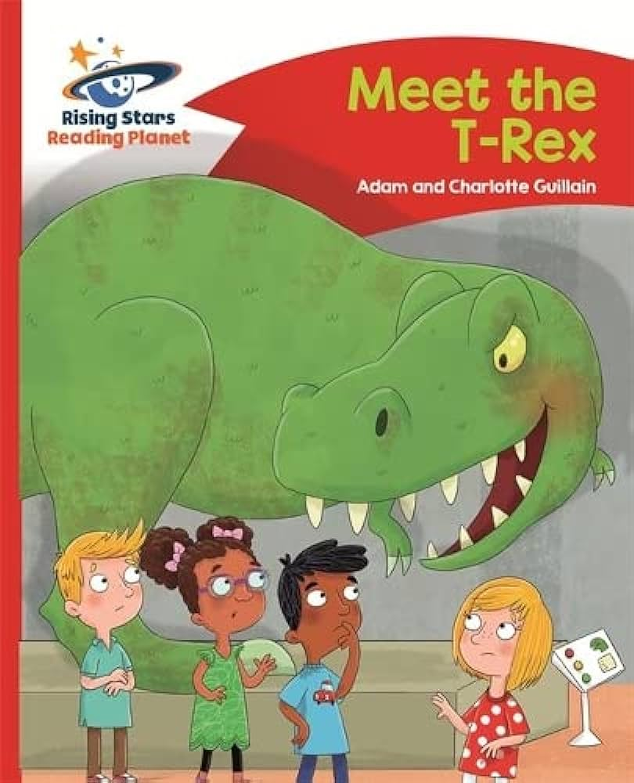



Shared Books in the Library

Slide 33
Home/School Reading Routines
Children change books once a week – minimum
Rocket Phonics password for all to access all e-books at home
Spelling Shed passwords for all
Spellings/high frequency words/phonics/CEW given as homework
Record comments in reading diary

Slide 34

Reading Expectations
Listen to your child read as often as possible – at least 5 times a week. Record in their reading diary. Just a few minutes every day will help but it must be an enjoyable experience!
Try – my turn, your turn.
Bring in books and reading diary every day.
Reading to your child helps them develop their own expression, comprehension and enjoyment. This is just as important as listening to children read independently.

Slide 35
Perryfields’ Approach to Reading
1-1 with teacher or LSA
Guided reading group sessions
Reading for pleasure and enjoyment endorsed
Book corners in every classroom
Author focus each term and author visits
Visits to the local library
Junior Librarians in each class
Buddy reading
Daily quiet reading sessions
Range of texts, e.g. comics, fiction, non-fiction, newspaper papers, magazines, recipes, signs etc
Weekly Reading Competition –points given each time a child reads at home/school. Each term, the class with the most points wins a case of special books for their class!

Slide 36
Reading Fluency
Once children can confidently blend phonemes in words they begin to read with greater fluency and their comprehension skills develop.
Fluency is when children can read words accurately without unnecessary sounding out and are effortless or automatic in recognising the words they encounter.
We aim for our children to read smoothly with expression, reading at a consistent pace and with an awareness of volume.
This is important as children can then start to work on comprehending the text they are reading.

Slide 37
Year 2 Assessments
Year 2 tests in Reading, Writing and Maths take place during the summer term.
Reading tests place a high emphasis on comprehension and text inference (reading between the lines and looking for clues in the story).
Teacher Assessments report children as working below, towards, at or above age- related expectations.

Slide 38
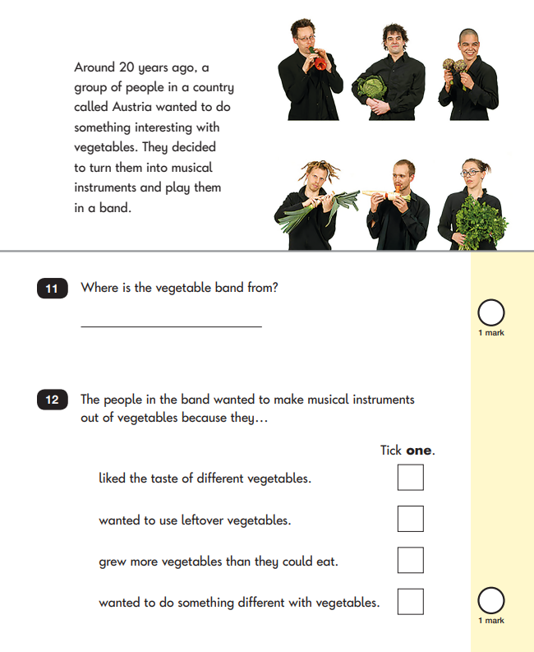
Year 2 Assessments
Non-Fiction
Poetry
Fiction

Slide 39
Skills Assessed
Read words containing common suffixes
Read common exception words
Read fluently with expression
• Sound out most unfamiliar words accurately
• Check it makes sense
Answer questions
Make inferences on the basis of what is said and done
Predict what might happen next
Make links between the book they are reading and other books they have read

Slide 40
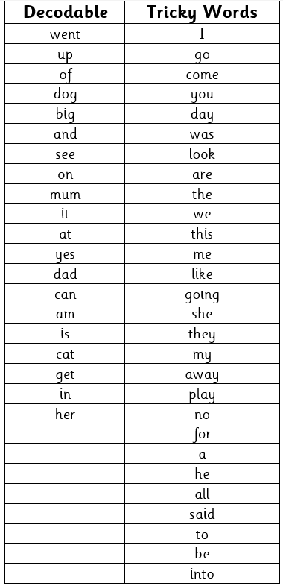

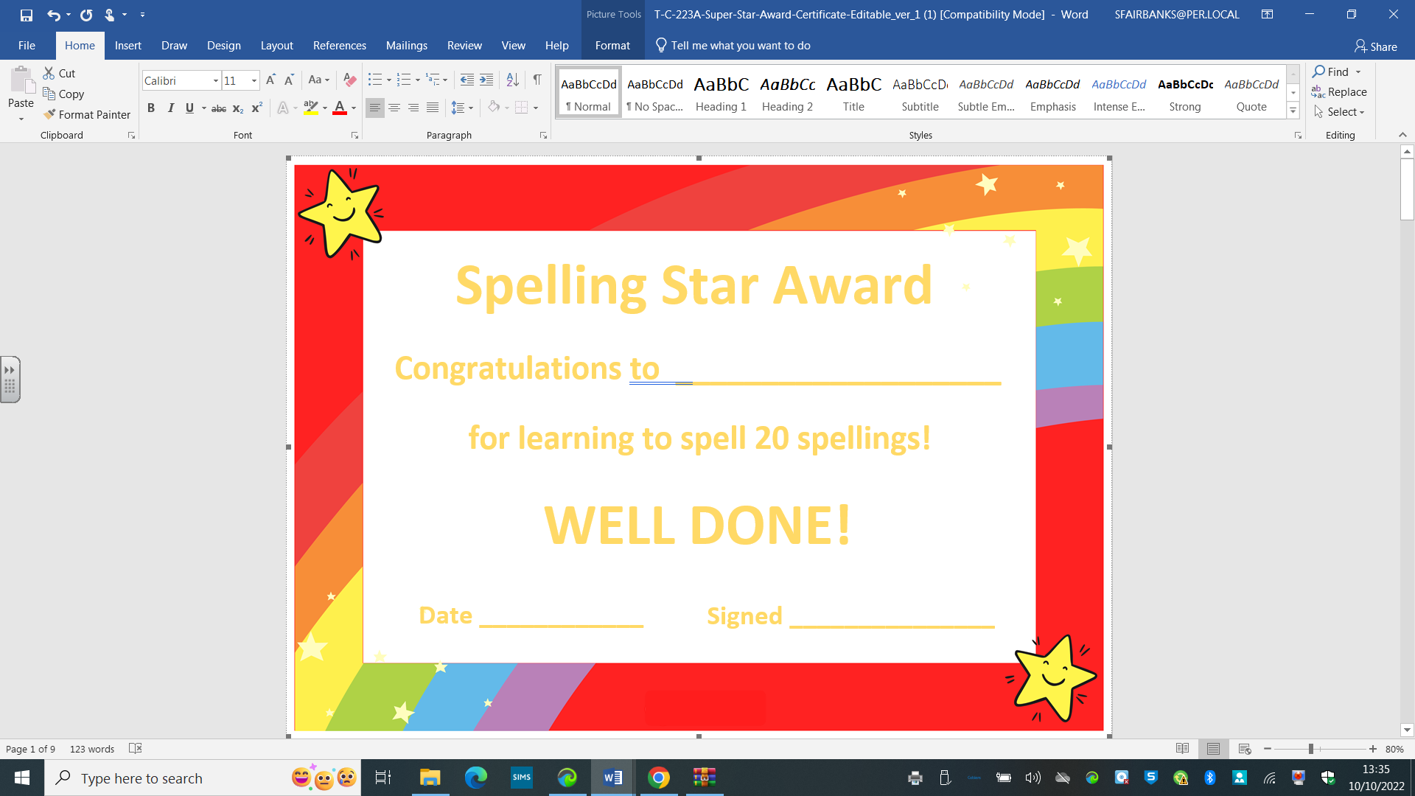
Reception High Frequency Words
Learning these words by heart, really aid fluency.
Read, spell and apply!

Slide 41
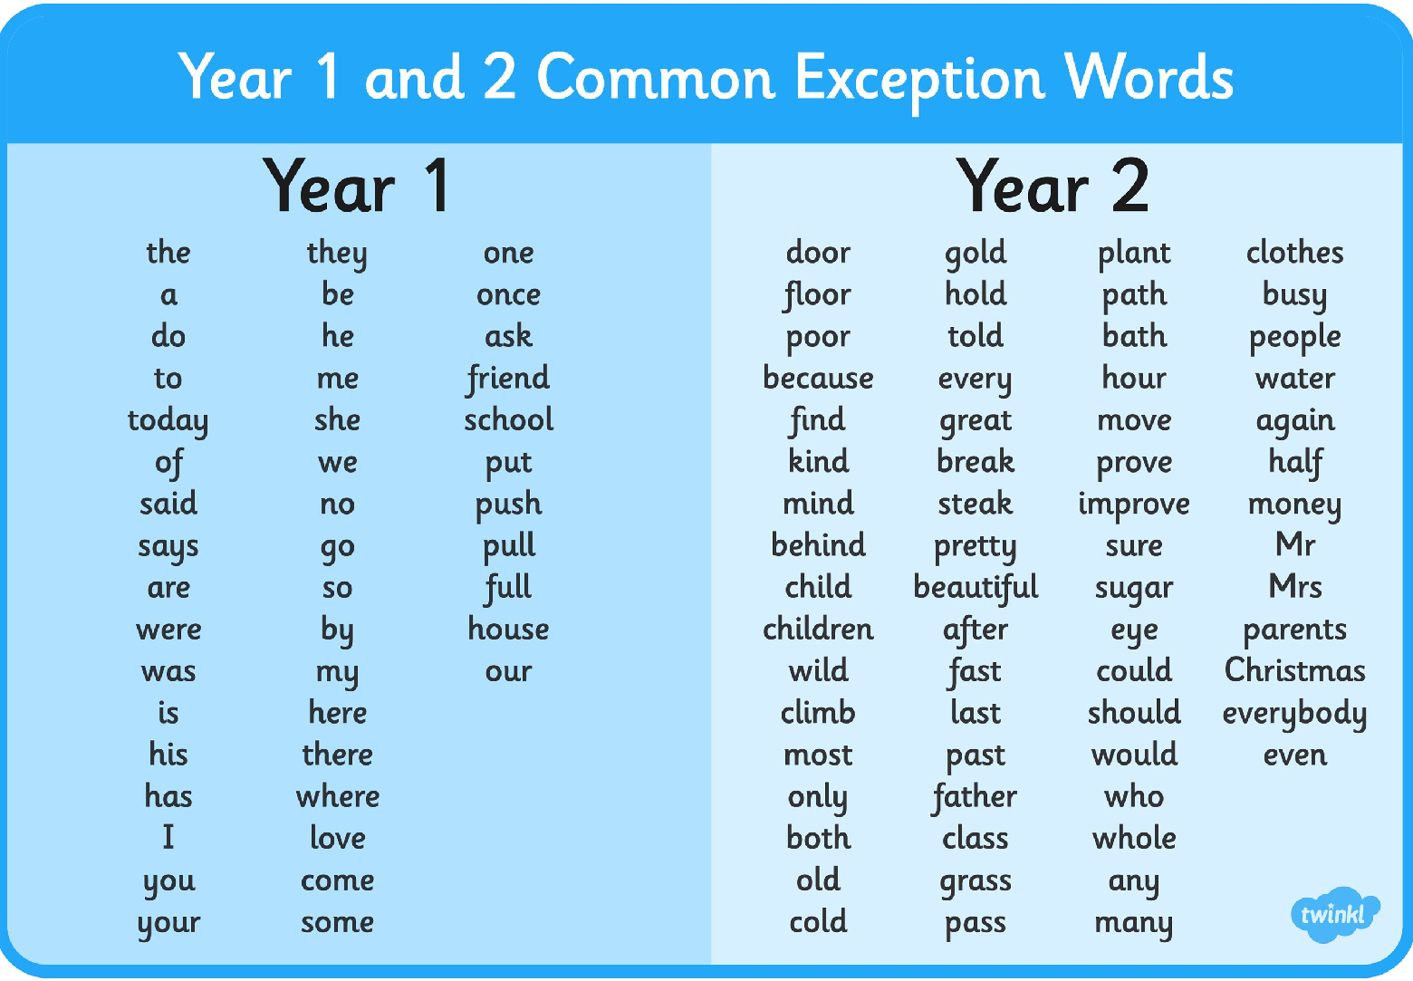


Common Exception Words
Read, spell and apply!
Super Spelling Challenge now introduced!

Slide 42


Supporting Reading at Home
Make it fun!
Variety of books and reading materials
Any reading is reading!
Rocket phonics –reading books to support at home
Hearing your child read daily
Paired and shared reading – my turn/your turn
Visiting local library
Reading when out and about
Being a role model- encourage children to see you reading and enjoying it!

Slide 43
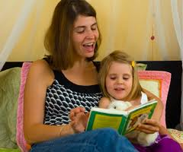

Reading with your Child
Some of the things you can do with your child are:
Look through the story first, talking about the pictures so they are not going into the book ‘cold’, make predictions what the story might be about.
Encourage them to infer information from the text and pictures.
Suggest they retell the story in sequence.
Ask them to predict what might happen next.
Ask them if they liked the story and to explain why.
Talk about the characters and their feelings and behaviour, encouraging them to justify why they think this, using the text to help them.

Slide 44
Any questions?
Have you signed in?
School Ping – Parent guide and video
PowerPoint on school website
Please complete feedback form

