Slide 1
Let’s read some digraphs!
th sh ai ee ch oa i-e
ur ow oi ar ay au
ea ir ie or ue oo o-e
aw ou er oy ng ey

Slide 2
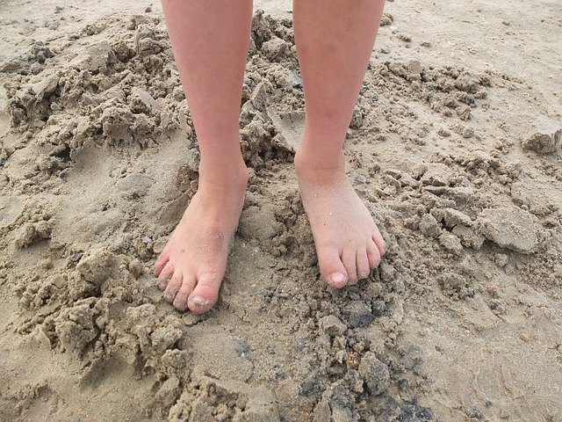
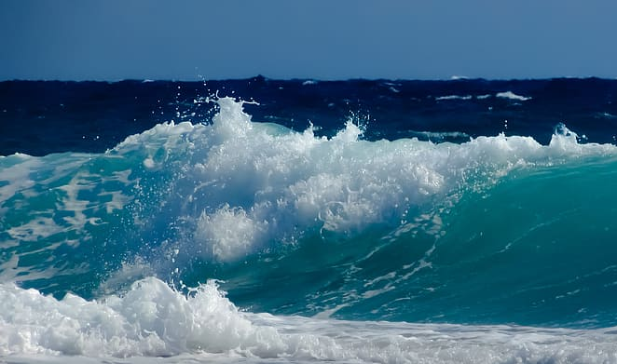
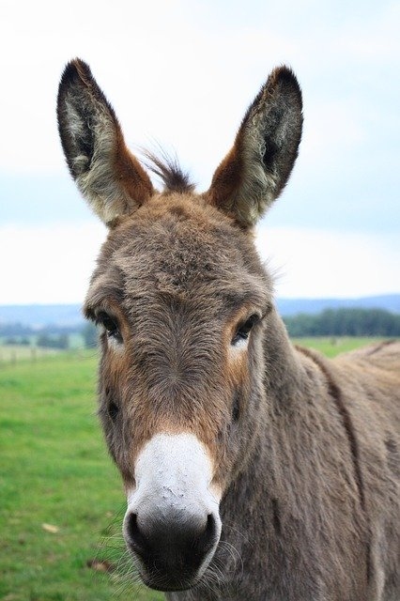
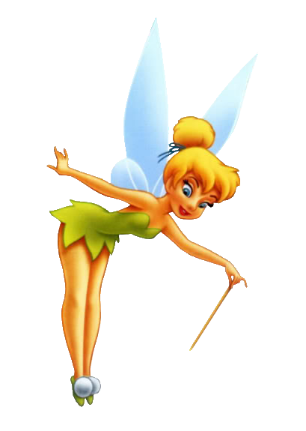
We are going to think about a sound that can be made with different digraphs…
What is the sound that is in all these words?
How can it be spelled?

Slide 3
The sound is ee/ea/ey/e-e
feet
sea
donkey
concrete
fairy
Can you add the sound buttons to these?

Slide 4
Not all words with ee/ea/e-e/ey/y are real words!
If you see an alien next to a word…
…it is trying to trick you by pretending to be a word you know.
So when you see an alien…
You MUST sound it out!

Slide 5
See if you can read these words.
seed dreav theme
wefe turkey frenby
sweet fleve meat roovey
beach tweep extreme

Slide 6
Let’s play Best Guess
steem steam steme steym
vallee vallea valley vally
seeks seaks sekes seyks
pottee pottea pottey potty

Slide 7
Let’s play Yes/No
Are you feeling happy today?
Have you got a pet monkey?
Do you like going to the beach?
Is your best friend called Steve?

Slide 8
What are the three right answers?
Things you do at home:
eat
sleep
play
concrete

Slide 9
Find another three right answers
Things people can eat:
honey
cream
money
beef

Slide 10
Last 3 right answers
Things you can find in or on a house:
chimney
sheep
door
seat

