Slide 1
What a strange term this has been!
Today we are going to look back on all the things we have (and haven’t) done!
We are going to use this planning grid →

Slide 2
Where did you learn after Christmas? Who helped you?
Some of you came into school. That was different because you didn’t always have your usual teachers. There were some children who weren’t normally in your class and you had a table all to yourself.
Most of you stayed at home. Who helped you work? Where did you work? When did you work and what did you do the rest of the time?
Make some notes on your plan!

Slide 3
We learned about lots of things in that first half term.
We thought of questions about little and large.
We learned about different animals and wrote a non-fiction book.
We shared “A Bit Lost” and wrote our own story.
We learned about split digraphs.
We put numbers in order and learned how to measure.
We learned about continents.
We made sculptures.
We also had zoom calls with our classmates.
Which was your favourite and why? Make notes!

Slide 4
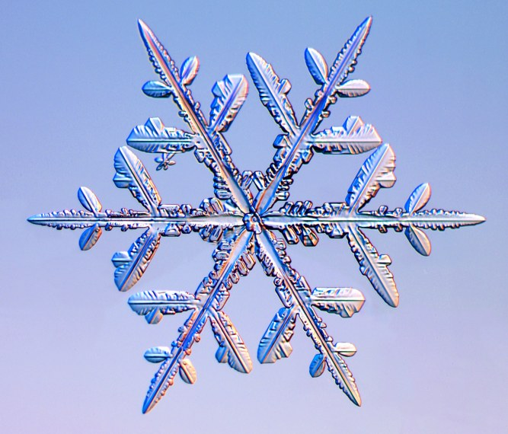
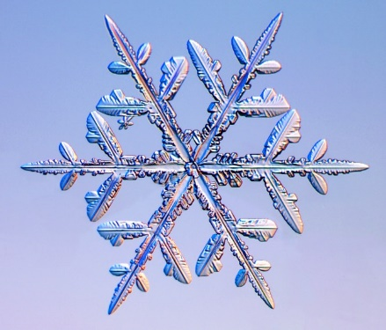
Snow and half term
What did you do in the snow?
Did you like it or not?
Did you do anything different during the half term holiday?
Make notes!

Slide 5
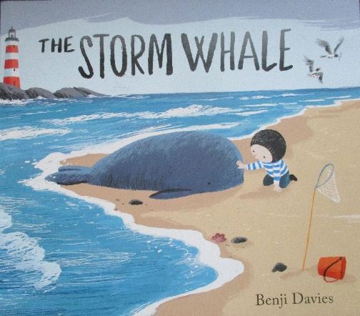
After half term we had 2 more weeks of remote learning.
We started a new story, “The Storm Whale.”
We learned how to multiply/ find “lots of.”
We learned about the Battle of Hastings.
We started to learn about materials in science.
We had World Book Day.
What did you enjoy most and why? Make notes.

Slide 6
Then we came back to school – hooray!
How did you feel about coming back?
We had science week, made parachutes and did a floating experiment.
We also looked at caterpillars under the microscope.
We learned about castles and did some drama.
We learned about dividing by sharing and had edible maths.
We did dance and fitness in PE.
We went on the climbing frame and played with our friends.
What did you enjoy most and why? Make notes!

Slide 7
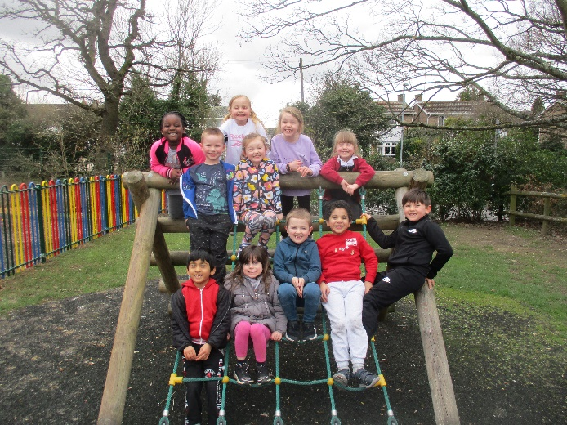
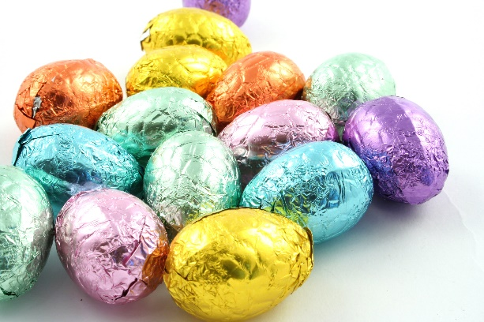
And then we had to go home again!
How do you feel now?
What are you looking forward to?
Are you expecting to do anything nice over Easter?
Are you looking forward to seeing your friends again?
Make notes!

Slide 8
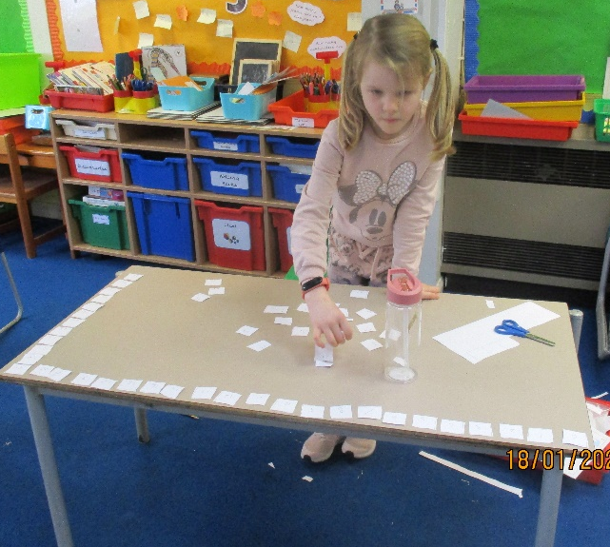
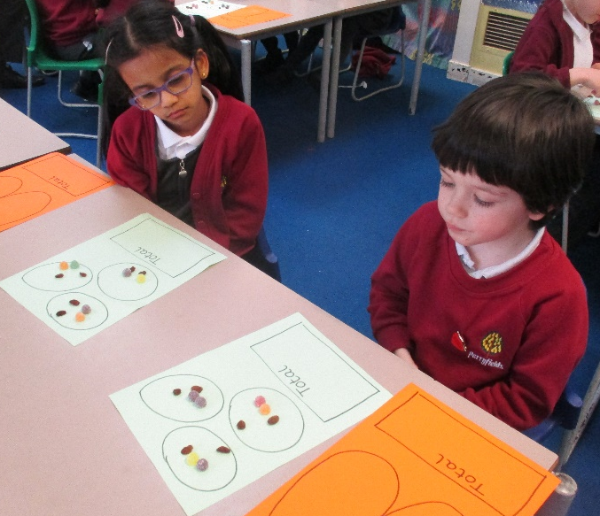
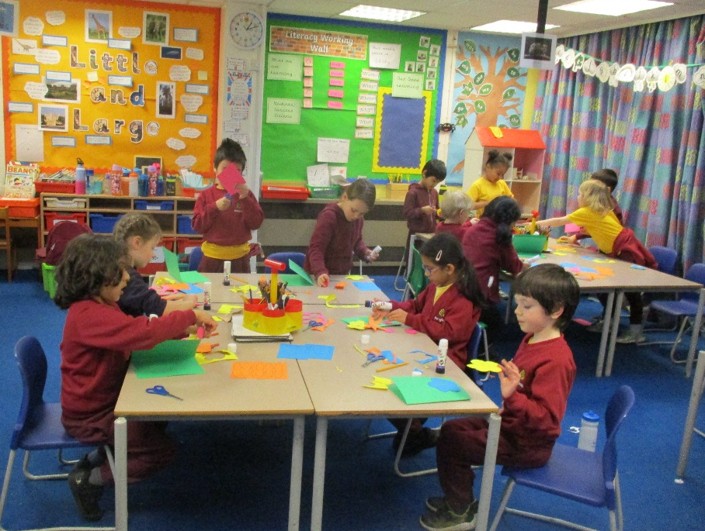
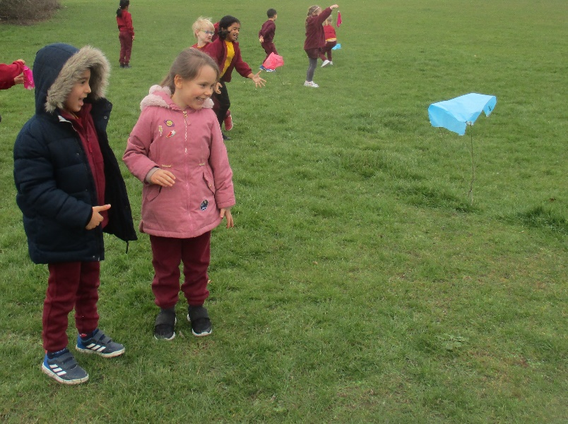
Tomorrow you will use your notes to write about Spring Term 2021
…telling me what you did, how you felt and what you are looking forward to.
Include notes on your plan that will help you!

