Slide 1
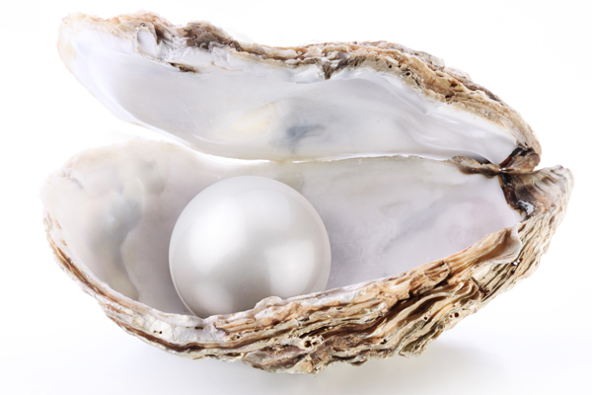
Welcome to Year 2
Diamond and Pearl Class

Slide 2
Housekeeping
Have you signed the register?
Please check the school website as you will be able to find the knowledge organiser for this term and some photographs of your child’s learning.

Slide 3
Meet the team…
Diamond Class:
Mrs Etheridge (Monday, Tuesday, Wednesday)
Mrs Shaikhly (Thursday and Friday)
LSA Mrs Alston-Baskett (Shared with Pearl Class)
LSA Mrs Mani (mornings)
Pearl Class:
Mrs Newland
LSA Mrs Alston-Baskett (Shared with Diamond Class)

Slide 4
The Curriculum
Our curriculum is cross curricular and topic based.
Literacy and numeracy every day in some form.
ICT suite every week and access to I-pads in the classrooms.
PE twice a week – currently Monday and Wednesday, but Wednesday and Tuesday after half term. Please ensure children have socks, take out earrings and tie up hair when they come to school in their PE kits.

Slide 5
Year 2 expectations
Role models for the rest of the school, greater responsibility for themselves/ independence.
Morning – wait sensibly in playground, give in letters and homework themselves.
Bring in correct equipment (hat, water bottle, swimming bag) – dropping them off later is very disruptive to the office.
Changing books – they know to ask when it is quiet reading and get asked to change their books after their guided reading session by an adult.

Slide 6
Homework
Set on Friday and due on following Wednesday
Reading 5 times a week
Literacy: spelling challenges/ patterns – Spellings are written on the homework sheet and can be accessed on Spelling Shed.
Numeracy to consolidate learning that week.
Sometimes research to spark interest for a new topic.
We cannot emphasise strongly enough the importance of parental support for their child’s learning!

Slide 7
Reading
Please record a comment when you hear your child read. Useful things to mention are fluency, expression, understanding, self correction, and any errors or successes.
Strong emphasis on reading comprehension in Year 2. To assist this, often guided reading rather than 1:1.
We will check your child’s reading colour band at least every half term to ensure the books meet their fluency and comprehension levels.

Slide 8
Phonics and spelling
Year 1 phonemes will be revised and built on.
Key words will also be practised – Y1 and 2 Common Exception words. We will be putting in diaries any CEW we would like the children to practise at home.
Lots of work on spelling conventions eg. Adding suffixes (-ing, -ed, -es, -ly, -ful etc)
These are also picked up in handwriting sessions.
There will also be lots of grammar work.

Slide 9
Behaviour
Each class has a set of golden rules, agreed by the children.
Positive strategies are used, such as star of the week, smiley rewards, magical rainbow, marble jar, stickers, good work wristbands, compliment boxes and golden time.
Golden time has to be earned!

Slide 10
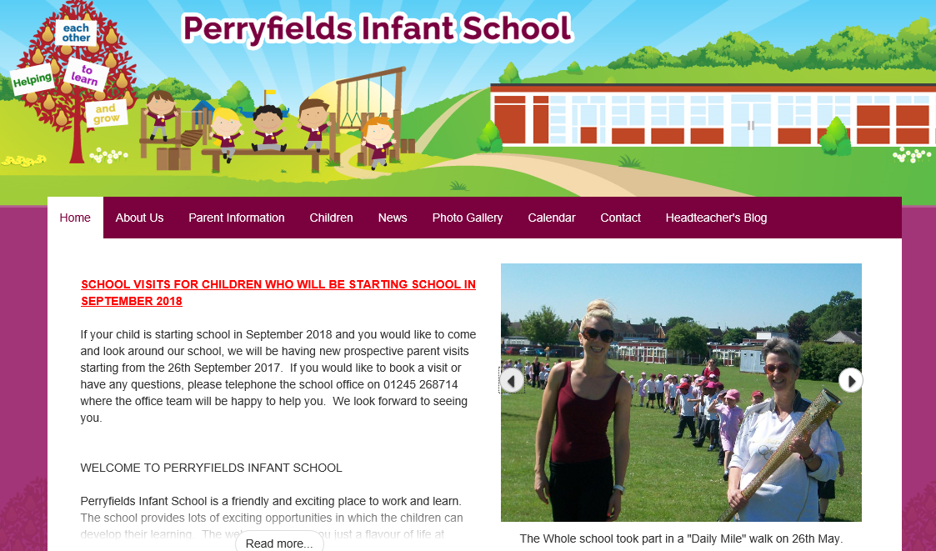
General information
If you have any worries or concerns please speak to us after school. You can also make an appointment. Please inform us of any different after school arrangements in writing too – we will have forgotten oral messages before we get back to the classroom!
School website which has calendar dates, information in relation to sickness, policies, children's work and is regularly updated with photographs of your children in their classes.
Now also Twitter.

Slide 11
Social networking
Social networking policy is on the website. Please check it – some children do not have permission to be photographed or named.

Slide 12
General information continued
PLEASE label school uniform
Bring in a water bottle every day - but do NOT put it in book bags – the school has lost so many new books through water damage that we will now charge for damage.
Jewellery, nail polish and large hair accessories are not part of school uniform.
Ensure money and letters are handed in in a named envelope.
Attendance and timekeeping is important – try to arrive on time.
Keep off for 48 hours if child has had sickness/ diarrhoea, even if symptoms have finished.
For COVID symptoms please follow the current COVID guidelines.

Slide 13
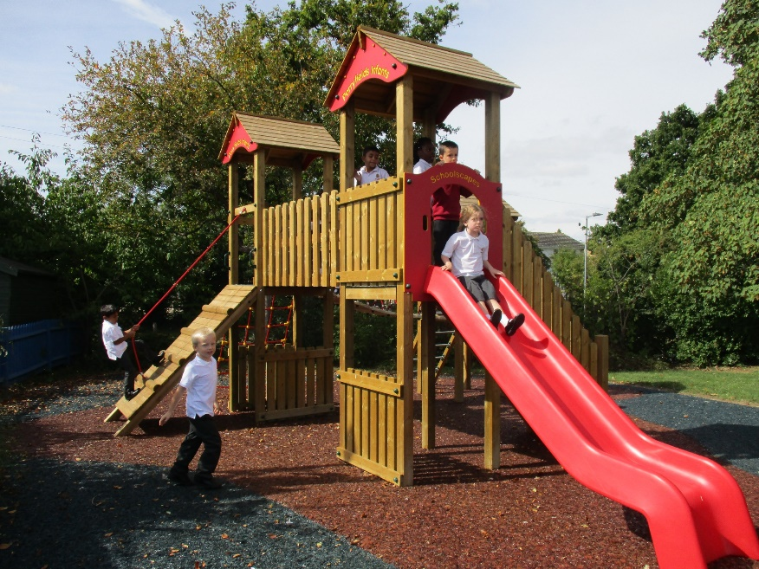
General information continued
Birthday books
Pupil Premium Grant
Climbing frame
Reading points
Oxford Owl
Pearl Penguin and
Sidney Squirrel.

Slide 14
Some Important Dates
Author Visit – Monday 3rd October (
Harvest Assembly – 10th October
Writing and Phonics Workshop – 17th October 9.15am
Numeracy Workshop – 4th October 9.15am

Slide 15
KS1 assessments
The end of key stage 1 tests continue to be compulsory and are currently taking place in June. These will take place in the middle of the Summer term. The children will be required to sit 2 reading papers, 2 maths papers, a grammar test and a spelling test.
We approach these in an informal and non-threatening way and the children tend to enjoy them! Please note that the continual teacher assessment of the children's work throughout the year determines which band your child is reported for your child at the end of the year.
Those children who did not meet the expected levels for phonics at the start of year 2 will retake the screening in the Summer term.

Slide 16
Parent helpers
Can you volunteer as a parent helper?
If you have already offered to help, please start as soon as you can!
We need your help to maintain our wonderful standards.
We would love some extra parent helpers to support our children’s reading in class.
Thank you ☺

Slide 17
Any questions?

