Slide 1
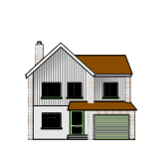
This term in RE we are thinking about special places.
Last time we thought about our own special places at home.
Today we are going to start learning about special places for people of different religions.

Slide 2
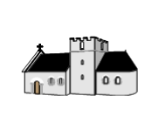
A special place for Christians is called…
A church
Christians can go there to say prayers, since hymns and learn about Jesus and God.
But what is a church really like? Are they all the same?
Let’s learn some more…

Slide 3
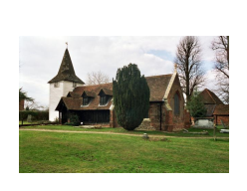
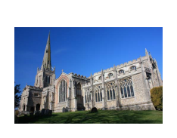
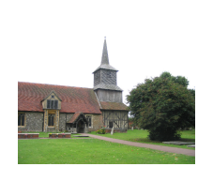
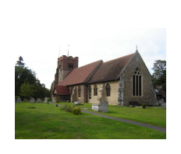
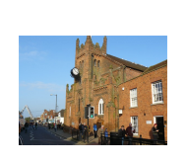
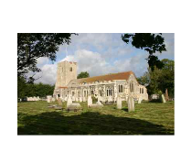
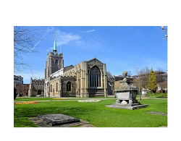
All these churches are in Essex. What is the same? What is different?

Slide 4
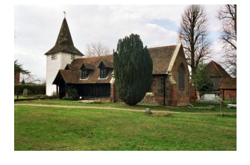
What materials are they made of?
Some are made of brick, some of stone and some of wood.
This is the oldest wooden church in the country!
Wood

Slide 5
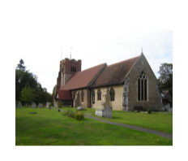
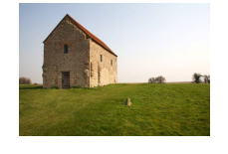
Towers and spires
Some churches have a tower.
Some have a steeple or spire.
Some don’t have either.
This church as at Bradwell on Sea.
It is over 1000 years old!

Slide 6
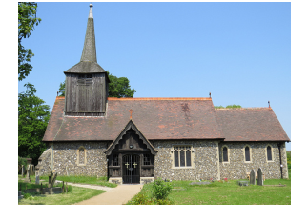
Windows and doors
Some have a porch.
Some have stained glass windows.

Slide 7
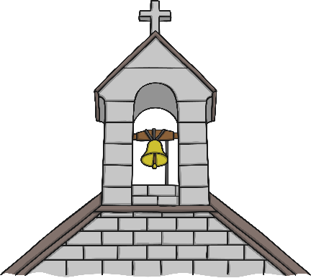
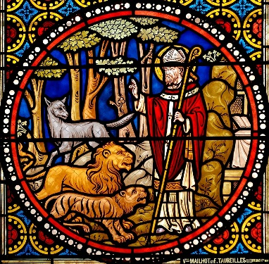
Features of a Church
A cross – This reminds people that Jesus died on a cross. Many churches are even built in the shape of a cross.
Bells – The bells used to be rung to remind people it was time to go to church. Bells are often inside a bell tower and the bell ropes are the only parts you can see.
Stained glass windows – These often show pictures of Bible stories.

Slide 8
Now let’s look inside…

Slide 9
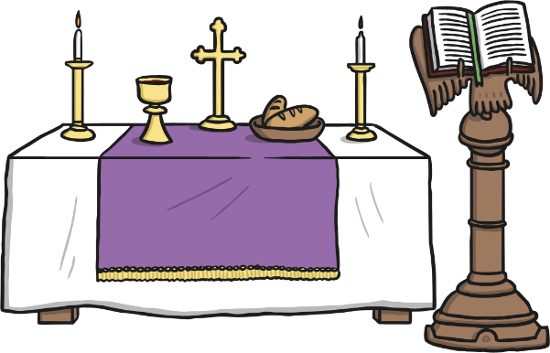
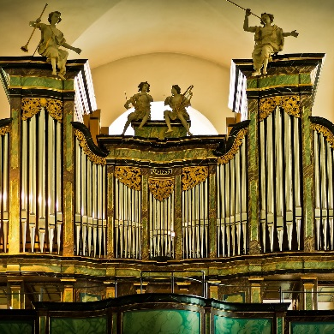
Inside the Church
Pews – The benches where people sit.
Altar – The table used during church services.
Organ – An instrument used to play hymns.

Slide 10
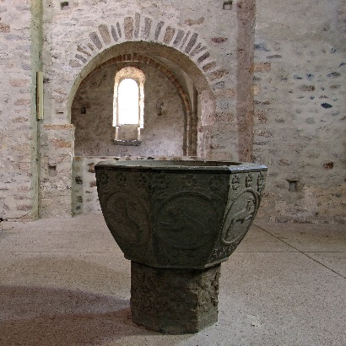
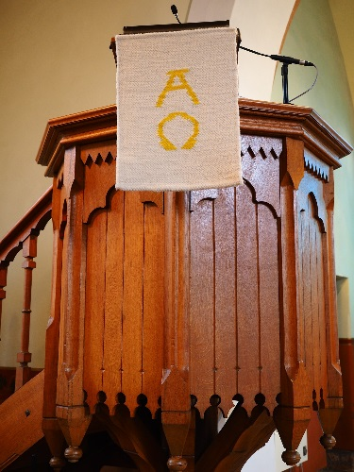
Inside the Church
Candles – They are lit to represent God’s love.
Font – A basin used for baptisms.
Lectern – A stand that someone might read from.
Pulpit - A raised area for the priest or vicar to talk to the people.

Slide 11
Your jobs today
Use the information from the PowerPoint to label the picture of the inside of the church.
Choose one of the pictures of the outside of the churches and draw it. Can you label the tower or spire, the porch and the stained glass windows?

Slide 12
In case you wanted to know where these churches are…
Blackmore
Thaxted
Doddinghurst
Greensted juxta Ongar
Chelmsford Cathedral
Springfield
Billericay
Burnham on Crouch

