Slide 1
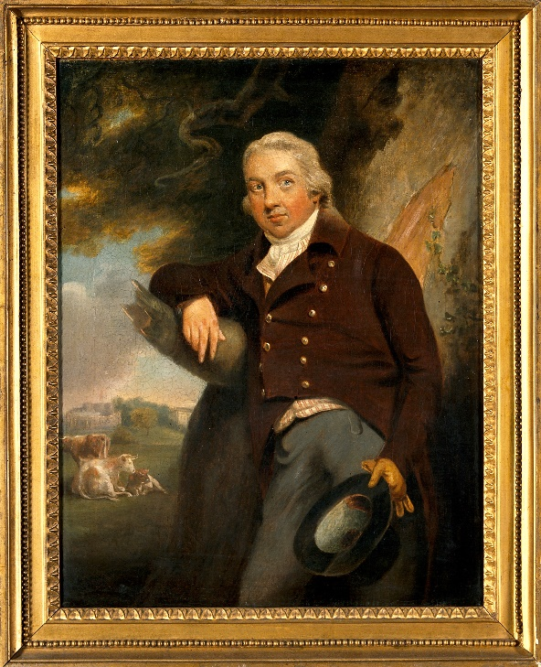
Last week, we learned some facts about Edward Jenner
Can you remember…
The year he was born?
His father’s job?
When he got married?
His wife’s name?
The disease he first vaccinated a boy against in 1796?
When he died?

Slide 2
Here are the answers
The year he was born?
His father’s job?
When he got married?
His wife’s name?
The disease he first vaccinated a boy against in 1796?
When he died?
1749
Vicar in Gloucestershire
1788
Catharine
Smallpox
1823

Slide 3
Today we are going to create a timeline about Edward Jenner’s life
But first, a word about dates.
The year Edward Jenner was born was
1749
You read this in 2 parts: 17 and 49

Slide 4
To make a timeline, you look at the first part first
The first 2 numbers are the hundreds of years.
Edward Jenner lived from 1749 until 1823.
So some of his key dates begin 17 and some begin 18.
Which comes first, 17 or 18?
17 of course!
So all the dates with 17 come before any of the years with 18 at the start.

Slide 5
Make a pile of all the dates with 17 at the start
Then look at the second part of those numbers.
Can you put them in order?
70 96 49
49 70 96
17
17
17

Slide 6
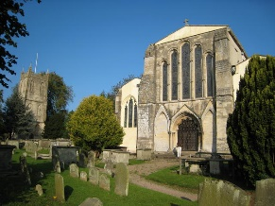
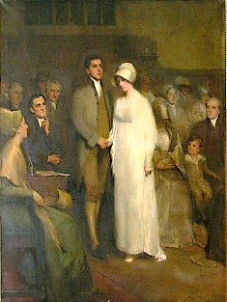
Then repeat with any numbers that have 18 at the start
All today’s dates have 17 or 18 at the start.
I have also put pictures on to help.
Obviously you can’t die before you are married or go to school before you are born! Think about what makes sense.

Slide 7
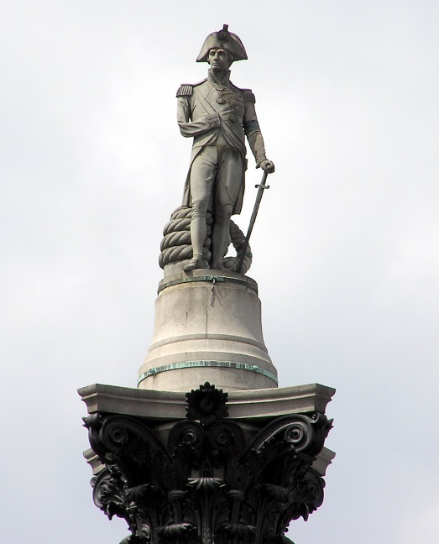
Your job today is to make a timeline
Cut out the pictures and dates TOGETHER.
Make a pile of dates starting 17.
Look at the second part of the dates and put them in order.
Stick them on a strip of paper in that order.
Do the same with the numbers starting 18.
There are some other dates that are important dates of the Georgian time.
*Challenge – where would 1714 (the start of the Georgian time), 1805 (the Battle of Trafalgar) and 1830 (the end of the Georgian time) go on the line?

