Slide 1
Let’s read some digraphs!
th sh ai ee ch oa i-e
ur ow oi ar ay au
ea ir ie or ue oo o-e
aw ou er oy ng ey

Slide 2
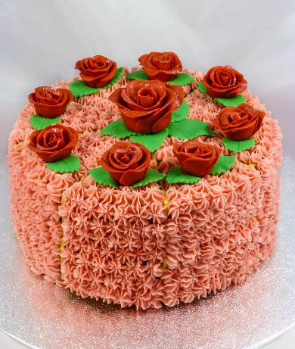
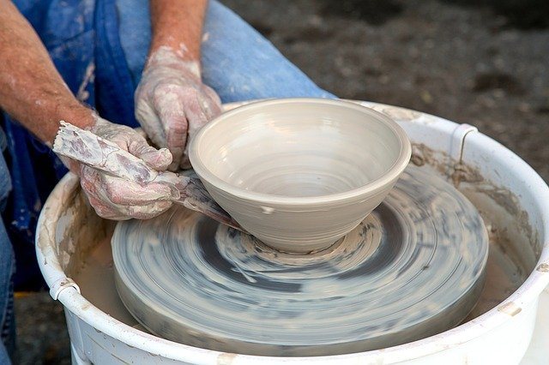
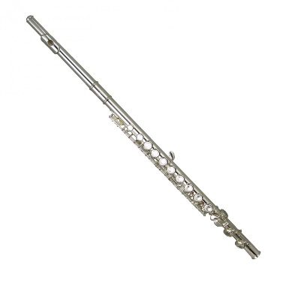
Can you remember the phonemes we looked at last week?
oo/ue/ew/u-e
Can you spell these?
ai/ay/a-e

Slide 3
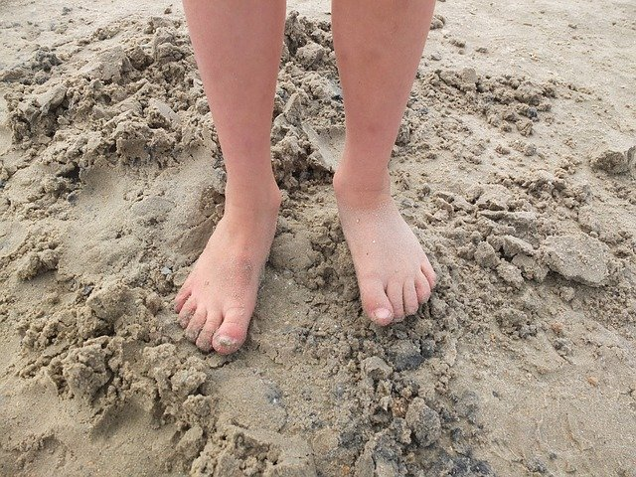
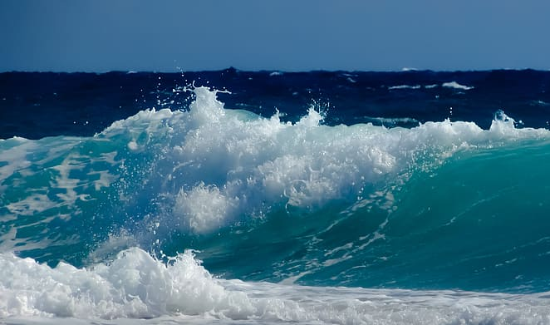
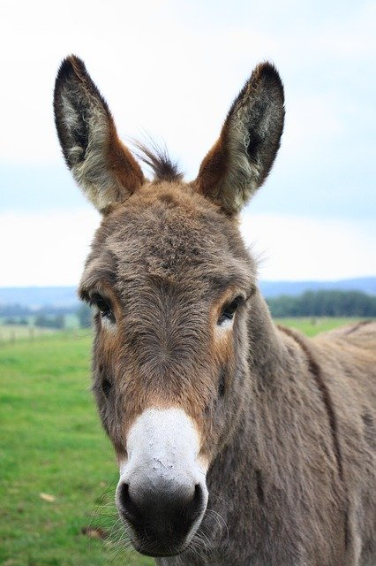
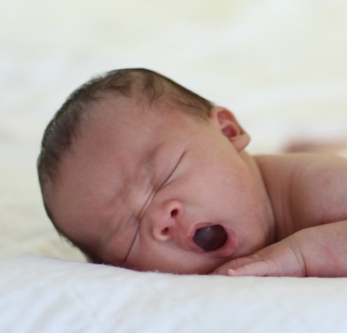
We are going to think about a sound that can be made with different digraphs…
What is the sound that is in all these words?
How can it be spelled?

Slide 4
The sound is ee/ea/ey/e-e
feeling
dream
donkey
concrete
fairy
Can you add the sound buttons?

Slide 5
Let’s play Best Guess
steem steam steme steym
vallee vallea valley vally
seeks seaks sekes seyks
pottee pottea pottey potty

Slide 6
Let’s play Yes/No
Are you feeling happy today?
Have you got a pet monkey?
Do you like going to the beach?
Is your best friend called Steve?

