Slide 1
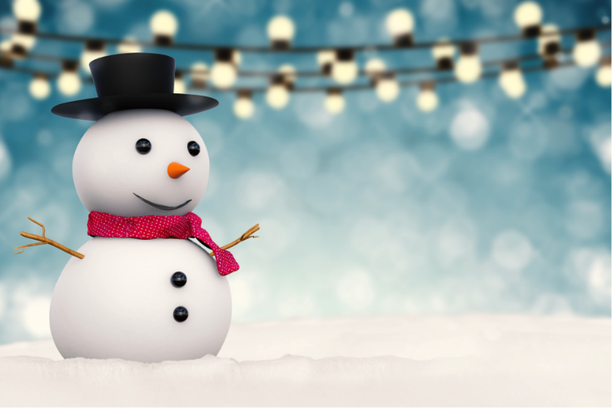
Monday 11th January
We hope everyone has had a lovely weekend.
This PowerPoint is going to include each day’s phonics and grammar activities. This will make sure we are practising our spelling and grammar rules whilst you are working at home. You will need a pen/pencil and a piece of paper.

Slide 2
Let’s start!
Can you remember the 4 different ways we spelt the j sound?
j g ge dge
Time for quick write!
Write 4 words using these spellings!

Slide 3
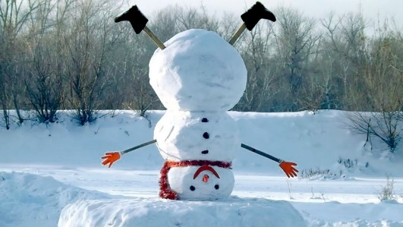
Now we will practise this weeks common exception words (CEW).
Reveal the words
one by one. Look/write/check.
break
great
steak
Well done all of you!!
If you already know your Year 2 CEW look for the Super Spelling Challenge on the
website and practise 6 x words a week. We have some fantastic new badges
for when you come back to school!

Slide 4
Now we are going to learn our new spelling rule for this week. Are you ready?
What do you notice about these words. What sound can you hear in each of them?
call, tall, ball, walk, talk, always
These words all have the ‘or’ sound spelt a before an l or a ll. Did you get that?

Slide 5
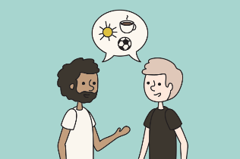
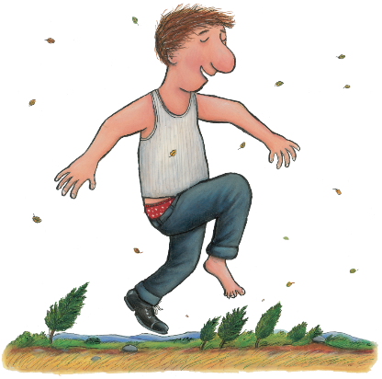
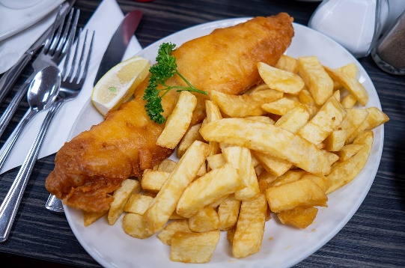
Can you spell the missing word?
The ________________bounced over the fence.
The giant was very________________ and had a kind face.
Please do not _________________ in the lesson.
Why must we ______________ in the dinner hall?
I _______________ eat fish and chips on Friday.
Well done everyone!

Slide 6
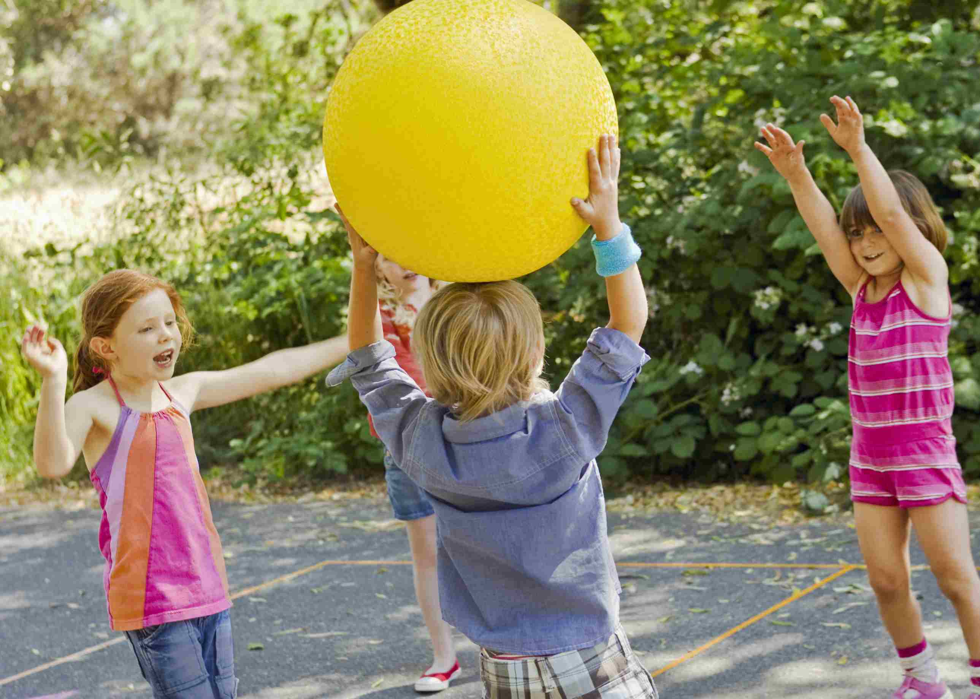
ABC . ! ?
Now make
Up your own sentence using some of your new words!
That’s all for today. Well done!!

Slide 7
Tuesday 12th January
Hello everyone! In today’s quick write I would like you to write down 4 words which end in -dge
Did you think of any of these?
hedge badge fridge bridge ledge fudge

Slide 8
Now have a go at practising this weeks CEW. Remember there are 3 of them (or practise your super spellings).
Go back to slide 3 to check.

Slide 9
Today we will practise the words we learnt yesterday with the ‘or’ sound spelt a. Can you remember the rule?
Unscramble them or spell them!
lalc - - - - - - klaw
- - - k - - - - t _ _ _

Slide 10
Let’s practise………
Can you write a statement and a question using 2 of the words? tall,call,ball,always,walk,talk
1.
2.
ABC . ! ?

Slide 11
Wednesday 13th January
Hello everyone! Today’s activity is writing silly sentences using some of the spelling rules we have learnt this week. We would like you to write your sentences very neatly with clear ascenders and descenders and the rest of the letters the same size. Please ask a grown up to read the sentences to you. You will need your paper and pencil.
The tall turkey always plays with a blue ball.
Why do you talk so quietly ?
Erin Pike had a dog called Archie.
Well done!

Slide 12
Thursday 14th January
Hello everyone! Can you practise putting these words into the past tense?
cry
play
sniff
jump
swim
wave

Slide 13
Quickly write your CEW words?
Well done!!!

Slide 14
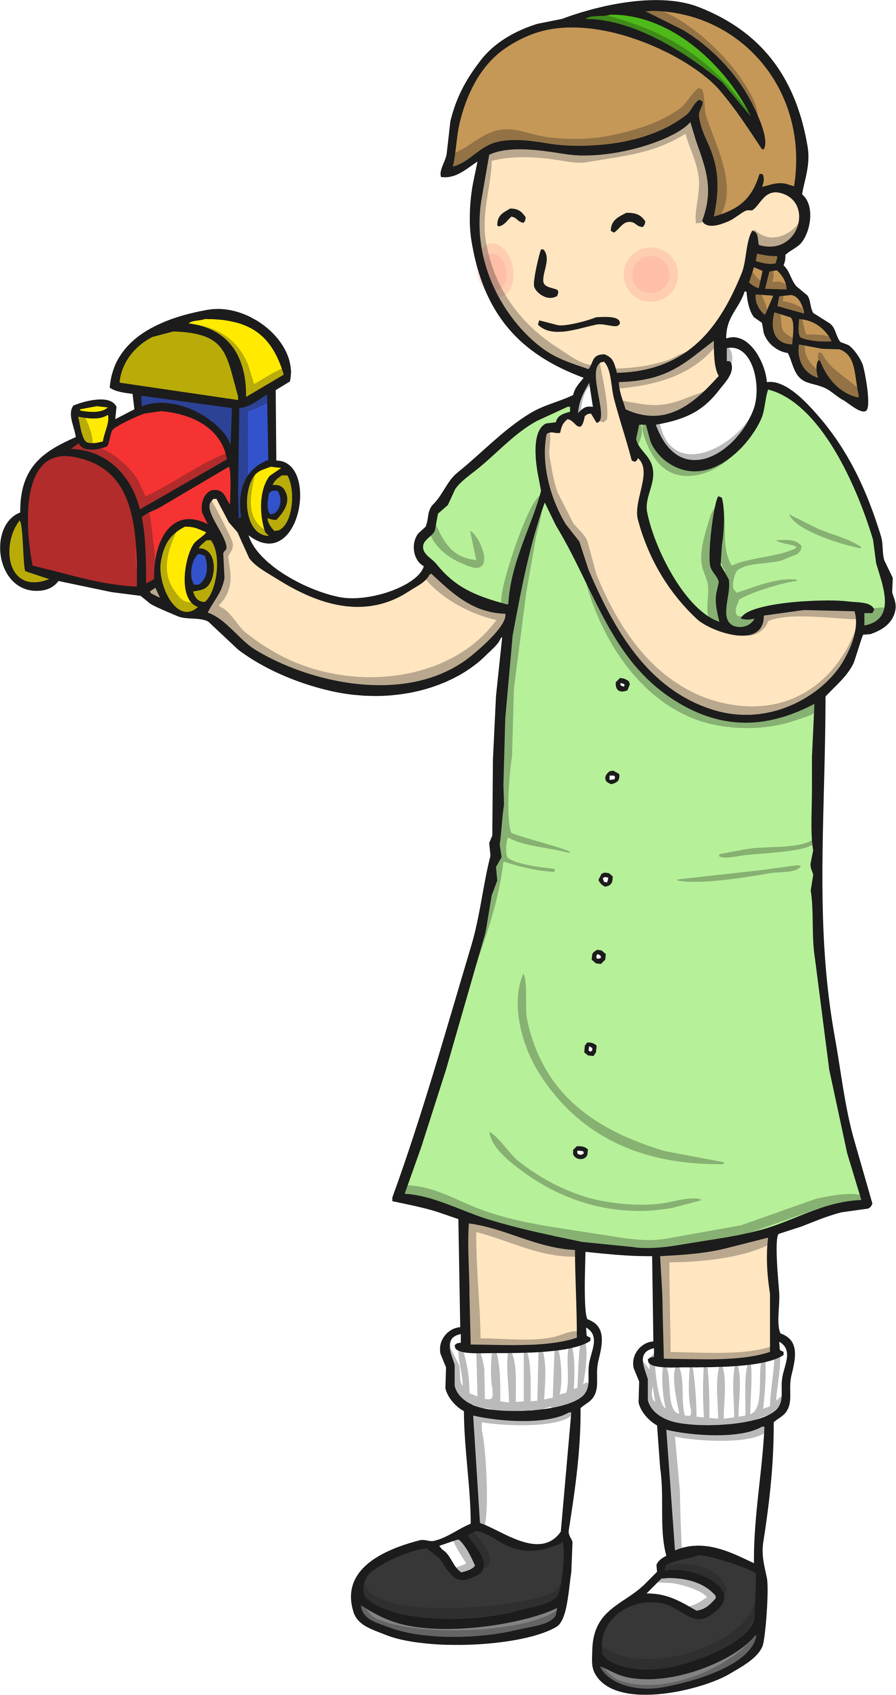
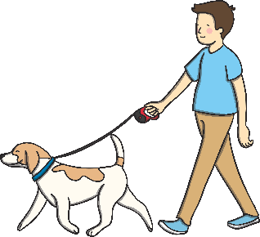
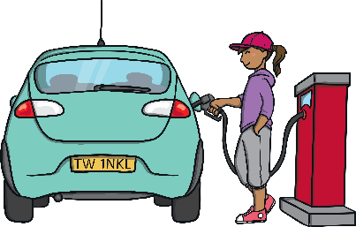
Today we are going to learn to spell words with the possessive apostrophe. The apostrophe tells us that something belongs to someone or something. The apostrophe goes at the end of the name/thing before the s.
Anna
Tom
Lara
Rachel
This is Rachel’s car.
This is ………….
This is ………….
This is ………….
Can you finish these sentences using the child’s name and the object they are holding.

Slide 15
Can you find what is wrong?
1. Erins dog was called Archie.
2. Erin climbed under her mums lobster pots.
3. The peoples stories about Black Rock were scary.
Well done everyone!

Slide 16
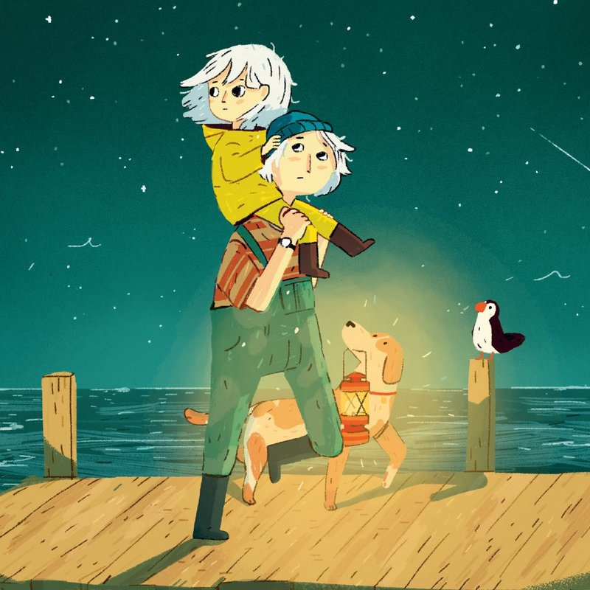
ABC . ! ?
Now make
Up your own sentence using a possessive apostrophe.
E.g Mum’s boots were green.
That’s all for today. Well done!!

Slide 17
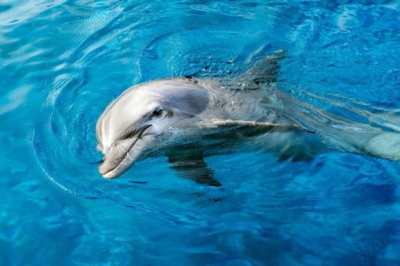
Friday 15th January
Hello everyone! Today’s quick write is finishing the sentence.
____________coat is yellow.
____________ fur is soft.
The ______________ skin is grey.

Slide 18
Today we are going to practise the possessive apostrophe. Which one is correct?
Do not sit on the teacher’s chair.
Do not sit on the teachers’ chair.
Sallys favourite day of the week is Friday.
Sally’s favourite day of the week is Friday.
I often borrow my brother’s clothes.
I often borrow my brothe’rs clothes.
I watered my neighbours plants while she was away.
I watered my neighbour’s plants while she was away.

Slide 19
Now let’s practise spelling some of the words we have learnt this week!
steak
break
great
always
ball
tall
walk
talk
call
fall
Well done everyone! We hope you have a lovely weekend.

