Slide 1
Welcome to Foundation Stage
Ruby Class and
Topaz Class

Slide 2

Meet the team…
Class Teacher’s
Miss Williams and Mrs Lovett
LSA’s
Mrs Pope, Mrs Mohur and Mrs Shankar
Thursday morning:
PE with specialist PE coach
Friday Afternoon: Mr Bowen

Slide 3
Our Daily Routine
Register and Zones of Regulation
Phonics
Morning Session 1 – adult directed activity (literacy/maths) discovery time (indoors and outdoors)
Milk/Playtime / snack/ story
Morning session 2 - adult directed activity (literacy/maths) discovery time (indoors and outdoors) continued
Lunch
Maths session
Afternoon session – individual reading, adult directed activity (topic), discovery time
Story time
Home

Slide 4

The Curriculum
Cross curricular and topic based approach.
Literacy, phonics, reading and maths every day.
Regular use of the ICT suite and access to iPads.
PE twice a week – currently Thursday and Friday.
Please remove earrings before PE days – we are not allowed to tape over anymore.

Slide 5


Reading
Decodable book, shared reading book, Little book of sounds and Tricky word keyring.
Please record a comment when you hear your child read. Useful things to mention are sound recognition, tricky words, blending, engagement and enjoyment with the book.
Weekly whole school reading competition.

Slide 6
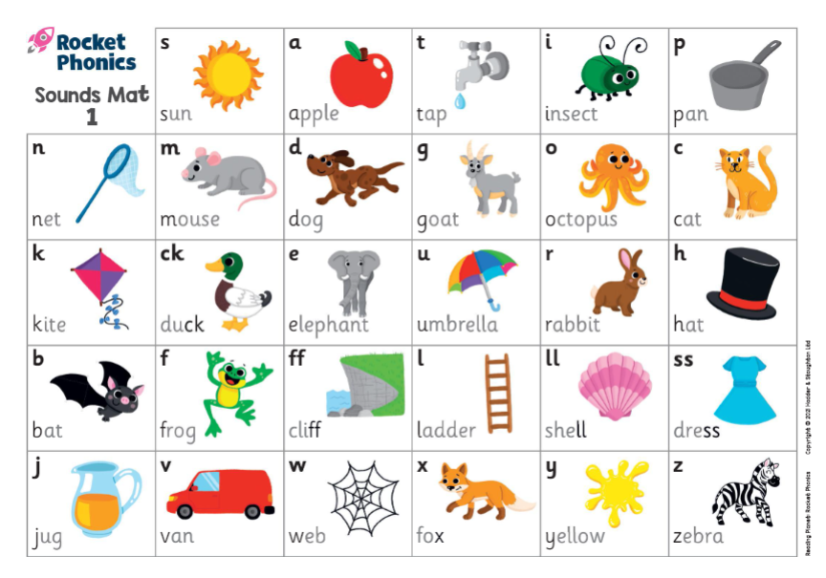
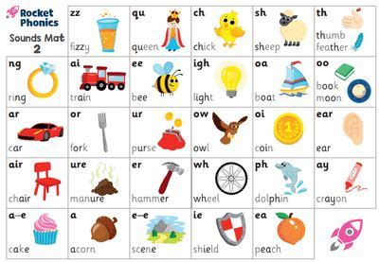
Phonics
At Perryfields we follow Rocket Phonics. We teach 2 sounds a week starting with the initial sounds and moving on to digraphs later in the year.
Your child will have a Little Book of Sounds to help them practise at home.
Your child may also have ‘I can blend’ words in the red book to help practise their phonic skills.
Please check the newsletter as this will tell you which sounds we are focusing on for the week.

Slide 7

Writing
We use print font for our handwriting in reception. This has changed as we previously used cursive script.

Slide 8

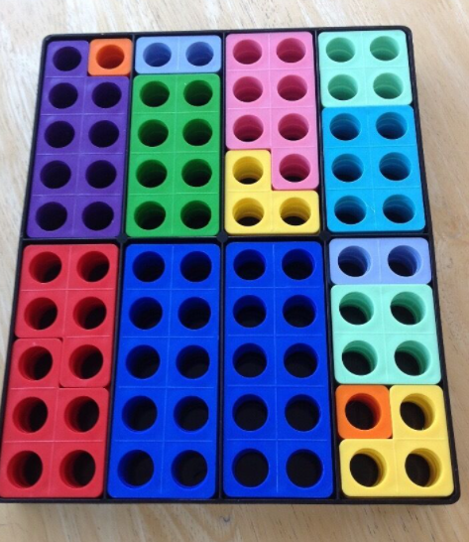
Maths
We follow the White Rose maths scheme
We teach the children in a practical way using a range of resources such as:
Numicon
Number Blocks
Counting apparatus
Natural resources
We like to extend our maths by using the outside area or by active learning e.g. body counting

Slide 9

Foundation expectations
Encouraging greater independence e.g. looking after their own belongings.
Morning – wait sensibly in playground (No adventure playground)
Bring in correct equipment (coat, hat, water bottle, book bag)
Remembering to take all of their items home at the end of the day.
Following the classroom and school rules.

Slide 10
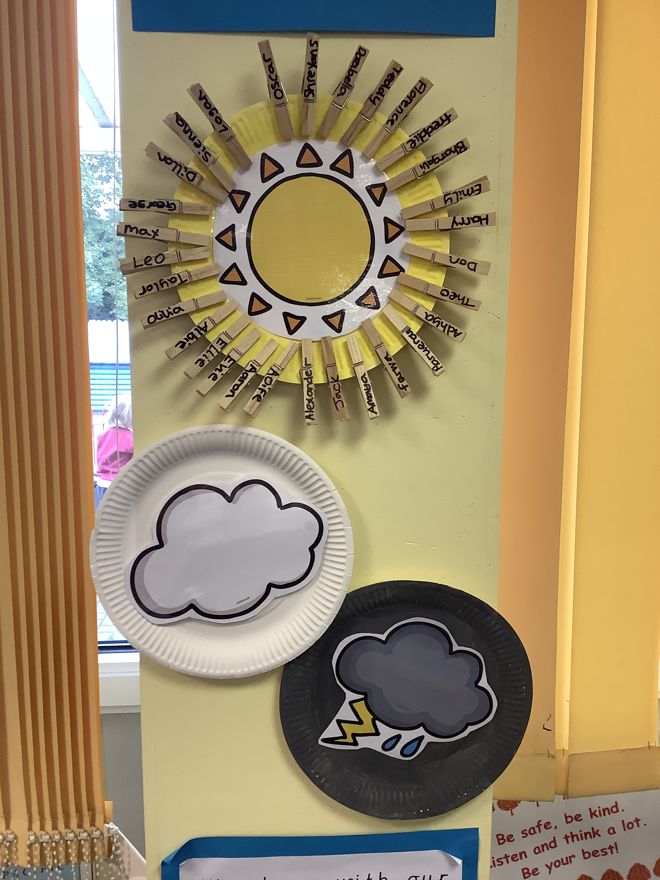
Behaviour
Each class has a set of golden rules. We use a Rainbow, sun, cloud and rain behaviour system.
Positive strategies are used, such as star of the week, stickers, Pom pom jars, lunch time awards and top trophy.
We expect the children to look after the resources and each other.

Slide 11

Homework
Set on Friday and due in on the following Wednesday, this will include either handwriting practise, a maths activity, or a topic related project
Reading 5 times a week where possible please
Letter sound recognition practise
Tricky word recognition
Name writing practise
Spelling Shed (After Christmas)
Rocket Phonics Online (After half term)

Slide 12
Sources of General information
If you have any worries or concerns please speak to us after school. You can also make an appointment.
Parents evening Thursday 17th and Tuesday 22nd October
Weekly Foundation stage newsletter.
Perryfields post
School Ping
School website
Please label school uniform
Bring in a water bottle every day

Slide 13

Any questions?

