Slide 1
Phonics 25th February 2021
Recapping the ‘oi’ and ‘oy digraphs.

Slide 2
Can you read these words?
porch
lawn
haunt
launch
August
storm
claw
sport
draw
Let’s recap digraphs we already know.
Can you add sound buttons too?

Slide 3
Today we are going to recap the digraph
oi
And its alternative spelling
oy
For example, ‘join’ and ‘joy’

Slide 4
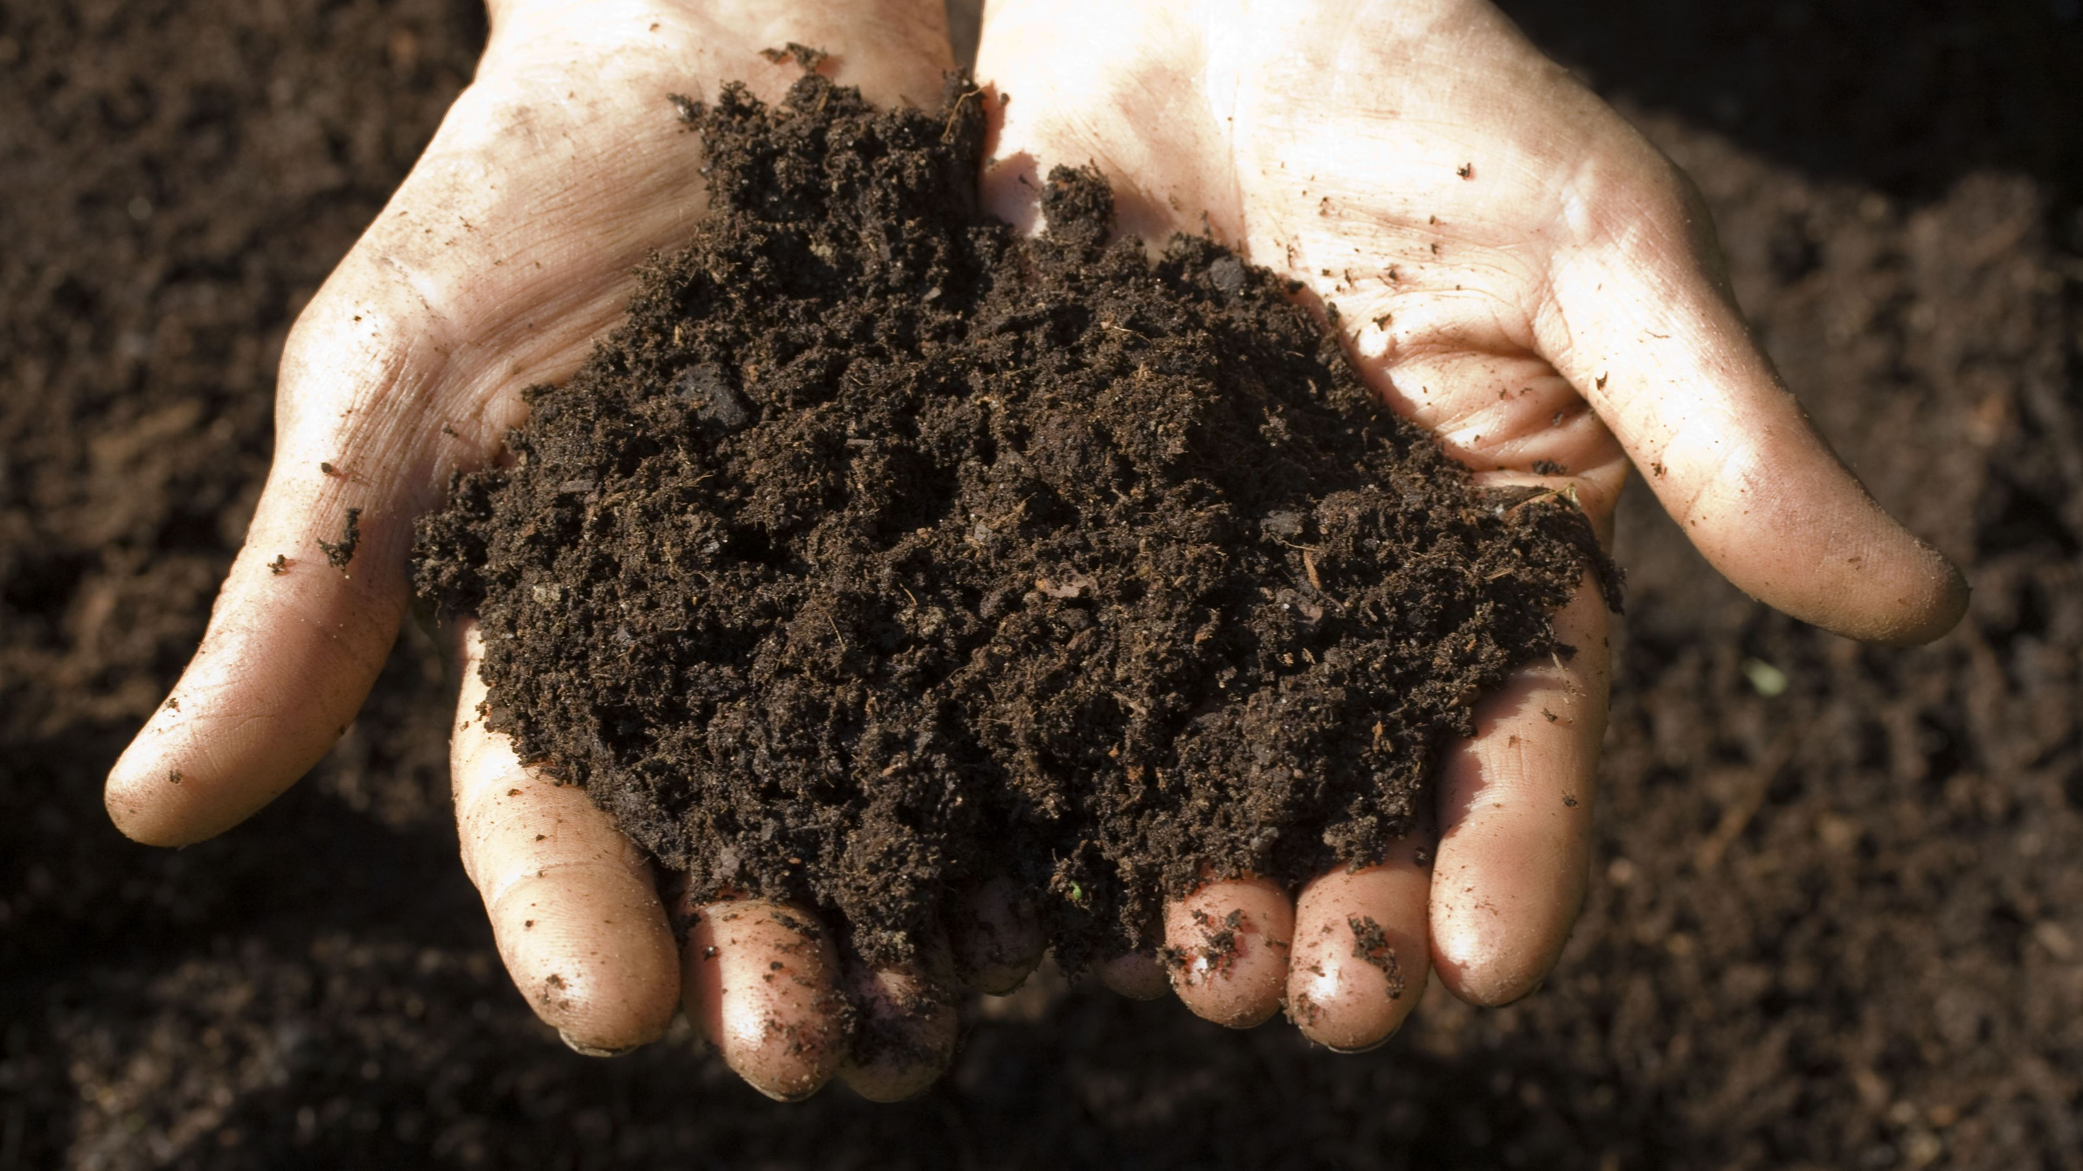
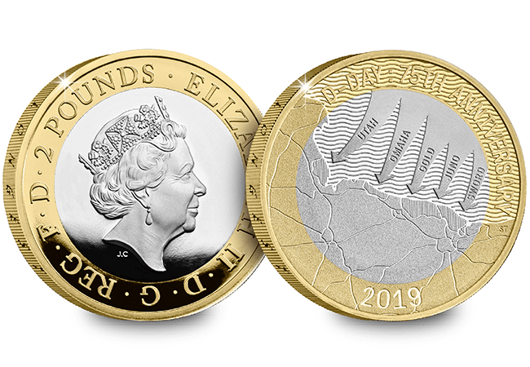
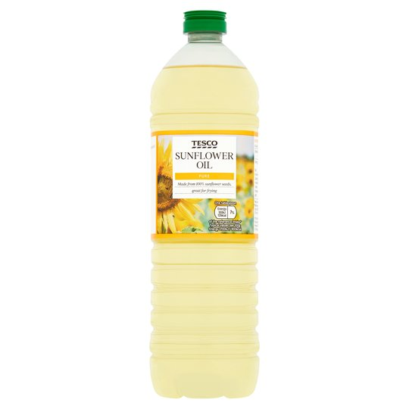
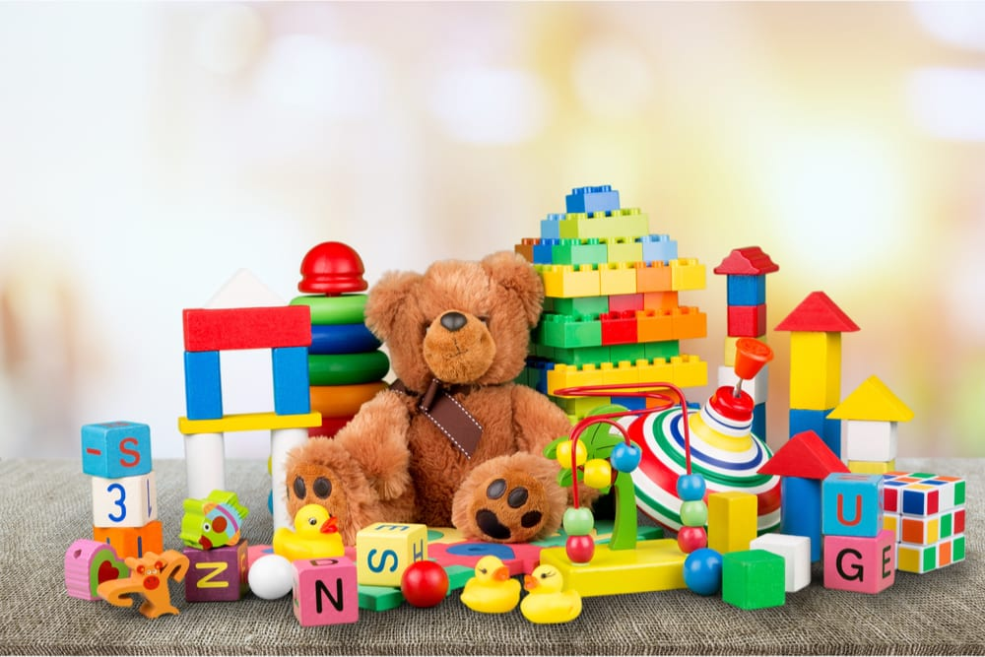
Can you guess these pictures and the correct spelling?
soil
Coin
boy
oil
toy

Slide 5
Can you read these words?
join
coin
boing
spoil
noisy
joy
enjoy
ahoy
Troy
destroy

Slide 6
Let’s beat these aliens! (Sound them out!)
d oi l
j aw f
pr oy b
st ie g
sh oi l
gr ow m
ch oi b
cr oy m

Slide 7
Now its time to play best bet!
A
B
boi boy
Toy toi
joi joy
coyn coin
destroi destroy
join joyn
What are the correct spellings?

