Slide 1

Monday 25th January
We hope everyone has had a lovely weekend.
This PowerPoint is going to include each day’s phonics and grammar activities. This will make sure we are practising our spelling and grammar rules whilst you are working at home. You will need a pen/pencil and a piece of paper.

Slide 2
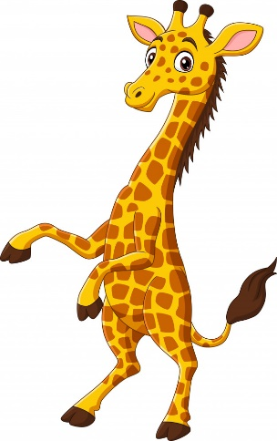
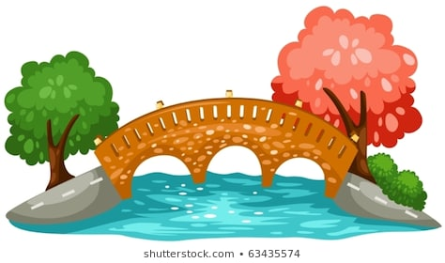
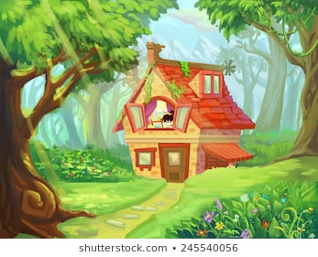
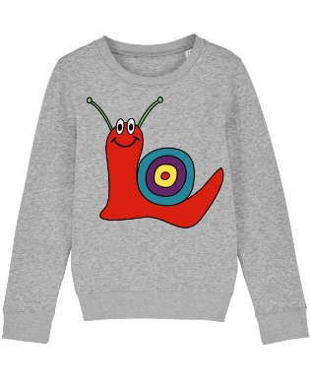
Let’s start!
Can you remember all the different ways of spelling the j sound?
Time for quick write!

Slide 3
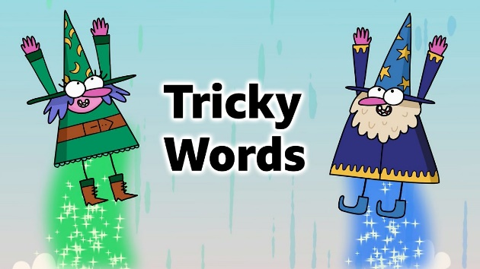
Now we will practise this weeks common exception words (CEW).
Reveal the words
one by one. Look/write/check.
move
prove
improve
Well done all of you!!
If you already know your Year 2 CEW look for the Super Spelling Challenge on the
website and practise 6 x words a week. We have some fantastic new badges
for when you come back to school!

Slide 4
This week we are going to focus on words with the ‘o’ sound spelt with an ‘a’.
What do you notice about these words?
watch was wash want swan squash
Did you notice the o sound is spelt with an a after a w or qu?

Slide 5

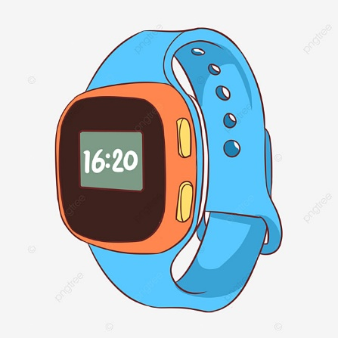
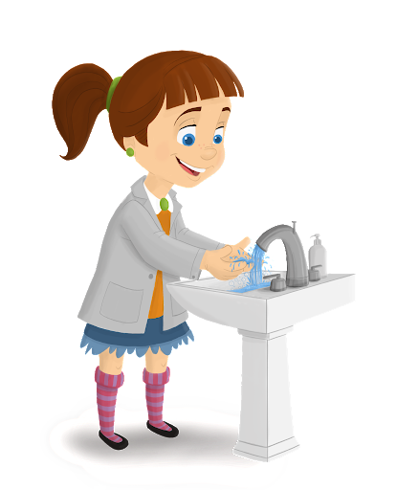
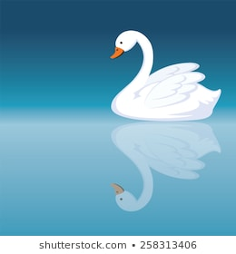
Can you spell the missing word?
The ________________swam on the beautiful lake.
My ______________ tells me the time.
Please_____________ your hands before lunch.
Do you _______________ fish and chips or spaghetti for your
dinner?
Well done everyone!

Slide 6
ABC . ! ?
Now make
Up your own sentence using the words from these pictures!
That’s all for today. Well done!!

Slide 7
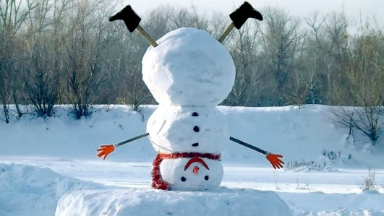
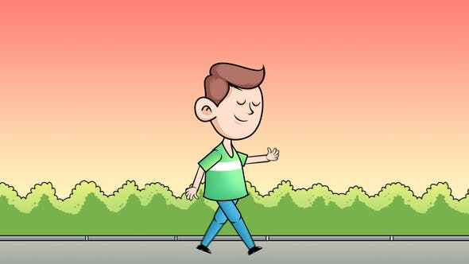

Tuesday 26th January
Hello everyone! Can you remember how to spell words with the or sound spelt a before an l or ll?
I’ll give you a couple of picture clues and then see if you can write a list!

Slide 8


Now have a go at practising this weeks CEW. Remember there are 3 of them (or practise your super spellings).
Go back to slide 3 to check.

Slide 9

Today we will be putting some of our words from yesterday into the past tense.
First, write the word watch.
Now write the word in the past tense.(Remember Uncle Ed!)
watched
Now do the same with wash and want.

Slide 10
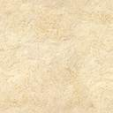
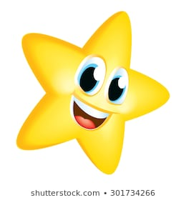
Can you find the missing word?
I _______________ a skateboard for my birthday.
Who _________________ their hands with soap?
We ___________ television last night.

Slide 11

Wednesday 27th January
Hello everyone! Today’s activity is writing silly sentences using some of the spelling rules we have learnt this week. We would like you to write your sentences very neatly with clear ascenders and descenders and the rest of the letters the same size. Please ask a grown up to read the sentences to you. You will need your paper and pencil.
The children watched the beautiful swans fly over the hedge.
Always sing Happy Birthday when you wash your hands.
I wanted a tall giraffe for Christmas.
Well done!

Slide 12
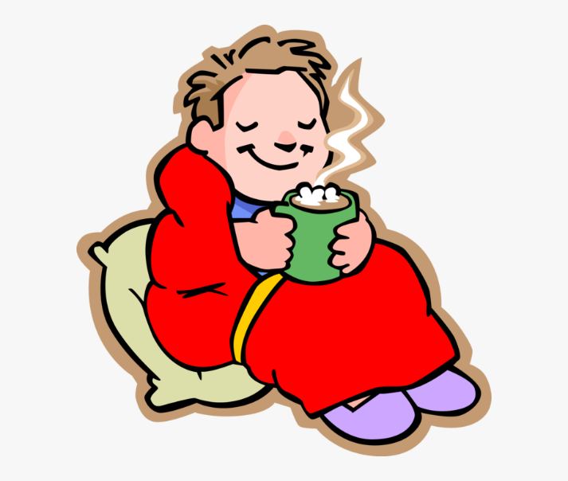

Thursday 28th January
Hello everyone! Let’s practise our words we learnt last week when we hear the or sound spelt ar after a w.
Here are some picture clues!

Slide 13
Quickly write your CEW words?
Well done!!!

Slide 14
Today we are going to recap the o sound spelt a after a w or qu.
What words can you remember from Tuesday’s lesson?
watch was wash want swan
Now let’s think of words where the a comes after the qu.
Can you remember the word from Tuesday? Are there any more?
Here’s a clue – another word for argue quarrel or squabble
football s _______ ________ _______ d (team)

Slide 15
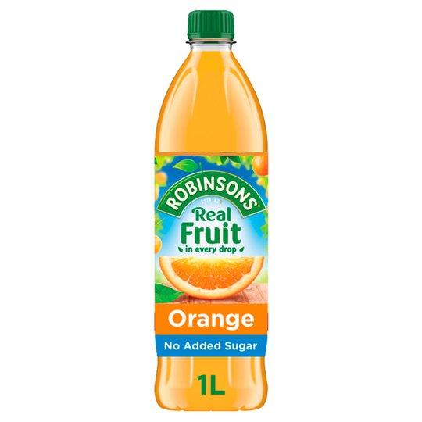
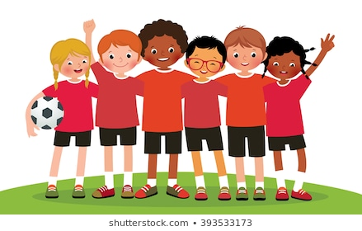
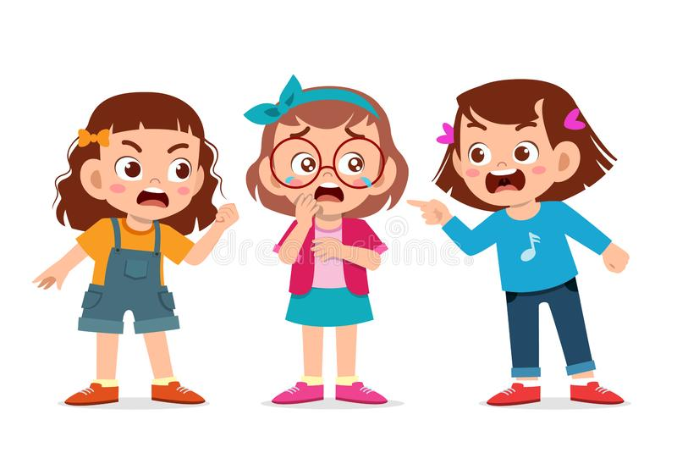
Can you write these sentences and spell the missing word?
Do you like to drink orange ________________?
Are you in the football __________________?
Do you and your brothers and sisters ___________________?
Well done everyone!

Slide 16
ABC . ! ?
Now make
Up your own sentence using the words from these pictures!
That’s all for today. Well done!!

Slide 17

Friday 29th January
Hello everyone! Can you remember what contractions are?
Time for a quick write! Don’t forget the apostrophe!
could not –
we will –
he is –
they are-

Slide 18
Now lets practise the spellings we have learnt this week. Ask a grown up to read out these spellings for you. If you are finding them tricky remember to write them out a few times!
swan
squash
wanted
watched
improve
washed
squad
quarrel
prove
move

Slide 19
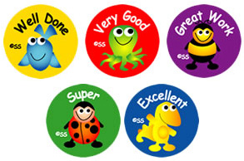
Well done everyone! We hope you have a lovely weekend.

