Slide 1
Today we are going to write another imaginary recount.
Can you remember what recounts need?
You use “I”.
You write most of it in the past tense.
You put events in the right order.
You use time words.

Slide 2
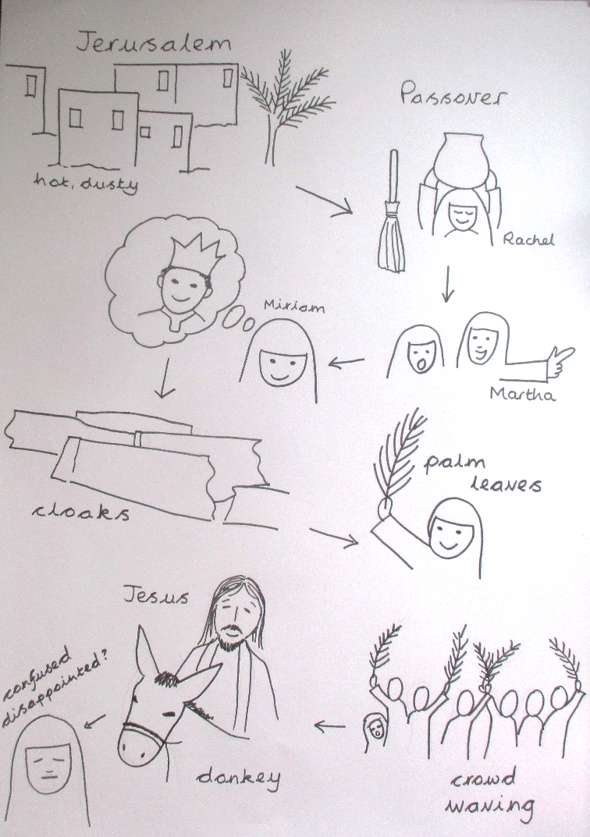
Your recount will be about the events of Palm Sunday.
You are going to retell it as if you were there.
You don’t have to be Miriam – you could be a boy (Isaac, Jacob, John, Samuel…)
You can use your story plan to help you remember the order of events.
Don’t forget to add how you were feeling!

Slide 3
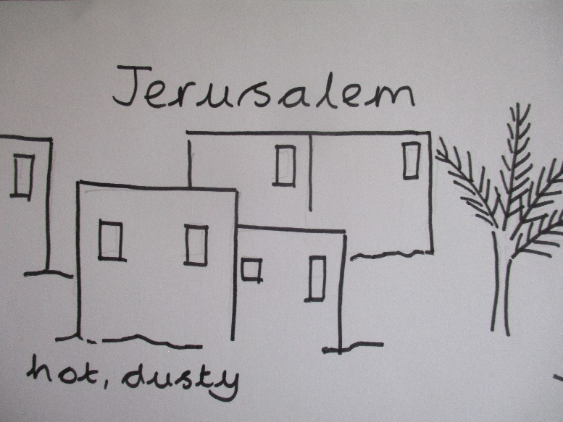
Setting the scene
At the start of the recount, you need to say who you are, where you are and when/what you are writing about.
This bit will be in the present.
Here is an example.
My name is Miriam and I live in Jerusalem. Last Sunday something very unusual happened. I will tell you about it now.

Slide 4
For each picture
You will need at least 2 sentences to say what happened and how you were feeling.
Remember to use “I” and “We”.
Use your think-say-write-check approach – decide what to say, say it out loud then keep saying it as you write.
Before moving on the to next sentence, reread it.
Did you start with a capital?
Does it make sense?
Did you end with a full stop?

Slide 5
Quality not quantity!
Only go to the middle of the story today.
Use the spellings on the word bank.
Think-say-write-check EVERY sentence separately.
Remember to use I and mention feelings.
Remember time words: The first thing that happened, Next, After that, Later on, At last…

